Slide 1
Social mobilisation in the national response for the control of emerging outbreaks, epidemics, and pandemics - the Ebola experince in Uganda 2000-2012
Samuel Okware PhD
Uganda National Health Research Organisation, Entebbe Uganda
The 6th East African Health and Scientific Conference and International Health Exhibition and Trade Fare
29-31 March 2017
BUJUMBURA, REPUBLIC OF BURUNDI

Slide 2
Presentation outline
Basic concepts – environment, globalization, social mobilization, community mobilization
Emerging outbreaks : Ebola
Organizing the National community response
Challenges
Best scenarios and outcomes
Lessons learnt
Conclusion

Slide 3
Social mobilisation (SM)
SM is Process – raises awareness; motivates people to demand positive change/develop
Involves groups persons- mass gatherings..
Social media and IT – currently integral tool in active social mobiisation
Facilitate dialogue different groups… changes
SM applied to bring together institutions groups/ stakeholders
Supports and linked to community mobilisation (CM) to attain specific pressing specific goals

Slide 4
Community mobilisation (CM)
Community mobilization is capacity building process through which community individuals, groups, or organizations plan, carry out and evaluate activities on a participatory and sustained basis to improve health and other needs on their own initiative or stimulated by others.
Goal: to improve the standard of living and eliminate threat
Agree on leadership

Slide 5
The Ebola Experience in Uganda

Slide 6
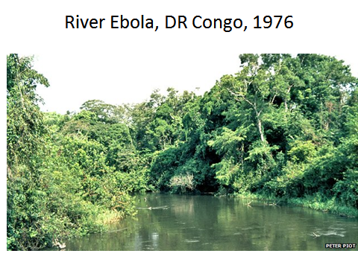
Ebola virus disease
Ebola Virus Disease -an acute infectious febrile illness: associated with - -bleeding tendencies,
-high case fatality (50-90%)
Sporadic outbreaks (26) – in Equatorial Africa
- recently to W. Africa
Coincided rainy season;
started rural areas
Caused by the Ebola virus

Slide 7
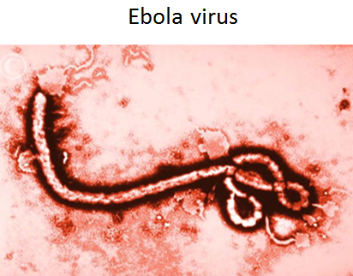
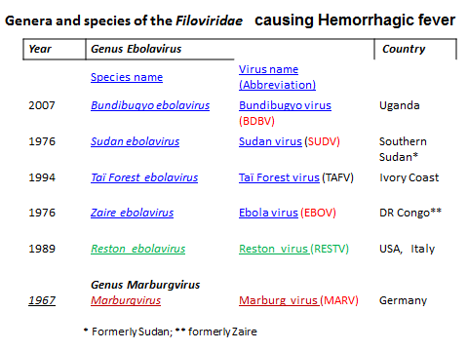
Cause of Ebola virus disease
Source: Eighth Report of the International Committee on Taxonomy of Viruses.

Slide 8
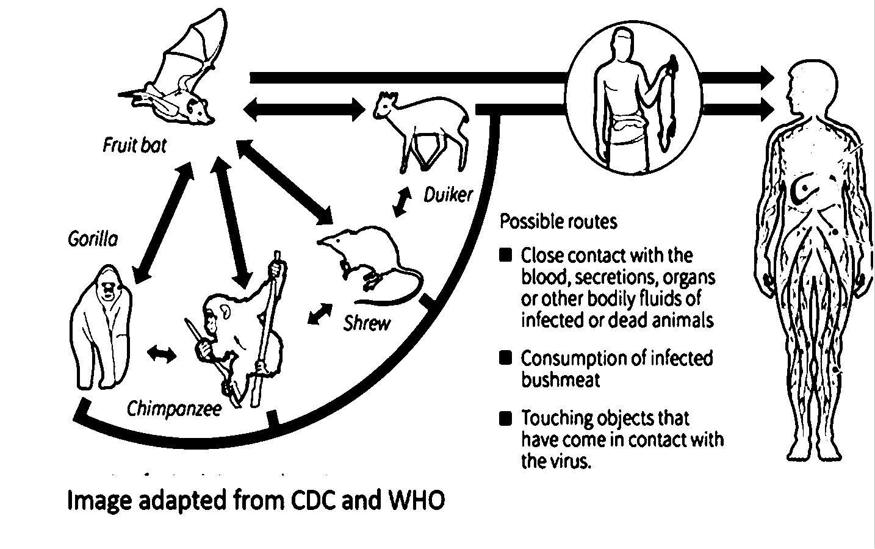
Presumed life cycle of Ebola – ? Zoonosis
Source: Adapted from WHO, CDC, 2017

Slide 9
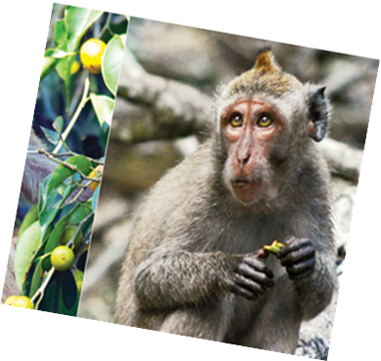
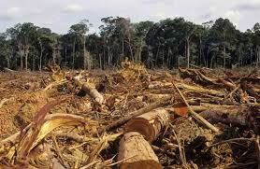
Deforestation and climate change

Slide 10
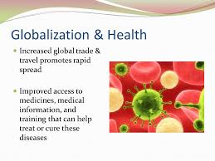
Globalization and health

Slide 11
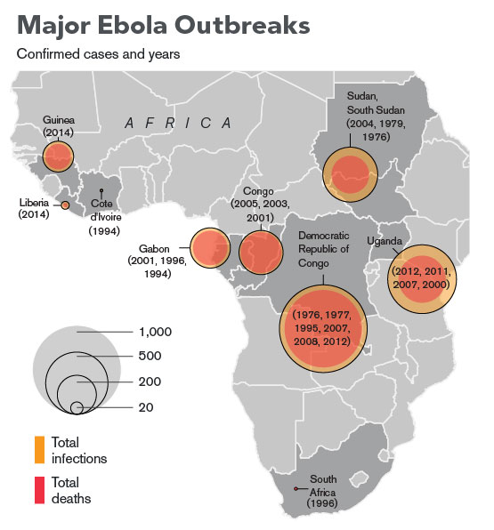
May 2016
Guinea,Liberia, Sierra Leone,
Total cases 28,600 Total deaths
11,300
-1976- Zaire- DR Congo
Major outbreaks rare
Minor outbreaks
2000 Uganda – largest
By 2016: Total 26 outbreaks with ≈ 2000 cases
2014/16 West Africa - 1st and most severe- > >28,000 cases and >11,000 deaths
– CFR 57-70%
Cities invaded
Source: Adapted from WHO/CDC report, 2017

Slide 12
Uganda : 5 Ebola outbreaks 2000-2012
2000 Gulu district
2007 Bundibugyo district
2011 Luwero district
2012 Kibaale district
2012 Luwero district

Slide 13
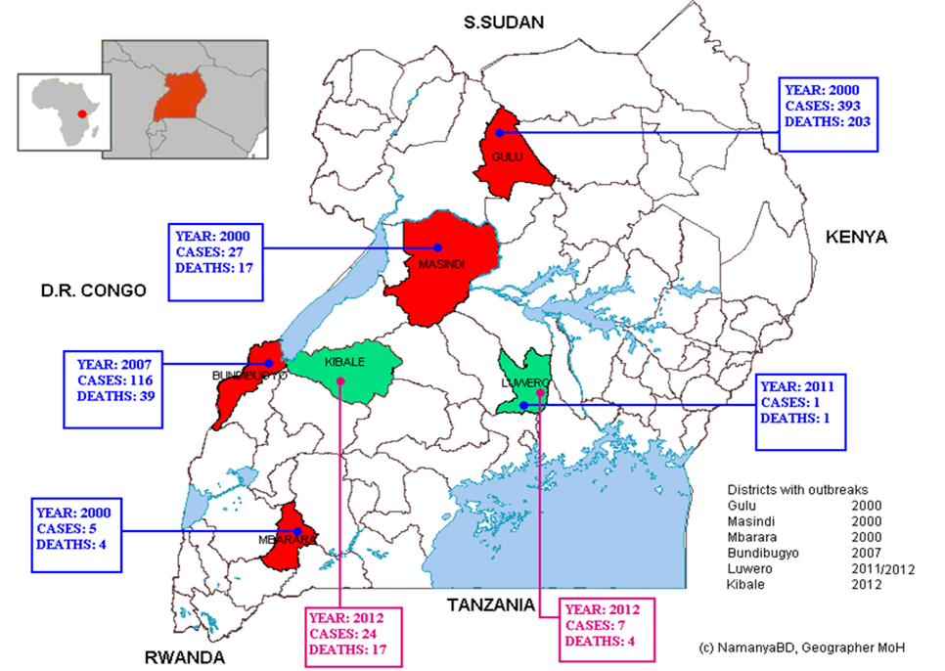
Ebola affected districts in Uganda , 2000-2012
2000
*393(203)
2000
27 (17)
2007
116 (39)
2011
1(1)
2000
5 (4)
2012
24 (17)
2012
7 (4)
*Cases (deaths)

Slide 14
Risk assessment in community

Slide 15
Understanding the problem: Determining the Community Diagnosis: Convergence model of disease

Slide 16
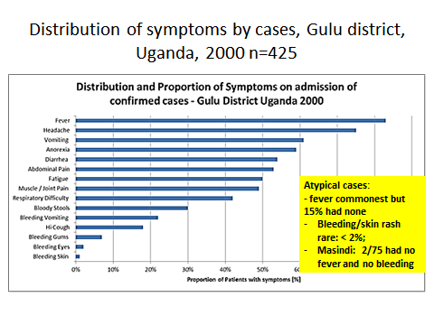
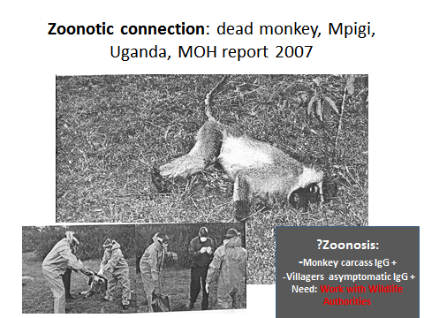
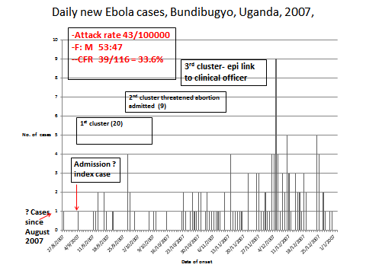
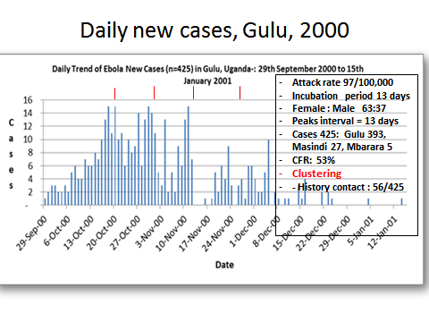

Slide 17
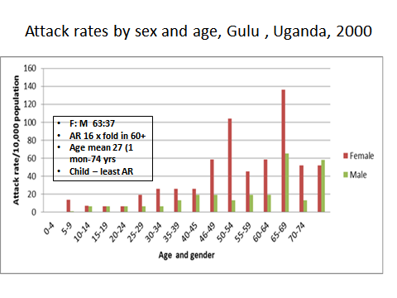
Analysed risk factors
Gulu district
Bundibugyo district
Contact with case, visiting health facility- RR 2.7 fold
Direct blood contact –needles, syringes
participating funeral rites increased risk RR 4.2 (3-4 fold)
Sexual route- up to 60-90 days

Slide 18
Case definition- Ebola
Classification Definition
Suspected cases | Sudden onset of fever, with at least 4 of: vomiting, diarrheal, abdominal pain, conjunctivitis, skin rash, unexplained bleeding, fatigue, difficulty swallowing, difficulty breathing, hiccups, or headache, OR fever in a contact with suspected case, OR sudden death without explanation.
Probable case | At least 3 of the following symptoms: vomiting, diarrheal, or bleeding, conjunctivitis, or skin rash; AND either an epidemiologic link to a suspected case
Confirmed case | Laboratory confirmation : isolation of virus from any body fluid or tissue, OR detection of viral antigen by ELISA, PCR OR serum Ebola virus-specific IgG antibodies by ELISA,
Contact | A person who had direct physical contact with a suspected case.
Note : EHF - Ebola Haemorrhagic Fever, Ig, immunoglobulin

Slide 19
National response
Community mobilisation
HARAMBEE…

Slide 20
National Response: Ebola task force, Uganda
What and Where do you fit?
Environment
Surveillance
Investigation
Contacts
Patients
Forecasting
1: Epidemiology
2. Isolation/care
Dead/burial
Leadership
Coordination & Logistics
Task force s
E
3.Education
4. Laboratory
Community
Clinical lab
Health staff
Diagnosis
Packaging
Relatives
Media
Authorities
INTERVENTION

Slide 21
Requirements for community mobilization
Shared vision-
Goal : Early detection and containment; threat to “0”
Strong leadership - structure- operations management
Engagement channels: community (int and external)
Create ONE joint strategic plan- inclusive, shared
Implement mutually reinforcing strategies- active case search, isolation and care
Resource mobilization
Establish effective communication –
Public education and information- community …..
Asses and evaluate – process and progress

Slide 22
Interministerial Task Force
District Task Force
District Task Force
District Task Force
Leadership and Coordination : Organisation National response: Leadership
Office of the Prime Minister
National Task Force
Lower levels….
Coordination and resource mobilisation
Surveillance and laboratory work
Case isolation and management
Public education
and MEDIA
Logistics
IV. County
III. Subcounty
II. Parish
I. Village

Slide 23
Surveillance: Community based epi- flow chart
Scu
Scout/
village
Community
Suspects, community deaths
Hospitals
Screening and isolation
Mobile team
Burial
team
Ambulance team
Laboratory testing
Contact meets suspect creteria
District Command centre:
Surveillance office/ communication/
Contact tracing
Case database
Contact database
Contact tracing list to mobile teams
Daily reports

Slide 24
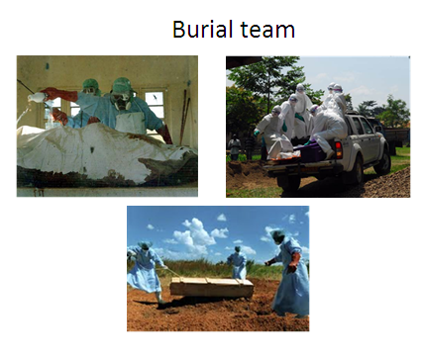
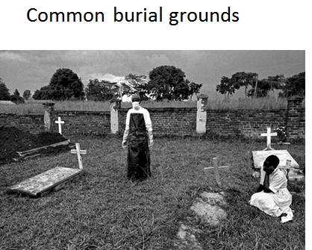
Safe burials and disposal

Slide 25
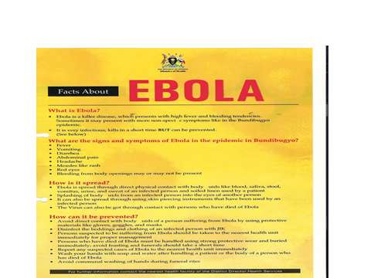
Tools for community mobilisation
Mass media e.g. radio/tv ..
Home visits – door to door
Discussion groups, rallies
Cascade training – to districts..villages
IEC Materials: posters,
Rumour management: work with media, press

Slide 26
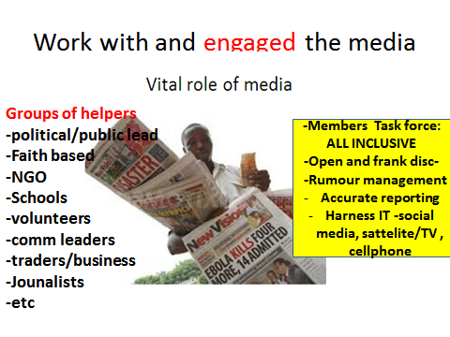
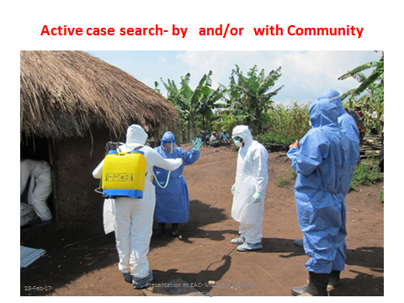
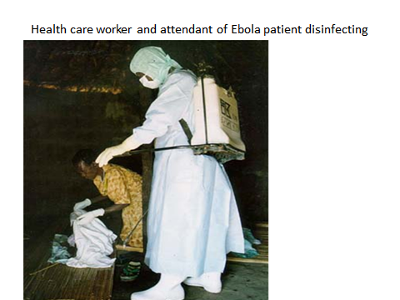
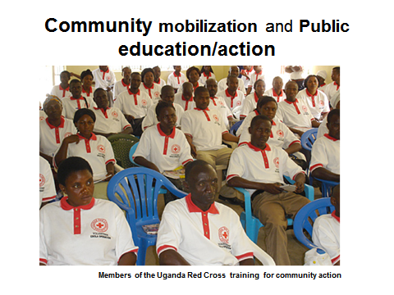
Community health workers/mobilisers

Slide 27
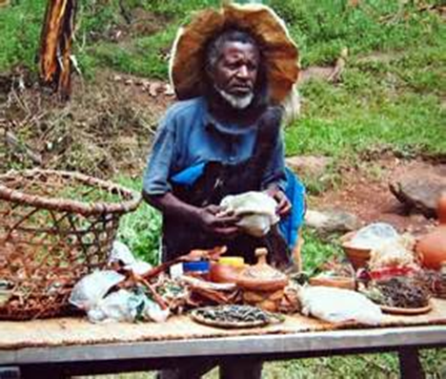
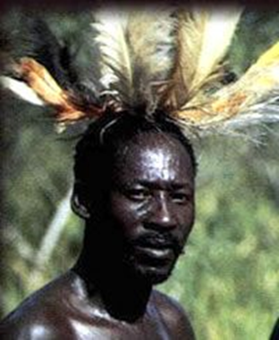
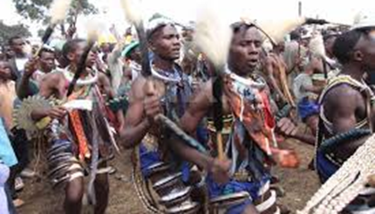
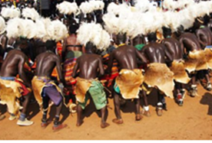
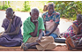
Cultural leaders: Acholi culture: 2 gods: ‘’jok’’- life and ‘’gemo’’ - death

Slide 28
Cultural control of epidemics by the Acholi
gods (2): - ‘’jok’’ for good/life
- ‘’gemo’’ for evil/death, -epidemics
Procedures for outbreak containment:
Isolation (house) >100 metres; identified with reeds
No movement
Care - only by survivor or elderly
No food from outsiders
No sex or dance
No rotten or smoked meat
Burials- at the edge of the village by the eldest
Elders have power to reverse this by sacrifice
Source: Hewlett B, 2001

Slide 29
Best scenarios and outcomes

Slide 30
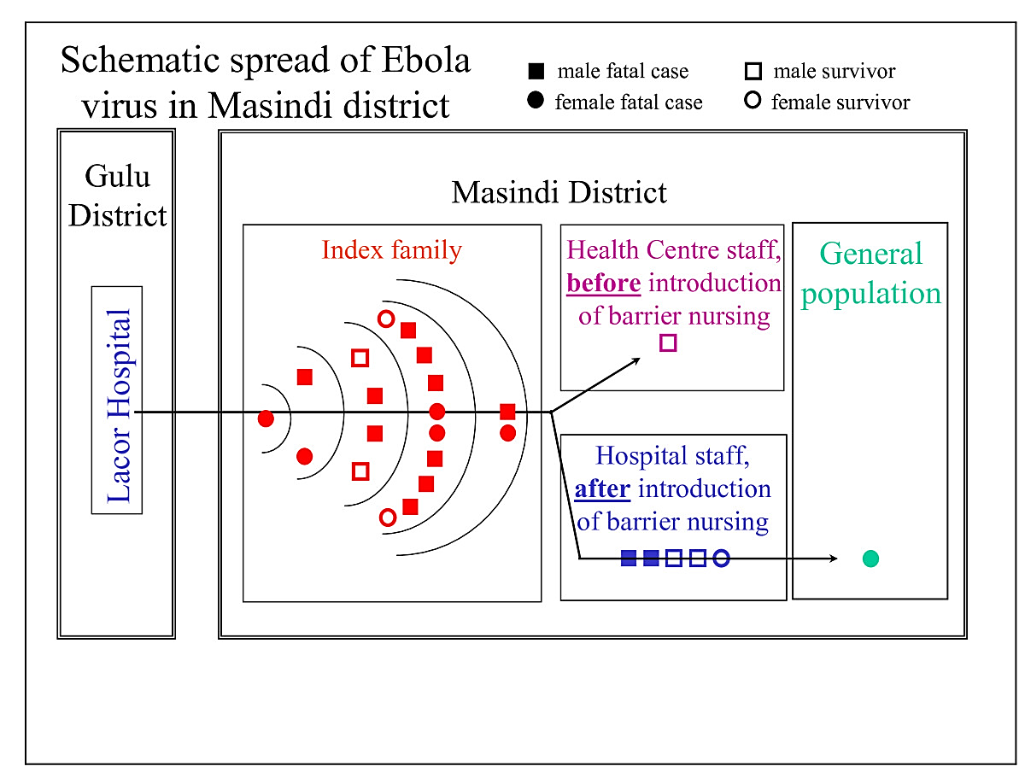
Community targeted isolation or mass quarantine?
Ebola containment in Masindi district, Uganda, 2000
73 members extended index family
Transmission prevented beyond index family by early case detection and isolation imposed by the community
Attack rate 19/73 (26%)
CFR in index family 15/19 (79%)
2nd generation lost 8/19 (50%)
Only 1 case in general population occured
Left 30 orphans
Enforcement : Community leadership v. police
Source: Borchert M 2011, and personal notes, 2000

Slide 31
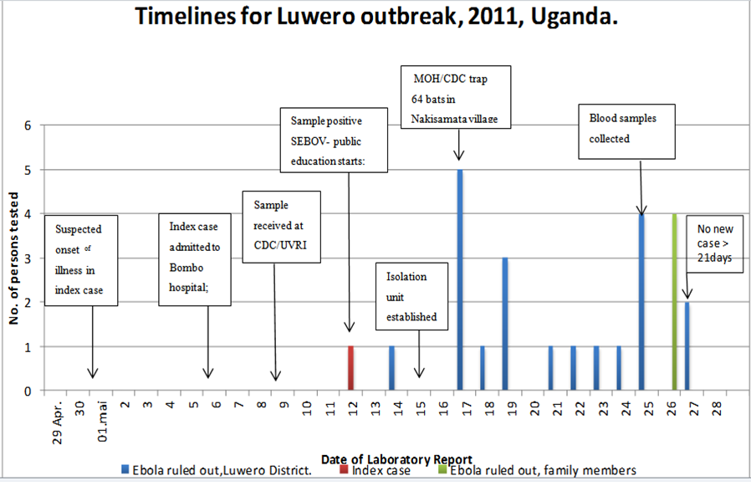
Early detection and containment, Luwero district, Uganda, 2011
Source: Shoemaker, 2012

Slide 32
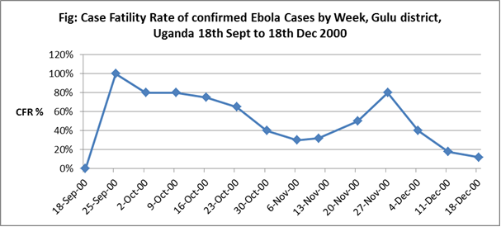
CFR Average 53%
Initially 100% ;
Towards End <40%
RR highest with bleeding (RR 1.8, p<.001

Slide 33
Challenges

Slide 34
timelines since onset for delays by district, uganda 2000-2012
District | Gulu, 2000 |  | Bundibugyo, 2007 |  | Kibaale, 2012 |  | Luwero, 2012
Time | Date | Days since onset | Date | Days since onset | Date | Days since onset | Date | Days since onset
Onset of strange disease in community | 19/09 | 0 | 07/08 | 0 | 12/6 | 0 | 13/10 | 0
Report to Ministry Health | 9/10 | 20 | 27/09 | 51 | 12/07 | 30 | 7/11 | 24
Investigation: Blood sampled | 12/10 | 23 | 29/09 | 53 | 13/07 | 31 | 8/11 | 25
Blood confirmation Ebola | 14/10 | 25 | 28/11 | 60 | 27/07 | 45 | 12/11 | 29
Declaration national action | 15/10 | 26 | 29/11 | 61 | 28/07 | 46 | 13/11 | 30
Last Case | 14/01 | 91 | 08/01 | 71 | 14/08 | 63 | 17/11 | 34
Total days epidemic lasted |  | 117 |  | 101 |  | 63 |  | 34
From laboratory confirmation to last case |  | 91 |  | 41 |  | 17 |  | 5
NB- The Luwero Ebola outbreak of 2011, was contained and limited to just ONE case

Slide 35
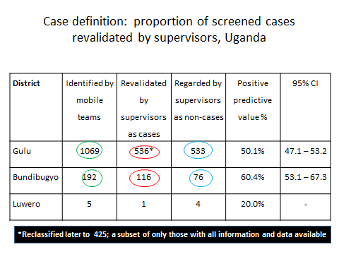
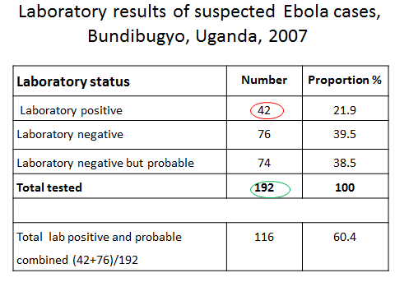
Challenge: validating screened cases by supervisors in Gulu and lab confirmation in Bundi– ?reliability
Challenge :
Low /unknown Pos. Pred. Value (ppv)
Need: appropriate Dx tools; determine ppv
Challenge: non specific; bleeding rare < 5%; Malaria etc; Needed: Case definition validation

Slide 36
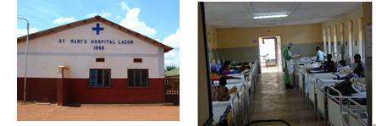
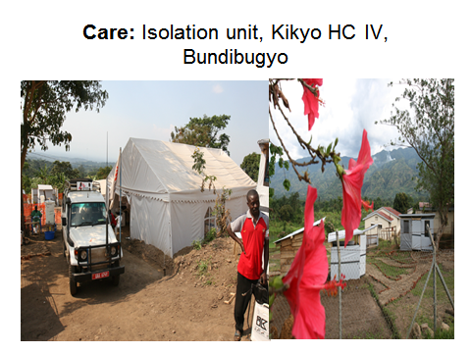
Care: Ebola Isolation units: Gulu, Bundi - 2000; 2007
Effectiveness of units :
Gulu: 31 HCW infected- 64% AFTER
Bundi: 14 HCW infected BEFORE
?Gaps-
-Hospital waste managemt policy

Slide 37
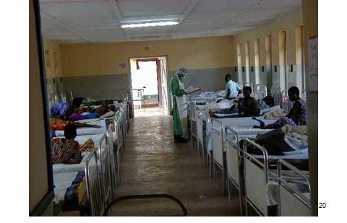
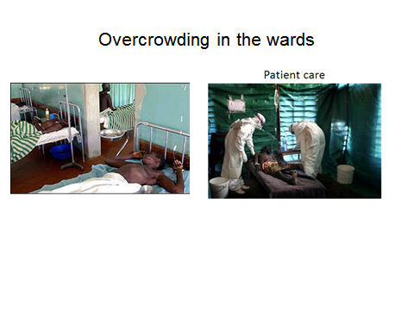
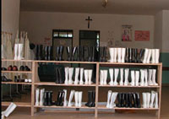
Care- Mitigating the Challenges in isolation wards
Mitigation of challenges
Incentives- risk allowances paid
Inventories: dedicated expertise
Tech support supervision/community dialogue
Steady supplies PPE
Statutory Compensation Act
Collaboration/partnerships
Overcrowding
Care labor intensive: few HCW; needed motivation; dedicated
Supplies- PPE
-Ethics- confidentiality

Slide 38
Lessons learnt from Uganda
Community mobilisation vital best scenario –
Leadership: - strong and inclusiveness at all levels
Building and holding public trust – engagement, media, manage rumour,
Harness new tools – community based surveillance (IHR 2005’unusual health events’’ ) , IT, care
Emphasise also care and survival- public trust
Stregthen and motivate Human resource: share the risks fairly- policy- attracts, rewards , retains;
Strenghthen primary health care systems-
Institutionalise EPR practice /partnerships- capacity
Early detection- early winner: community vital

Slide 39
CONCLUSION
Early detection … early winner
Not all was 100% perfect , but the Ministry of Health working along side its partners and involving the community contained the outbreaks… sometimes with delays, but once promptly and effectively

Slide 40
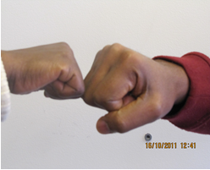
Thank you

Slide 41
Acknowledgement
Members of The Ebola Task Force, Uganda
Government and the people of Uganda
Partners- bilateral and international workforce
Ministry of Health, Uganda
Health care workers, Uganda
Colleagues & friends who died in the line of duty

Slide 42


Slide 44
Participatory decision making
Group have transcended their differences to meet on equal terms in order to facilitate a participatory decision-making process.
Process which begins a dialogue among members of the community to determine who, what, and how issues are decided, and also to provide an avenue for everyone to participate in decisions that affect their lives…

Slide 45
Challenges
Delays in diagnosis index case
Atypical presentation
Hard to reach areas
Health care workers motivation
Funding and expertise
Delays in diagnosis index case
Atypical presentation
Hard to reach areas
Health care workers motivation
Funding and expertise

Slide 46
Lessons learnt from Uganda
Social Community mobilisation… vital best scenario/outcomes
Early detection and action – early winner
Leadership and inclusiveness : planning and leading; feedback;
Community based surveillence : early detection+ isolation ‘’unusual health events’’
Engage media - openness; manage rumours
Treatment and survival not just quarantine- powerful incentive
Motivation for workers directly involved : share the risks fairly
Human resource strategy that attracts, rewards , retains, compensates
Health systems- intrastrure, lab, care, surveillance
Collaboration/partnerships: capacity for EPR

