Slide 1
March 30,
2017
The Policy Context and Health Service Delivery to Key and Vulnerable Populations at Cross Border Sites: Experience from CB-HIPP, Kenya.
6th East African Health and Scientific Conference & International Health Exhibition and Trade Fair
Bujumbura, Burundi
Muroki, D.; Olenja, J.; Kitungulu B.; Oindo, M; Muinde, F. Sirengo, M; Musyoki, H and Egondi, T.

Slide 2
CB-HIPP Goal and Result Areas
Goal. To catalyze and support sustainable and African-led regional health development partnerships to improve health outcomes among mobile populations and vulnerable communities residing along Eastern, Central, and Southern African transport corridors and cross-border sites. This goal will be achieved through three
Results:
Increased access to and uptake of integrated health and HIV/AIDS services at strategic cross-border sites and a select few regionally recognized HIV transmission “hotspots” along Eastern, Central, and Southern transport corridors.
Alternative health-financing models identified, implemented, and tested to strengthen the long-term sustainability of networked health and HIV/AIDS service delivery.
Strengthened leadership and governance by intergovernmental institutions to improve the health of mobile and vulnerable populations.

Slide 3
CB-HIPP Result Areas
HIV
STIs
TB
ANC
MCH
FP/
RH
Result 1: Increase access to and uptake of health services
Result 2: Health financing
Result 3: Health policy

Slide 4
CB-HIPP Target Populations
(GP)
VP
KP
KP: FSW, MSM, PWID
Vulnerable populations: Transport workers/mobile populations, cross-border traders, fisher folk, vulnerable women and girls (15-24 years), PLHIV
GP: Not targeted by CB-HIPP

Slide 5
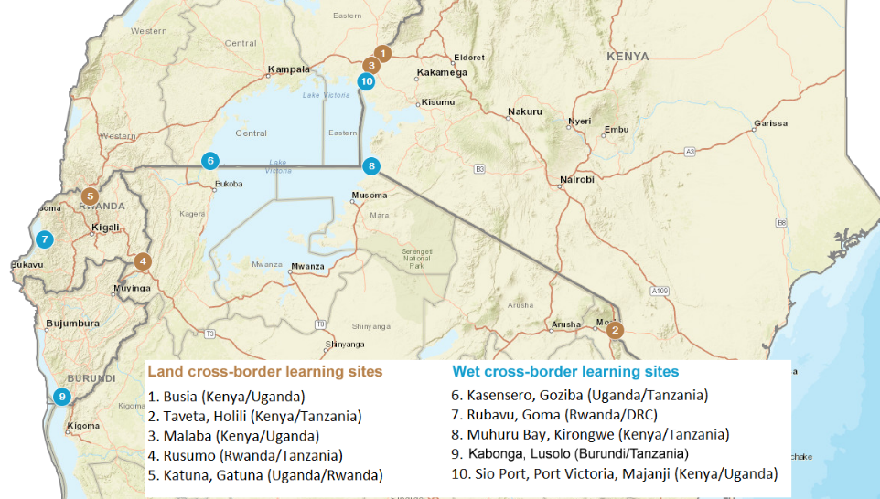
Project Sites

Slide 6
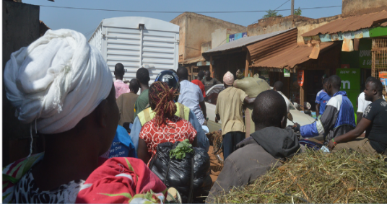
Context
East African Community Common Market Protocol (2010)
Free movement of goods; labour; services; and capital for regional integration
Mobility is a social determinant of health; cross border areas report dynamic mobility patterns
Health policies and strategies focus on national service delivery

Slide 7
Literature Review
Transnational health care seeking has been attributed to:
Cost of/affordability of health care services (Bird and Law 2009)
Client - service provider effective communication (language barrier) (Hunter- Adams and Rother 2017)
Perception of quality of care, proximity, cost (CB-HIPP, unpublished)
Challenges
Testing and treatment responses within public health systems particularly with chronic conditions fail to engage with migration (Vearey 2014)
Language and health literacy are barriers to accessing care (Hunter Adams and Rother 2017)
Choice of drug regimen and monitoring of adherence present ethical and logistical challenges in ART and retention among LDTDs in South Africa, Zimbabwe and Zambia transport corridor (Gomez et al 2013)
Limited access to SRH services (Obel et al 2014)
Cross-border health care seeking impacts on commodities at border facilities

Slide 8
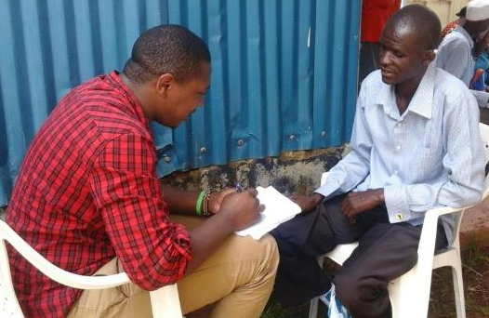
Methodology
Formative Assessment conducted at cross border sites in Busia, Malaba, Sio Port/Port Victoria/Majanji (Kenya/Uganda), Taveta/Holili (Kenya/Tanzania) and Muhuru Bay/Kirongwe (Kenya/Tanzania).
Though data is available from cross-border sites, presentation focuses on Kenyan sites.
The assessment utilized qualitative methods: 30 key informants, 33 focus group discussions and 120 in-depth interviews that were subjected to thematic and content analysis.

Slide 9
Strong National Policy Environment in Kenya
There are national policy documents that cover key and vulnerable populations:
Kenya National AIDS Strategic Framework
HIV Prevention among Key Populations (2016)
Kenya HIV Prevention Roadmap (identifies FSW, MSM and PWID as key populations)
National HIV and AIDS Policy
National Strategy on HIV/AIDS and STI Programming along Transport Corridors in Kenya
National Health Insurance Fund

Slide 10
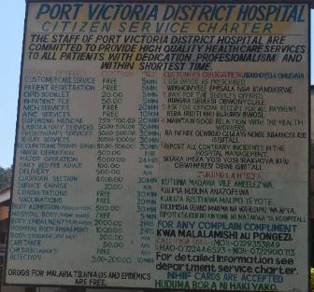
Results: Transnational Access to Health Services - Proximity to Comprehensive Health Services
Busia County Referral Hospital, Alupe, Sio Port, Kocholya and Port Victoria sub-county hospitals are of higher level than Busia Health Centre IV, Majanji Health Centre II, Malaba Health Centre III on the Ugandan side
Kenya health facilities offer a range of comprehensive health services

Slide 11
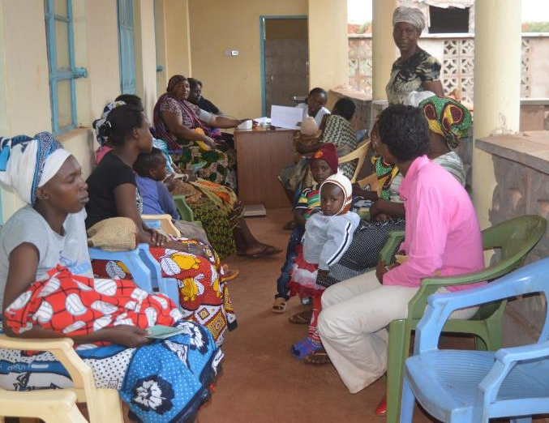
Results: Transnational Access to Health Services – Other Factors
Transnational access includes integrated health services (HIV, TB, ANC, STI, etc.)
Other factors include cost to and for the service, e.g. free maternity services attract Tanzanians on Kenya-Tanzania border
Stigma and discrimination

Slide 12
Results: Challenges to Seeking Healthcare
User fees is sometimes a barrier for transnational access to services
While the policy aims to ensure membership in NHIF targets the formal and informal sectors, clients, especially LDTDs reported NHIF was only useful in-country – need for portability of health insurance
“…but let’s say you even have a medical card, but maybe it doesn’t cover you for out of the country treatment, then you can’t go to those hospitals if you don’t have money” (FGD: clearing and forwarding agents- Busia/Kenya)
Potentially higher default rates, missed appointments and lack of adherence result from transnational access as no cross-border follow up and tracking mechanism exists
Language barrier affects health communication
Different treatment regimens affect e.g. access to ARV refills

Slide 13
Results: Policy Gaps
Identified gaps in policy include lack of guidelines and a regional framework for service delivery on transnational access to health services
Different treatment regimens for HIV in Kenya, Tanzania and Uganda
Current systems do not support defaulter tracing for individuals on treatment across borders contributing to loss-to-follow up
Current tools do not capture data on migrant and cross-border populations
“There is no specific indicator that captures data for the migrant population. So that is a huge challenge. In Busia, at the facility for example, ART coverage is around 110% which covers all the people in Busia accessing ART treatment and also another 10% from outside the Country”. (Key Informant: national level).

Slide 14
Opportunities
Existing cross-border meetings can include discussions on health issues, e.g.. Border Management Committees in Kenya and other cross-border coordination mechanisms
EAC health policy can address treatment regimens and protocols for HIV, TB, STI, etc.
Review of national and regional HMIS to incorporate mobile population indicators for planning and decision making
Opportunity for enhanced cross-border referral and data sharing between border countries
Unique Identifier Codes could facilitate sharing and tracking of migrant patient data regionally to enhance access and quality of care
Counties are beginning to develop own health policies and there is an opportunity to incorporate service delivery guidelines specific to key and priority populations at cross-border areas

Slide 15
Conclusion and Recommendations
Transnational access to health services is a critical component for quality of care among key and priority cross-border populations
Regional coordination mechanisms can improve policy context for transnational access to care for key and priority cross-border populations
Need to review health policy and standardize treatment regimens in the EAC region
Consider portability of social health insurance benefits in the EAC region
Need to establish cross-border referral mechanisms in the region
There is a dearth of data on transnational access to health services between neighboring countries and regionally. Therefore, need for regional HMIS and data sharing mechanisms.

Slide 16
Acknowledgement
MOH Kenya – NASCOP/NACC
Kenya County Governments:
Busia
Migori
Taita Taveta
Study and program participants
EAC
USAID KEA

