Slide 1
2016 HPAI H5N1 multisectoral outbreak response: Case of Cameroon
Serge Nzietchueng
Africa Regional Deputy Director and Senior Technical Advisor
USAID Preparedness and Response Project East and Central Africa Region
East Africa Community Scientific Conference
Burundi, Bujumbura, March 29-31, 2017

Slide 2
Contribution and Acknowledgments Taiga: Minister of Livestock, Fisheries and Animal Industries, Cameroon André M. Fouda: Minster of Public Health, Cameroon Sali Ballo: Technical Coordinator of the Zoonotic Program, Prime Minister Office, Camroon Gaston Djonwé: Director of Veterinary Service at Ministry of Livestock, Fisheries and Animal Industries, Cameroon Alain G. Etoundi: Director of disease control, epidemic and pandemic at Ministry of Public Health, Cameroon Casmir Ndongo: Director of Livestock Production at the at Ministry of Livestock, Fisheire and Animal Industries, Cameroon Abel Wade: Director of the National Veterinary Laboratory, Annex Yaoundé, Cameroon Zephyrin K. Fotso: Deputy Director of veterinary drugs at Ministry of Livestock, Fisheries and Animal Industries, Cameroon Jean Marc Feussom : Permanent Secretary of Cameroon Epidemiosurveillance Network for Animal Disease (CENAD)Cameroon Penda Rose: Tchamba Magloire: Nko Conrad: Vitalis Chenpda: Permanent Secretary of the Zoonotic Program, Cameroon Aristide ABah: Cameroon Elise Seukap: Deputy Director of…………. Elisabeth Dibongué: One Health Focal person and Deputy Permanent Secretary of the Zoonotic Program, Cameroon Matthew Lebretton: Country Coordinator, USAID PREDICT-2 project, Cameroon Ubald Tamoufe: Director METABIOTA, Cameroon Julius Nwobegahay: Cameroon Severin Loul: National One Health Technical Advisor, USAID Preparedness and Response Proejct Baba Soumare: Director USAID Preparedness and Response Project West Africa Region Andrew Kitua: Director USAID Preparedness and Response Project East and Central Africa Region

Slide 3
Background and Context
Agriculture: 20% of GDP
60% of the active population
Livestock: 13% of agriculture GDP
Poultry population
About 75.000.000
Industrial, semi-industrial and traditional
Credit: https://en.wikipedia.org/wiki/Cameroon

Slide 4
2006
2016
Mai-September 2016
18 outbreaks
Exotic chicken
22,040 dead, 44,981 destroyed
04 Regions: Center, South, West, Adamoua
Wild birds:03 cases
02 regions: North and Far North

Slide 5
Data Collection and Analysis Data sources:
Field observations
Open discussions with key informants
Outbreak situational reports from MoLFAD, MoPH
Animal Health regional Organization report
Animal Health Organization report
World Health Organization report
Food and Agriculture Organization of the United Nation report
Center for Disease Control report ProMed data bases
Outbreak Response after action review tool

Slide 6
Outbreak investigation and Response

Slide 7
Activation of EOC: Incident Chains of Commands
Directorate of Veterinary Services
Directorate of Disease Control

Slide 8
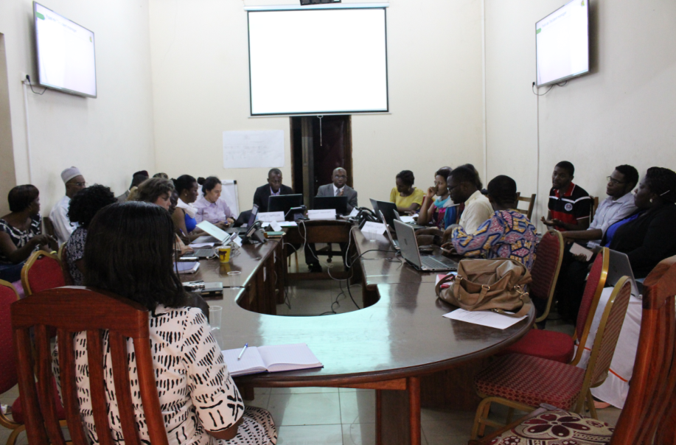
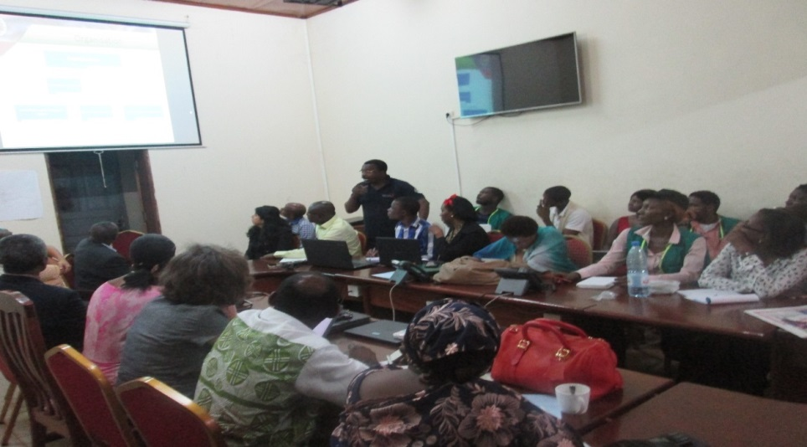
EOC-Directorate of disease control/MoH
Officer of Animal disease surveillance during a EoC-MoH

Slide 9
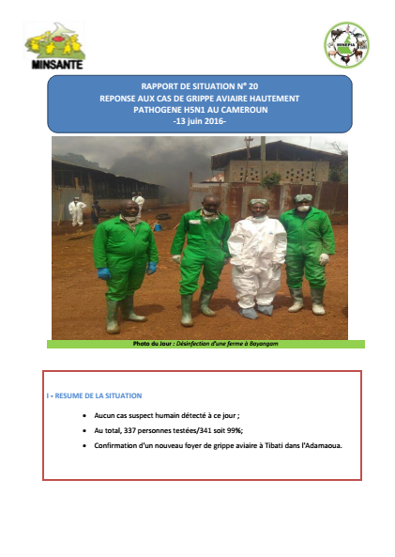
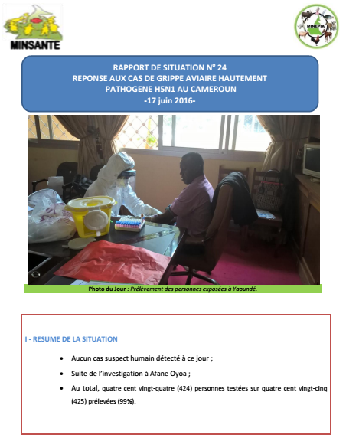
Joint-Daily outbreak response situational Report

Slide 10
Response timeframe
Actions | Timeframe | Comments
Deployment of Veterinary Rapid Response teams | Within 24-96hours
Laboratory diagnosis and laboratory results | Within 24hours
Deployment of Public Health rapid response teams | Within 72hours | Identification of person at risk and monitor during 15 days
Other actions | Within 24-120 hours | Implementation of sanitary (bio-safety and bio-security) and administrative measures

Slide 11
Preparedness and detection Gaps Detection:
High number chicken deaths reported once: 18 outbreaks

Slide 12
Gaps:
Weak early detection
Weak implementation of the HPAI H5N1 preparedness and response plan
Credit: RESCAM, 2016

Slide 13
Lessons Learnt-1
MoLFAD
Leverage on experience to response to African Swine fever outbreak
In-country capacity to collect, ship and perform laboratory diagnostic test
MoPH
Effective and operational EoC
Multi-sectoral
Collaboration at Ministerial and technical levels
One Health

Slide 14
Lessons Learnt-2
Detection
Weak early detection
No involvement of poultry units as part of the animal disease surveillance system
Preparedness
HPAI H5N1 contingency plan revised but no HPAI H5N1 preparedness activities implementation
Late adoption of the revised plan
No in-country budget to support preparedness activities

Slide 15
Thank you

