Slide 1
Actions taken and responsibilities of the EAC during the Ebola and the HPAI outbreaks
By
Samuel Okware PhD
Uganda National Health Research Organisation, Entebbe Uganda
Symposium on Emergency Preparedness and response
The 6th East African Health and Scientific Conference and International Health Exhibition and Trade Fare
29-31 March 2017
BUJUMBURA, REPUBLIC OF BURUNDI

Slide 2
Presentation outline
EAC regional initiatives for Disease control
Regional encounters with Ebola and HPIA
Lessons learnt
Conclusion

Slide 3
Emerging and remerging infections and threats
Disease | Year | Country | Cases /deaths | Locality | Comments
Ebola | 2000-12 | Uganda | >500/300 | Gulu Luwero Bundibugyo | Sudan ebolavirus Zaire ebolavirus Bundibugyo ebolavirus
Marburg | 2007 | Uganda | >50/40 | Kamwenge
HPAI | 2007 2010 | Uganda |  | Central North East and South 2017: new c | Outbreak 1977; transmission migratory birds and poultry ; CFR 60% -2017 new outbreak
Wild Polio virus | 2006 2009 | Kenya | 16/1 | NE , Garisa, imported; Turkana; | Genetically linked to strains in Uganda
Malaria; HIV |  |  |  |  | Re-emerging outbreaks

Slide 4
EAC regional response

Slide 5
HPAI experience
1977- identified in Hong Kong- Pandemic
Transmission poultry and migratory birds
Africa –Egypt
-Uganda, South Sudan : over 200 cases
Case fatality - >60%
2007- Field simulation in Busia border
2017 Uganda – new cases

Slide 6
EAIDSNet objectives
Formed in 2001 to support partner states to respond shared public health threats
Recognition of fragmented disease strategies and weak lab capacity
Zoonosis
Build cross border capacity for IDS and control
Improve quality data and harmonise IDS
Strengthen sharing of information and data
Share capacity and expertise
Constant exchange expertise andbest practices

Slide 7
EAIDSNet initiatives
2008: EAC implemented “Regional Project to strengthen cross border Dis Prevention” (H &A)
2014 Ministerial and stakeholder multisectoral conference endorsed “Reg. EPR Strategy for EVD”;
Strengthened cross border institutions/collaboration through ONE HEALTH approach
Joint outbreak investigation and management-cross border communities- more vulnerable
Advice - Regulation of human and commercial traffic
Web portal- linking Human and Animal health
EAPHL network (recent)
Field training- simulation eg Busia border

Slide 8
National Response: Ebola task force
What and Where do you fit?
Environment
Surveillance
Investigation
Contacts
Patients
Forecasting
1: Epidemiology
2. Isolation/care
Dead/burial
Leadership
Coordination & Logistics
Task force s
E
3.Education
4. Laboratory
Community
Clinical lab
Health staff
Diagnosis
Packaging
Relatives
Media
Authorities
INTERVENTION

Slide 9
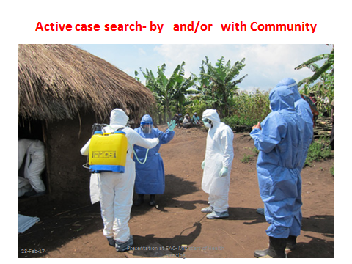
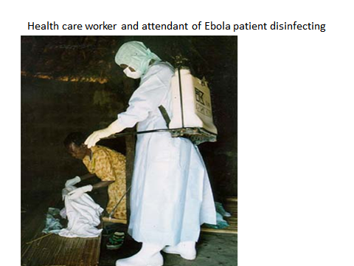
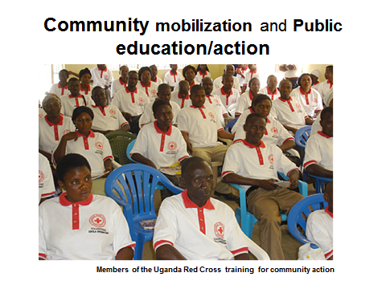
Community health workers/mobilisers

Slide 10
Tools for community mobilisation
Mass media e.g. radio/tv ..
Home visits – door to door
Discussion groups, rallies
Cascade training – to districts..villages
IEC Materials: posters,
Rumour management: work with media, press

Slide 11
Regional encounters

Slide 12
Kenya Community targeted in Masindi district, Uganda, 2000
Escape of contacts: 7 to Kenya; 1 to Masindi dist
73 members extended index family in Masindi
Transmission prevented beyond index family by early case detection and isolation imposed by the community
Attack rate 19/73 (26%)
CFR in index family 15/19 (79%)
2nd generation lost 8/19 (50%)
Only 1 case in general population occured
Left 30 orphans
Enforcement : Community leadership v. police
Source: Borchert M 2011, and personal notes, 2000

Slide 13
Cross border Efforts against Ebola,2000
2001- Ebola contact Kenyan relative escaped Gulu to W Kenya
Three hormes: Busia,Malaba Bungoma
Acholi diaspora meeting Nairobi drama
Human and commercial traffic slowed
Stigma

Slide 14
Drama and rare encounters

Slide 15
Cross border Field simulation against HPAI, Busia, 2010
Tested EPR cross border response agaist HPAI –Busia
Synergy possible: multisectoral teams and expertise

Slide 16
Lessons learnt
EAIDSnet regional strategy has potential
One health approach promotes regional synergy teams and expertise
Information sharing- permanent cross border meetings
Lab capacity - silver lining – Centers of Excellence
Inventories
Empathy

Slide 17
CONCLUSION
EAIDSnet regional initiative has potential
but needs nurturing and expansion in scope and content

Slide 18
Acknowledgement
Members of The Ebola Task Force, Uganda
Government and the people of Uganda and EAC partners
EAC Partner States- bilateral and international
Ministry of Health, Uganda
Ministry Health, EAC Partner States
Ministries of Agriculture and Veterinary services, Partner States
Ministry of EAC Affairs
Health care workers
Colleagues & friends who died in the line of duty

Slide 25
Best scenarios and outcomes

