Slide 1
ADJUNCT FACULTY: AN UNTAPPED RESOURCE FOR MEDICAL EDUCATION.
Nduati R, MMED MPH¹, Kibore M, MMED², Njoroge P, MPH¹, Kinuthia R BSc, MSc¹ , Child M, MPH MPA², Davis L MPH², Farquhar C MD², Nyaga L, Njiri E, Kibwage I, PhD, Kiarie J, MMED MPH^{1,}
¹ University of Nairobi, ² University of Washington,

Slide 2
Partnership for Innovative Medical Education for Kenya (PRIME-K)
Health Research
Student research Projects
Implementation Science Research
Health System
Health outcomes
Know do gap
Quality Care
Staff retention
Quality of training
Medical Education
Health Care Delivery
Decentralized Training
E-Learning

Slide 3
Background
In order to bridge the human health resource gap African Universities have increased admissions into existing training programs.
The direct outcome has been an increase in internship training centers.
In Kenya this has been > 60 and thus contributing to the goal of taking healthcare closer to the public.

Slide 4
University of Nairobi College of Health Sciences Graduates

Slide 5
Background
Infrastructure and human resource within the universities has not grown in tandem with the growth of the student body resulting in diminishing opportunities for hands-on exposure required for effective pre-service medical training.

Slide 7
Hypothesis
Hospitals currently designated as post-graduation professional training sites (internship sites) could be developed into undergraduate and post-graduate clinical training sites.

Slide 9
Objectives
This was an evaluation of the acceptability and feasibility of engaging senior health personnel working at internship training sites into a non-financially remunerated position of adjunct faculty with the College of Health Sciences of the University of Nairobi.

Slide 10
Methods
Senior medical personnel from 18 internship training sites in Kenya were invited to partner with the University of Nairobi, College of Health Sciences in an experiment on mentored decentralized pre-service clinical training.
A 3 day induction course in medical education and clinical mentorship adapted from a course provided at St John’s Christian Medical College, Bangalore was offered to all senior staffs at the selected sites.
The staff were then requested to formally apply for accreditation as adjunct faculty.

Slide 11
Adjunct Faculty training content
Medical Education
Mentorship
Overview of the MEPI program in Kenya
Health Status of Kenya: Educational Needs
Principles of Learning
Educational Spiral, Taxonomy and Domain
Specific Learning Objectives
Learning Methods
Bedside Teaching
Problem-based Learning
Integrated Learning
Microteaching
Introduction and Rationale of Mentorship
Basic Knowledge and Skills in Mentorship
Roles and Characteristics of an Effective Mentor
The components of the mentorship process
Characteristics of an ideal mentorship site
Work-planning and organizing your work as a mentor.

Slide 12
Pilot testing of decentralized clinical training
Undergraduate medical, nursing, pharmacy and dental students were offered an opportunity for mentored clinical training at the participating hospitals.
To test the potential for sustainability in the absence of funding, we shifted from a model of fully sponsored rotation used for the first batch of students to partial and finally no financial support to subsequent batches of students.
At the end of year 4 of the project a phone survey was carried out to determine what proportion of trained faculty who were still at the original site.

Slide 13
Results
Overall 216 health staffs from the 18 participating hospitals were trained.
48 were formally accredited as adjunct faculty after applying and satisfying the criteria set out by the University.
35 (48.6%) of 72 eligible medical specialists (~ equivalent to a > 10% increase in clinical faculty)
2 Dentists,
7 Nursing officers, and
4 pharmacists..

Slide 14
Adjunct Faculty retention
Retention of Faculty
At the end of 4 years, 53 (26%) of the 204 personnel had left the original station.
22% of the medical specialists versus 28% of the other cadres (p=0.3).
Destination of the personnel who left
Private practice 18 (8.8%)
Faculty positions in other medical schools in Kenya, 10 (4.9%)
Transfer to other government facilities 9 (4.4%)
Further studies 3 (1.4%)

Slide 15
Student Training
Over a period of 4 years 379 students were exposed to mentored clinical training at the 18 decentralized sites, including 50 students who participated without stipend support from the program.
The student feel transformed and highly motivated to learn to be good doctors.

Slide 16
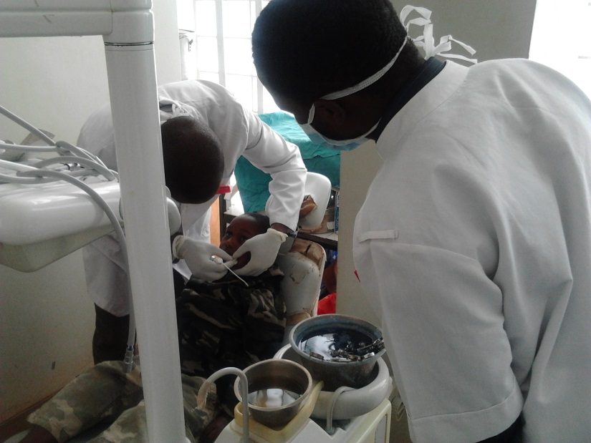
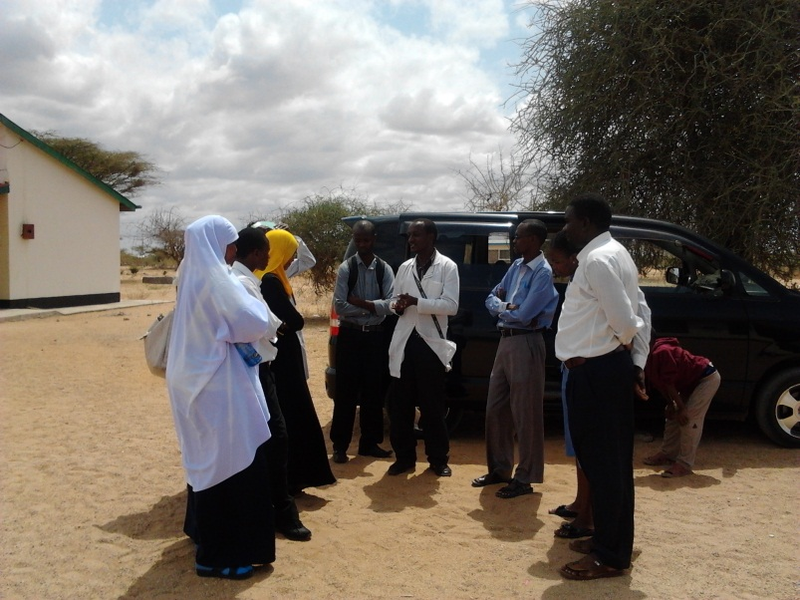
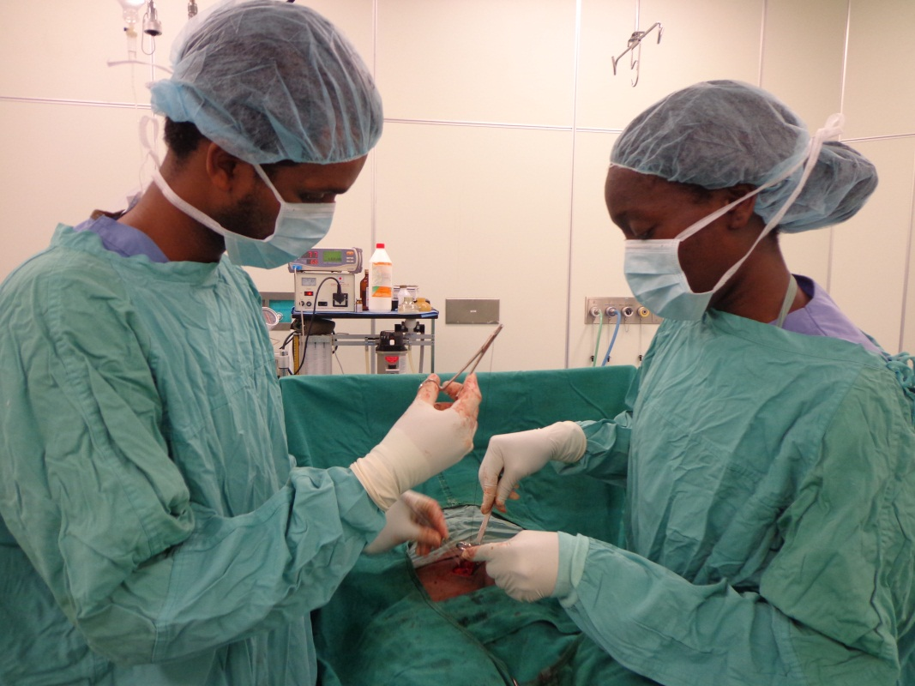
Students at the decentralized clinical facilities

Slide 17
Adjunct Faculty experience with the decentralized clinical training
Adjunct faculty report that the decentralized clinical training of the undergraduate students has added new meaning to their professional work.
Faculty felt motivated to study and improve themselves.
Only one (1.4%) of 72 medical specialists declined to have medical students placed under his supervision.

Slide 18
Needs going forward
Policy
Curriculum review to adopt decentralized clinical training .
Accreditation of decentralized clinical sites as training centres by the Medical Board
Infrastructure & Logistics
Safe accommodation for the students
ICT resources
Sustained faculty training

Slide 19
Conclusion
There is an opportunity for African universities to harness the resources of public hospitals and specialists in non-academic institutions to increase quality and quantity of training opportunities.

Slide 20
REFERENCES
Monroe-Wise A, Kibore M, Kiarie J, Nduati R, Mburu J, Drake FT, Bremner W, Holmes K, Farquhar C. The Clinical Education Partnership Initiative: an innovative approach to global health education. BMC Med Educ. 2014 Dec 30;14:1043. doi: 10.1186/s12909-014-0246-5. PMID: 25547408
Kibore MW, Daniels JA, Child MJ, Nduati R, Njiri FJ, Kinuthia RM, O'Malley G, John-Stewart G, Kiarie J, Farquhar C. Kenyan medical student and consultant experiences in a pilot decentralized training program at the University of Nairobi. Educ Health (Abingdon). 2014 May-Aug;27(2):170-6. doi: 10.4103/1357-6283.143778. PMID: 25420980
Child MJ, Kiarie JN, Allen SM, Nduati R, Wasserheit JN, Kibore MW, John-Stewart G, Njiri FJ, O'Malley G, Kinuthia R, Norris TE, Farquhar C. Expanding clinical medical training opportunities at the University of Nairobi: adapting a regional medical education model from the WWAMI program at the University of Washington. Acad Med. 2014 Aug;89(8 Suppl):S35-9. doi: 10.1097/ACM.0000000000000350. PMID: 25072575
Kiarie JN, Farquhar C, Redfield R, Bosire K, Nduati RW, Mwanda W, M'Imunya JM, Kibwage I. Strengthening health systems by integrating health care, medical education, and research: University of Nairobi experience. Acad Med. 2014 Aug;89(8 Suppl):S109-10. doi: 10.1097/ACM.0000000000000318. No abstract available. PMID: 25072562
Daniels J, Nduati R, Farquhar C. Kenyan women medical doctors and their motivations to pursue international research training. Educ Health (Abingdon). 2013 May-Aug;26(2):89-97. doi: 10.4103/1357-6283.120700.

Slide 21
Medical Education Partnership Initiative (MEPI) Partnership for Innovative Medical Education for Kenya (PRIME-K)
Implementers
University of Maryland Baltimore
University of Nairobi
University of Washington
Mission
“To strengthen and build training, clinical and research capacity in College Health Sciences for improvement of health outcomes in Kenya.”
Notes:
Development of medical education capacity in non-tertiary hospitals,
Strengthening e-learning programs,
Establishing a multidisciplinary skills lab,
Improving library facilities,
Training for UoN faculty as well as adjunct faculty from non-tertiary hospitals,
Promoting locally relevant research &
Strengthening research administration

