Slide 1
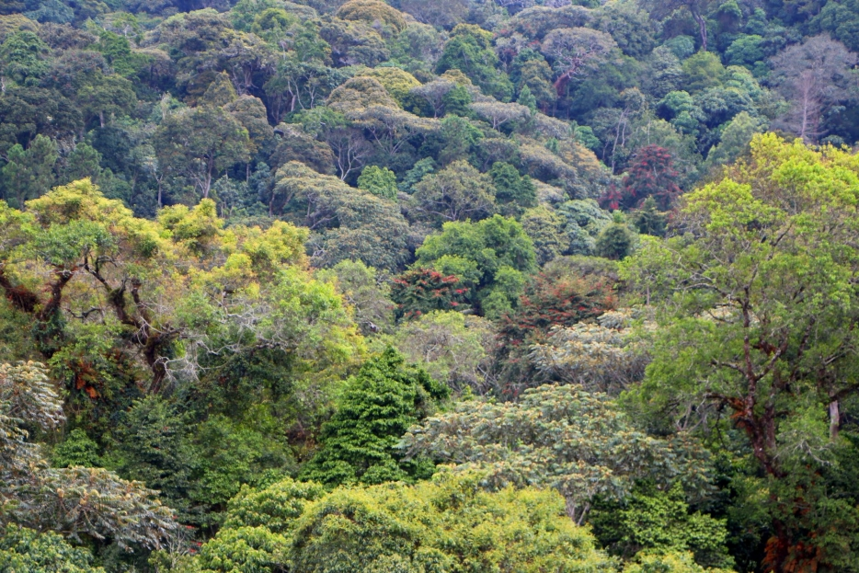
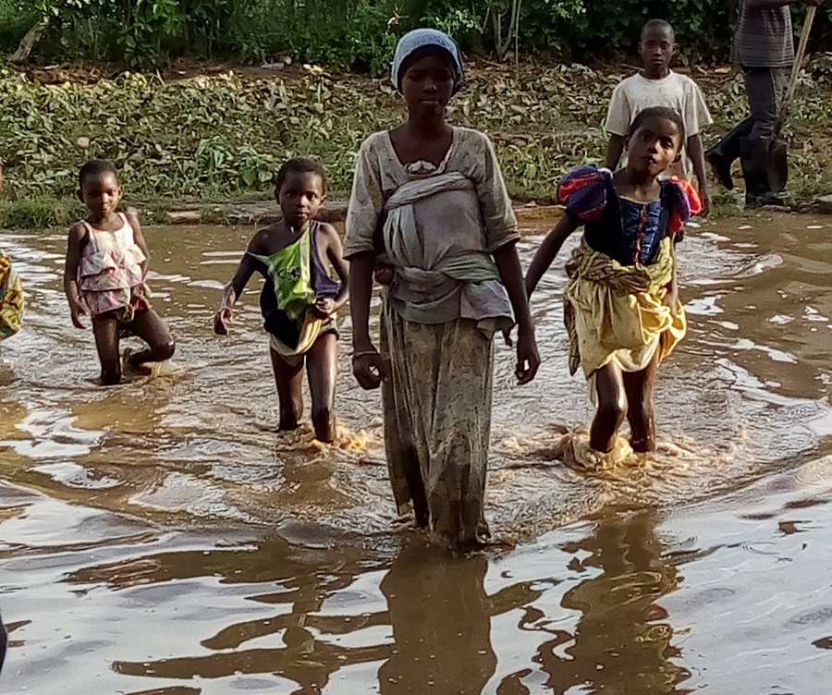
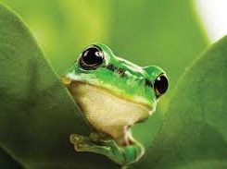
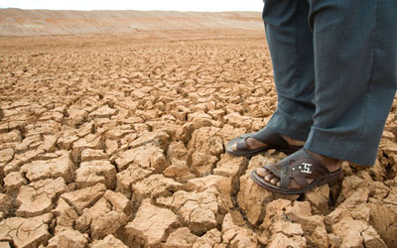
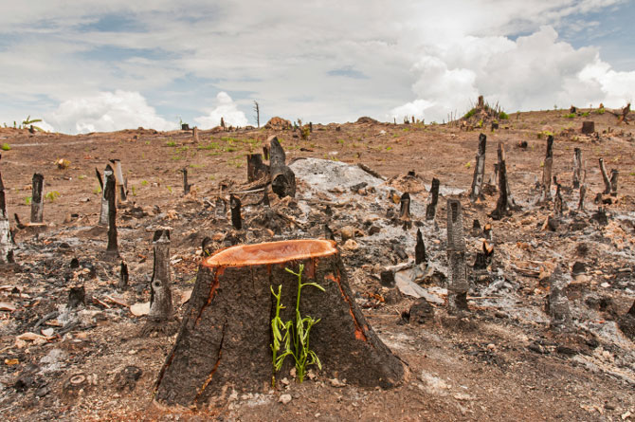
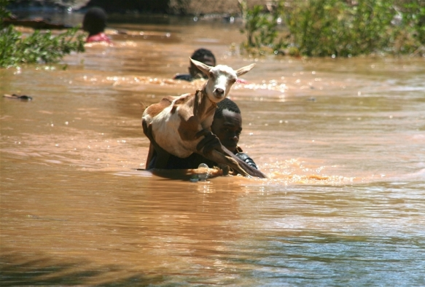
Biodiversity and Climate Change Impacts Mitigation for Human Health,
The 6th East African Health and Scientific Conference & International Health Exhibition and Trade Fair
Claver SIBOMANA, PhD
Biology Department,
Faculty of Sciences
Unviersity of Burundi
Bujumbura, 31th March 2017

Slide 2
Health and main environmental changes
Stratospheric
ozone depletion
Climate change
Land degradation
Agroecosystem productivity
Diverse pathways
Human health
Altered precipitation
Water quantity and safety
Biodiversity
loss and ecosystem
function
Freshwater decline
Modified, WHO (2003)
Notes:
FIGURE 1.4 Interrelationships between major types of global environmental change, including climate change. Note that all impinge on human health and—though not shown here explicitly—there are various interactive effects between jointly acting environmental stresses. The diverse pathways by which climate change affects health are the subjects of much of the remainder of this volume. (modifié d’après WHO, 2003: Climate change and human health)

Slide 3
Recent ecosystem service models have placed biodiversity as a central factor in the processes that link natural environment (and its changes) to health
Lovell et al. (2014)

Slide 4
Biodiversity loss and human health
Disruption of ecosystems providing « nature’s good and services »
extinction of species of medicinal plants and animals
loss before discovery, of many natural chemicals and genes, others with enormous medical and health improvement benefits
e.g: 5/6 of tropical vegetative nature’s medicinal goods have yet to be recorded (Myers 1999).

Slide 5
Environmental (climate) change affect parasite-host…
environment
host
community
Parasite
community
parasite
host
Modified from Brunner & Eizaguirre (2016)

Slide 6
Biodiversity and invasive species
Invasive species: non-native plant, animal or other organism that dominates the encountered ecosystem and impairs its function and structure.
They displace or damage native fauna and flora, often posing serious threats to local biodiversity and causing adverse environmental, economic or public health effects.
e.g. 1: Spread of water hyacinth in Lake Victoria, is now a breeding ground for the water snail that transmit schistosomiasis and for the proliferation of diarrheal disease organisms
e.g. 2: The Asian tiger mosquito has been linked to more than 20 diseases, including yellow fever and chikungunya fever. It was spread from Asia through intecontinental trade in use tires.

Slide 7
Although not traditionally seen as related to human health, biodiversity loss and species invasion must be addressed for prevention and control of diseases

Slide 8
Biodiversity and climate change
Biodiversity and associated ecosystems are impacted by climate change;
Biodiversity can help people mitigate climate change;
Biodiversity can help people adapt to climate change
CBD-AHTEG Report (2001)

Slide 9
The global carbon cycle
SCBD (2015)

Slide 10
Biodiversity and climate change mitigation
There is correlation between higher levels of species diversity and higher rates of carbon sequestration
Higher biodiversity can increase the resilience of ecosystems and their carbon stocks to disturbance
Individual species (high productive plant) or functional groups (pollinators, seed dispersers or predators that control herbivore populations) are important for carbon sequestration and storage,

Slide 11
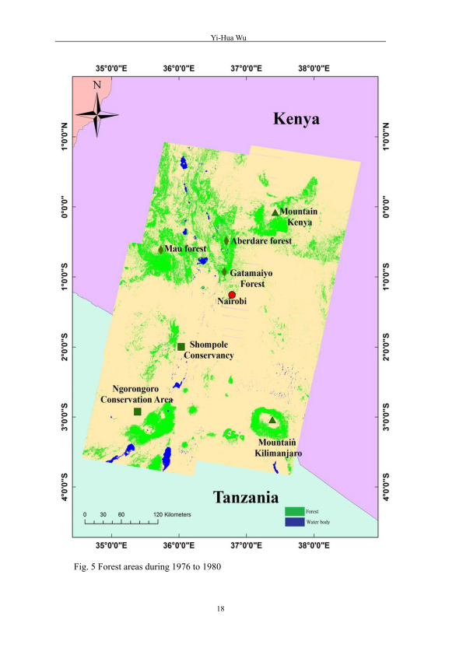
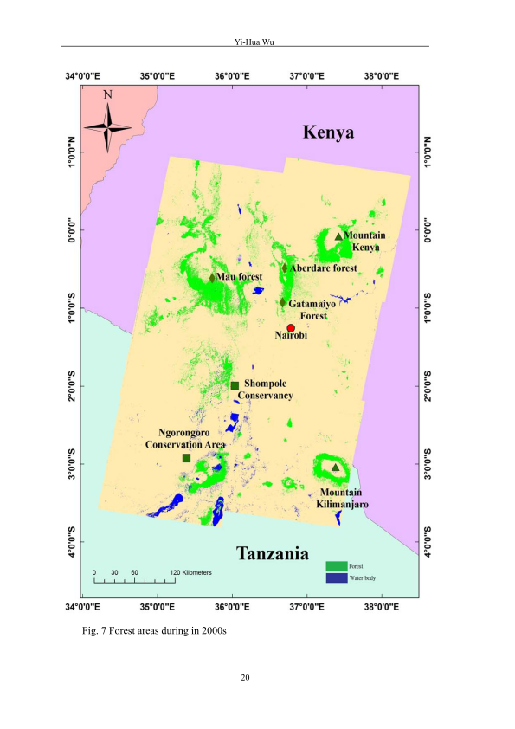
Deforestation in East Africa (Kenya & Tanzania)
1976-1980
1980s
2000s

Slide 12
Deforestation in East Africa (Burundi & Rwanda, East Congo)

Slide 13
Biodiversity protection and climate change mitigation : co-dependant!
Managing and protecting biodiversity will mitigate the negative impacts of climate change and help humans adapt to it;
Policies and actions aiming at limiting the effects of climate change will contribute to the protection of biodiversity.

Slide 14
EAC legal framework to adress climate change
Treaty for establishment of EAC-
Art.5: sustainable utilisation of natural resource
chap. 19: clarifies in relation to cooperation
The protocol on the establishment of the EAC Common Market
Art. 40: States must ensure environment management practices
Lake Victoria Basin Commission (LVBC)
Protocol on Environment and Natural Resouce Management
EAC climate Change Policy (EACCCP)
EAC Climate Change Strategy (EACCCS)
EAC Climate Master Plan (EACCMP)
Fit together
Notes:
Art 5: promotion of sustainable utilisation of natural resources of partner states and take measures… , chap 19. clarifies in relation to cooperation

Slide 15
Recommendations
Fully implement EAC legal framework for sustainable management of natural resources
Improve environmental management of health-supporting ecosystems (e.g. forests, freshwater resources, agricultural areas) to reduce the adverse health impacts of climate change,
Monitor for detecting changes resulting from both climate and ecological change,
for immediately required action and to serve as the basis for developing predictive programme.
Notes:
Such models can serve as effective aids in developing strategies and mechanisms for minimising parasitic disease consequent to expected changes in the environment; they can provide insight into associations among ecological factors, entomological, genetic and behavioural characteristics of vectors and parasites, and human behaviour that are associated with disease transmission.

Slide 16
Recommendations
Integrate ecosystem-based mitigation actions into climate change strategies (EACCCS)
Choose management methods that maintain or restore biodiversity to support the effectiveness of ecosystem-based climate change mitigation efforts, with regard to resilience over the longer term.
Restore degraded agriculture lands in dryland areas and increase reforestation

Slide 17
THANK YOU MURAKOZE ASANTE
claver.sibomana@ub.edu.bi
University of Burundi

