Slide 1
CLIMATE CHANGE, WATER RESOURCES, HYDROLOGIAL RISKS AND HEALTH
EAST AFRICA COMMUNITY
EAST AFRICAN HEALTH COMMISSION
By
Dr. Charles BAKUNDUKIZE (PhD)
University of Burundi
Department of Earth Sciences

Slide 2
OUTLINE OF THE PRESENTATION
INTRODUCTION
THEORETICAL BACKGROUND
IMPACTS OF CLIMATE CHANGE: WATER RESOURCES Hydrological riscks AND HEALTH
CONCLUSIONS ET RECOMMENDATIONS

Slide 3
I. INTRODUCTION
CLIMATE CHANGE is mainly characterised by:
global warming with its associated recurrent heat waves
Sea level rise: as a consequence of glaciers melting
changes in precipitation: erratic nature of rainfall
more frequent or intense extreme weather events:
extreme rainfall events causing floods and mass movements: landslides, mud flow,….
drought causing crop failure
Cyclones
Climate variability is characterized:
Seasonal or yearly fluctuations of the climate above or below a long-term average value.
Some seasons/years being wetter or warmer than others

Slide 4
I. INTODUCTION
Besides effects of climate change and variability, climate in most of the EAC countries in also influenced by El-NINO AND LA NINA phenomena
EL-NINO AND LA NINA = Natural PHENOMENA
Resulting from the interaction between the ocean and the atmosphere in the equatorial Pacific Ocean
Characterised by abnormally elevated or low temperatures of the sea surface departing from the long-term average in the equatorial Pacific Ocean
Recurrent with an average frequency of 4.5 years
While EL NINO episodes are associated with abundant of rainfall LA NINA episods are rather characterised by drought in most of EAC

Slide 5
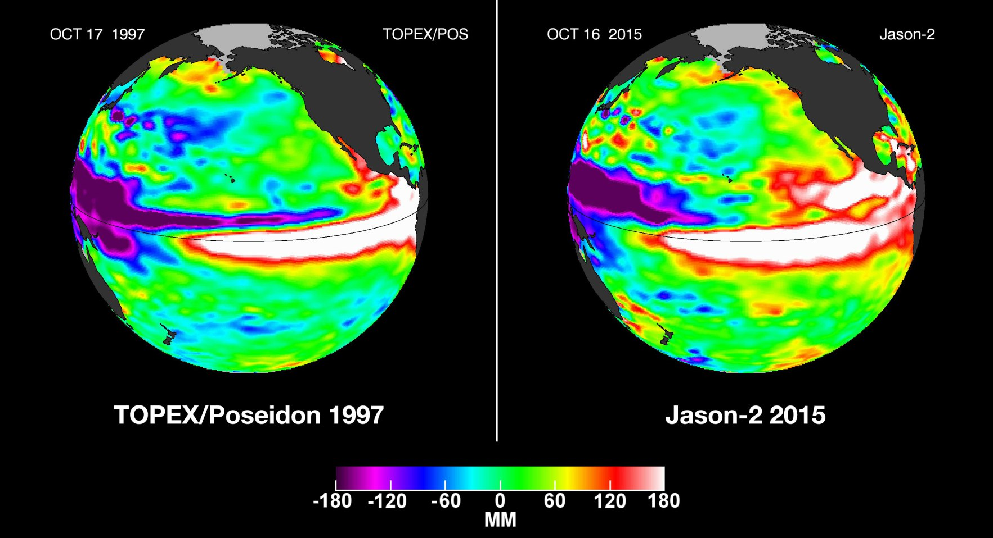
I. INTRODUCTION
El Niño : 2015-2016 comparable to 1997-1998

Slide 6
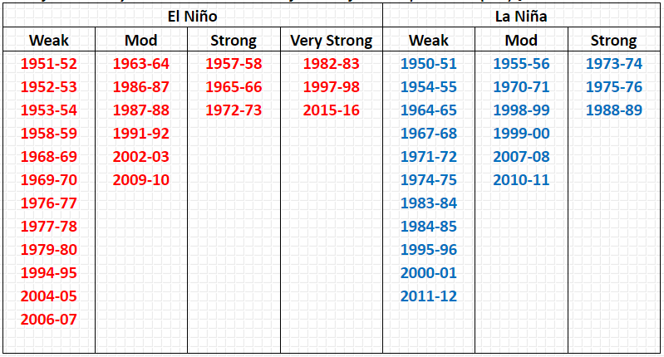
I. INTRODUCTION
EL-NINO and LA NINA EPISODES FROM 1951 to 2016

Slide 7
I. INTRODUCTION
climate change is an global issue but impacts are not felt equally across the planet
Some nations will likely experience more adverse effects than others depending on capacity to adapt.
particular groups of people are sensitive to climate change impacts: elderly, people with disabilities, children and pregnant women, native and tribal groups, and low-income populations.

Slide 8
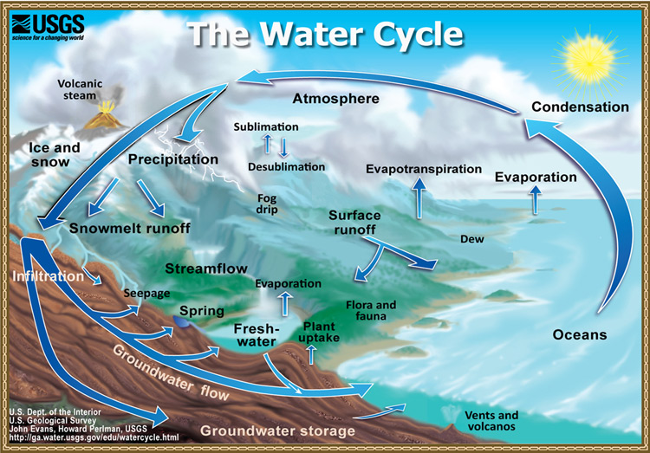
II. THEORETICAL BACKGROUND
The hydrologic cycle is an endless process, powered by the sun's energy, which moves water between the oceans, the sky, and the land.

Slide 9
II. THEORETICAL BACKGROUND
P = ET_{O} + R_{O}+ I
This general equation can be also detailed as follows:
P = ET₀ + Q_{riv} + Q_{p} + ∆PAW+ ∆S_{aq}
Where
I = Infiltration
ET_{O} = Evapotranspiration
P = precipitations (inputs)
Qriv = River discharge
Qp: water abstracted from underground aquifers
∆PAW: plant available water
∆Saq: variation of water storage in underground aquifers
Water balance equation helps to quantify the different fluxes of water circulating between the different reservoirs of the hydrologic cycle
Input
Outputs
Change in storage over the time

Slide 10
IMPACTS OF CLIMATE CHANGE: WATER RESOURCES, Hydrological risks AND HEALTH
Details of the components of the water balance equation in order to understand well how climate change affects the livelihood of population and particularly health aspects:
∆PAW+ ∆S_{aq}
PAW = plant available water =soil moisture storage
Periods of extreme rainfall events: soil moisture level is kept at its maximun capacity (field capacity) and this results in:
increased surface runoff and river discharges which will be discussed further.
Elevated Soil moisture favours agricultural production and hence ensure food security
However prolonged elevated soil moisture may be detrimental to crop production resulting in food insecurity

Slide 11
III. IMPACTS OF CLIMATE CHANGE: WATER RESOURCES, Hydrological riscks AND HEALTH
Increased groundwater recharge (∆S_{aq}) leads to:
Increases the availability of groundwater (Q_{p})
Substantial baseflow and consequently increased river discharge during dry season: water available for irrigation, livestock, energy production,....
Substantial spring discharge which allows to have drinking water even during dry seasons
P = ET₀ + Q_{riv} + Q_{p} + ∆PAW+ ∆S_{aq}

Slide 12
IMPACTS OF CLIMATE CHANGE: WATER RESOURCES, Hydrological risks AND HEALTH
Q_{riv}= river discharge comprises the surface runoff and the baseflow (discharge from the underground aquifer)
In period of extreme rainfall events the surface runoff can cause disasters such as:
Soil erosion and the ensuing siltation of hydropower or irrigation dam reservoirs
High river discharge results in floods which:
contaminate freshwater supplies,
heighten the risk of water-borne diseases,
and create breeding grounds for disease-carrying insects such as mosquitoes
SEA LEVEL RISE STEMING FROM MELTING OF glaciers OR EXTREM RAINFALL MAY RESULT IN THE SALINAZATION OF SOLS AND GROUNDWATER IN COASTAL INVIRONMENTS

Slide 13
III. IMPACTS OF CLIMATE CHANGE: WATER RESOURCES, Hydrological risks AND HEALTH
Elevated river discharges can also cause:
drownings and physical injuries: e.g. the torrential rains on the 09-10/02/2014 caused the death of more than 100 peoples in Bujumbura,
Damage to homes therefore compelling people to be relocated in camps: promiscuity causes propagation of diseases such as dysentery, cholera, AIDS, diarrhoeal disease, which kills several children especially those under 5 years
Damages to road network, disrupting access to health facilities (hospitals, pharmacies, supply of medical and health services, humanitarian aid: e.g. Kabezi health center in 2009
Damage to hydropower plants: e.g. Mugera and Burasira in 2016
Torrential rains can also:
disrupt drinking water, sewage and electricity conveyance systems,
damage crops and livestock thus negatively affecting food security

Slide 14
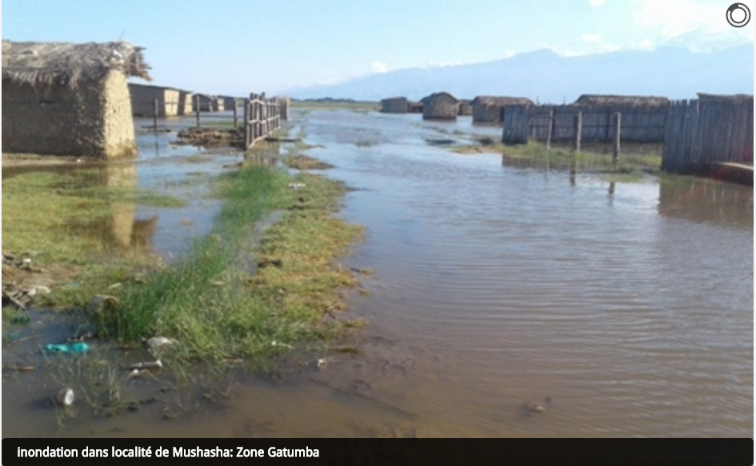
Flooding at MUSHASHA-GATUMBA in May 2016

Slide 15
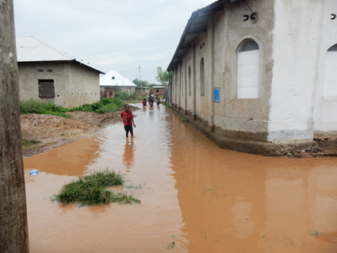

Slide 16
III. IMPACTS OF CLIMATE CHANGE: WATER RESOURCES, Hydrological risks AND HEALTH
But soil moisture is a double-edged sword as water stored in the sol:
lubricates the surface of rupture thus accelerating the movement
increases the weight of the weathered materials and crea
Create pore pressure which uplifts the weathered mantle thus reducing the shear resistance

Slide 17
IMPACTS OF CLIMATE CHANGE: WATER RESOURCES, Hydrological risks AND HEALTH
All the above factors when combined with a favorable topography and geology will trigger mass movements: landslides, debris flows, mudflows, ….
Heavy rainfall are the main triggering factor of mass movements

Slide 18
III. IMPACTS OF CLIMATE CHANGE: WATER RESOURCES, Hydrological risks AND HEALTH
Like floodings, mass movements can cause:
death and physical injuries: e.g. Nyaruhongoka (2015), (Musigati, 2013), Mabayi (2017),….
Damage to public infrastructures and private homes therefore
compelling people to be relocated in camps and the ensuing health problems (dysentery, cholera, AIDS, diarrhoeal diseases)
Damage to roads and bridges, hence disrupting access to hospitals and pharmacies, supply of medical and health services and humanitarian help to the population in need
Damage to hydropower plants, water, sewage and electricity conveyance systems,
damage to crops and livestock thus negatively affecting food security

Slide 19
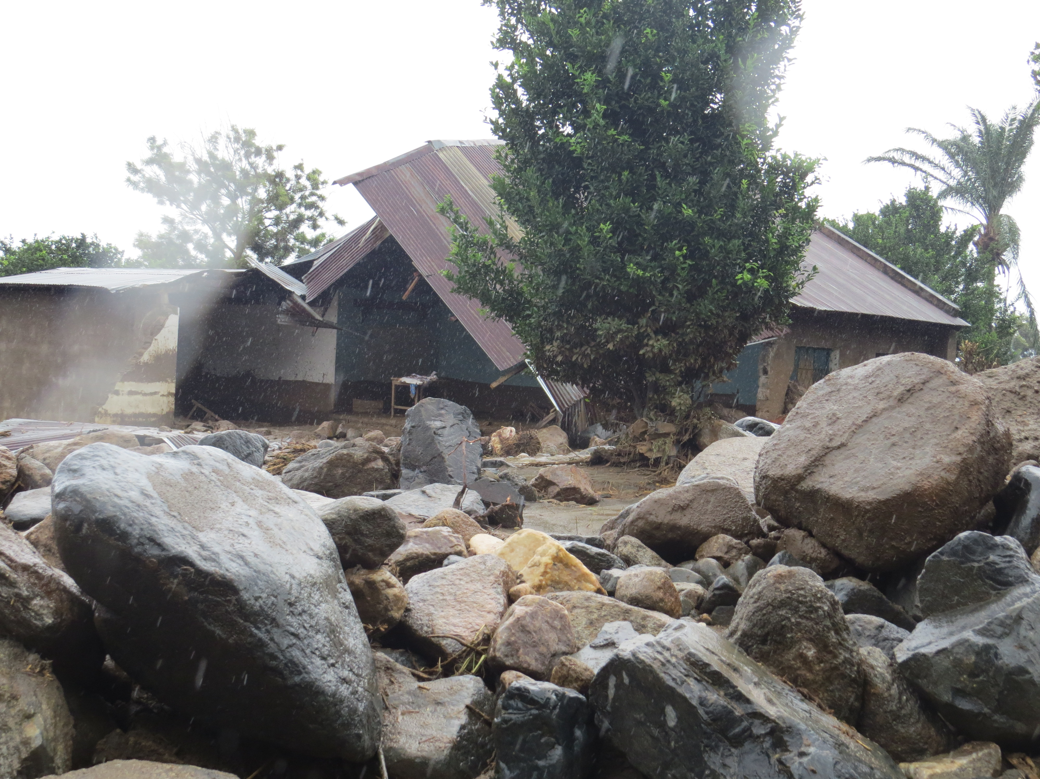
IMPACTS OF CLIMATE CHANGE: WATER RESOURCES, Hydrological risks AND HEALTH
NYARUHONGOKA 2015

Slide 20
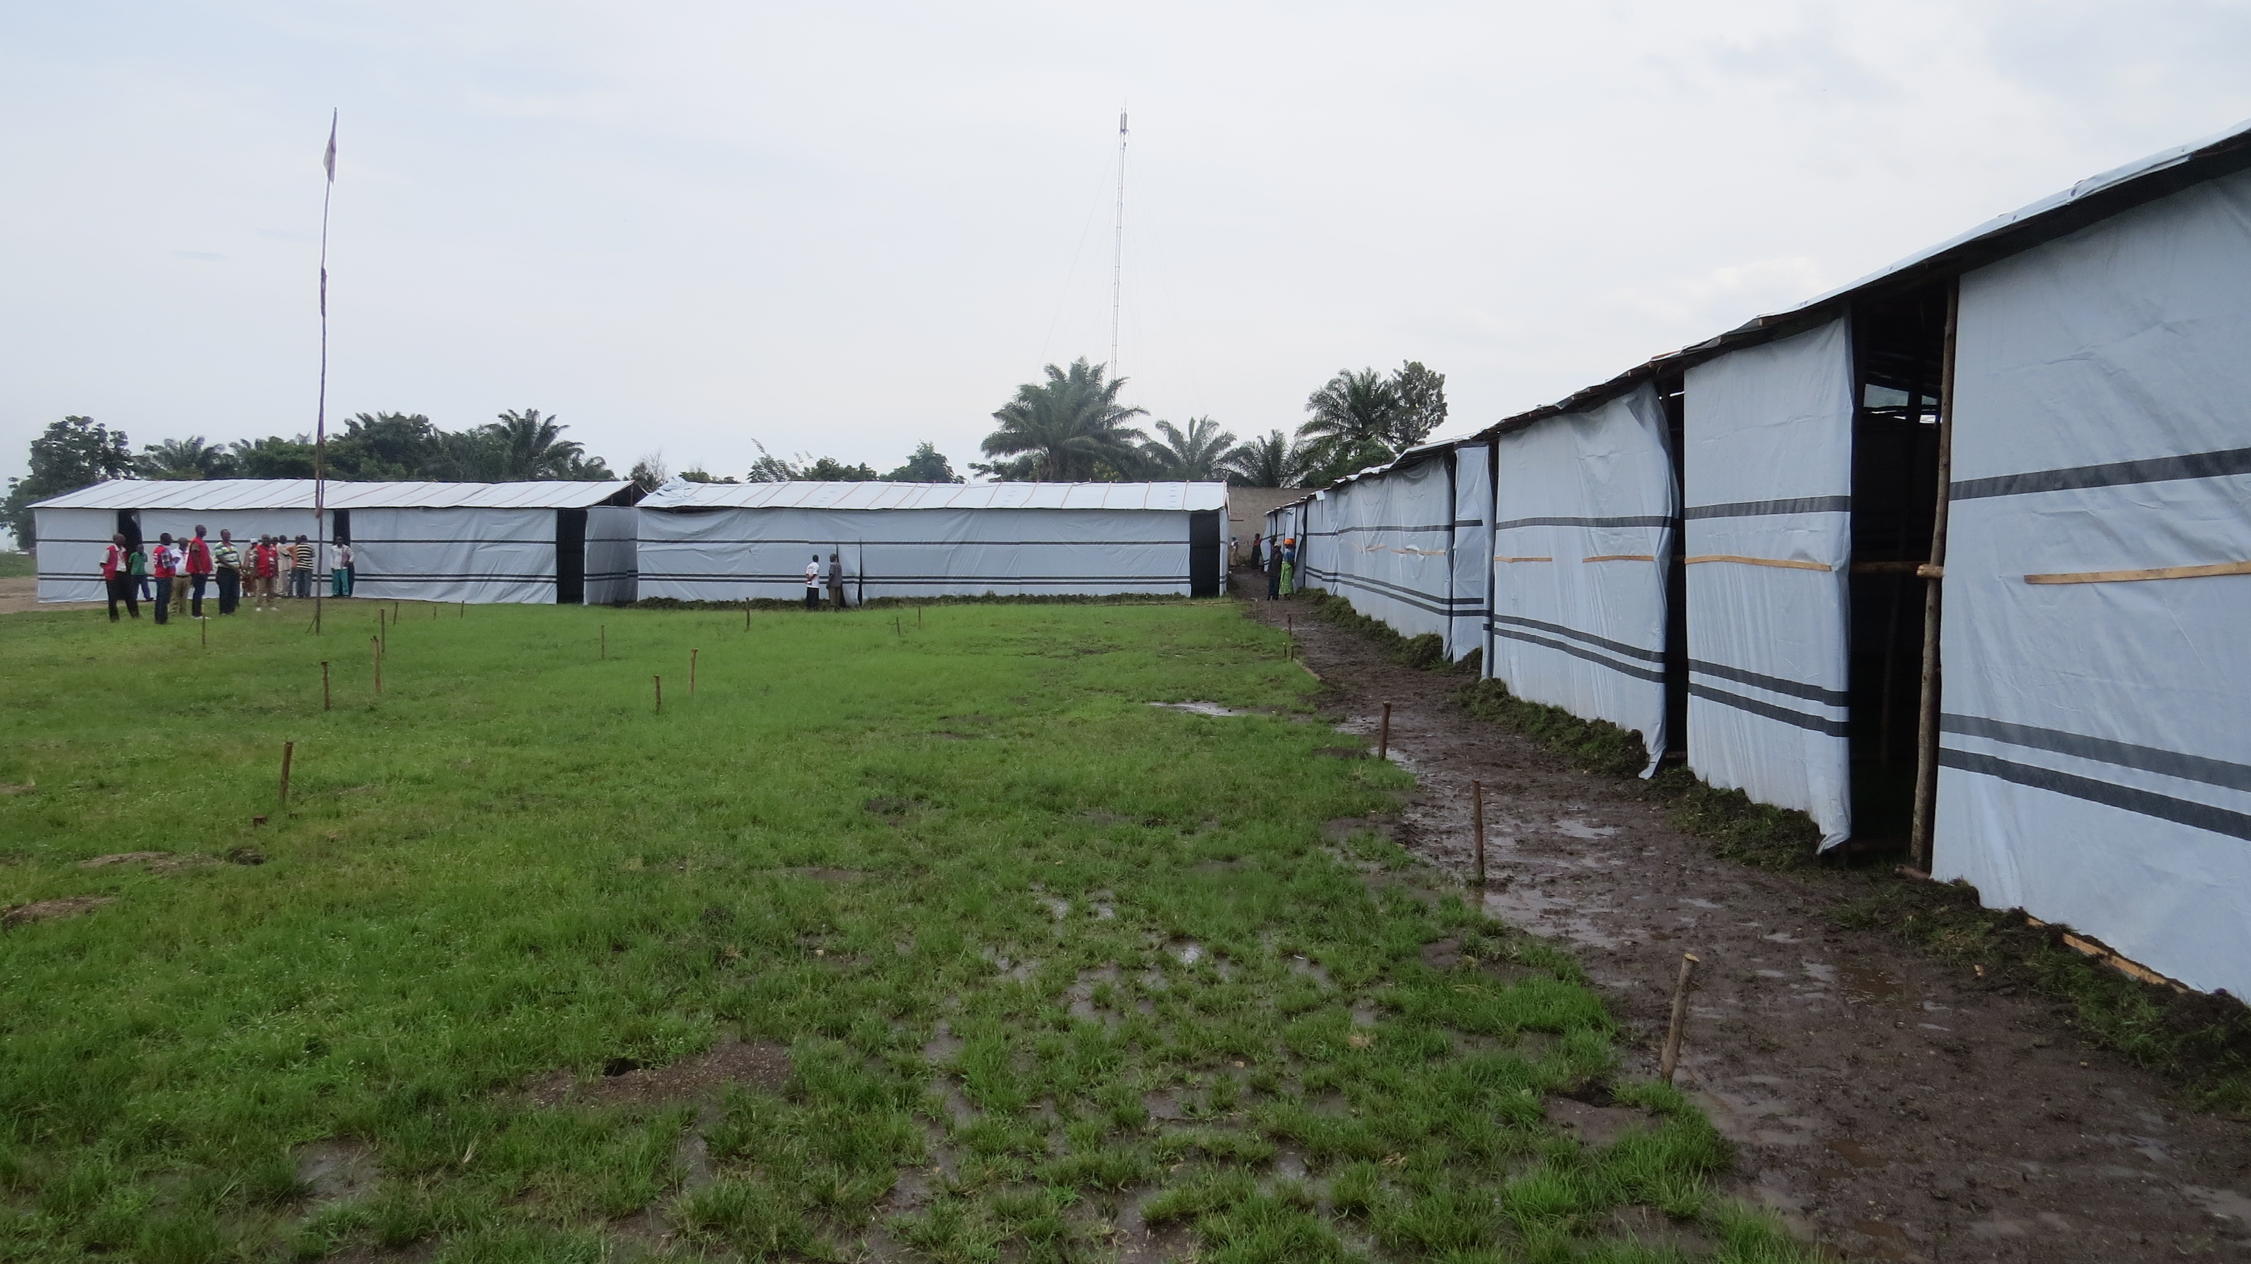
III. IMPACTS OF CLIMATE CHANGE: WATER RESOURCES, Hydrological risks AND HEALTH
Displaced persons in Nyaruhongoka after the debris flow (2015-2016)

Slide 21
IMPACTS OF CLIMATE CHANGE: WATER RESOURCES, Hydrological riscks AND HEALTH
Periods of droughts and high temperatures:
∆PAW+ ∆S_{aq}
Soil moisture (PAW) is depleted and this results in crop failure
Recharge does not take place: there is no rainfall
groundwater levels drop and this results in spring drying out
groundwater in boreholes and hand-dug wells drops sometimes below the intake of pumps
Droughts and warming temperatures result in decreases in water resources in many parts of the word, especially in water-stressed areas due to droughts such as the Mediterranean, southern Africa and northeastern Brazil

Slide 22
IMPACTS OF CLIMATE CHANGE: WATER RESOURCES, Hydrological risks AND HEALTH
Decrease in water resources compels people to use non potable water which results in proliferation of water-borne diseases.
In coastal environments, drying out of springs will lead to groundwater overabstraction with the consequent sea water intrusion in coastal aquifers: e.g. mediterranean region, Tanzania, Latine America, Southeastern Asia
Likewise, rising tempertures and droughts will lead to the déterioration of water quality through salinization of coastal aquifers and soils:

Slide 23
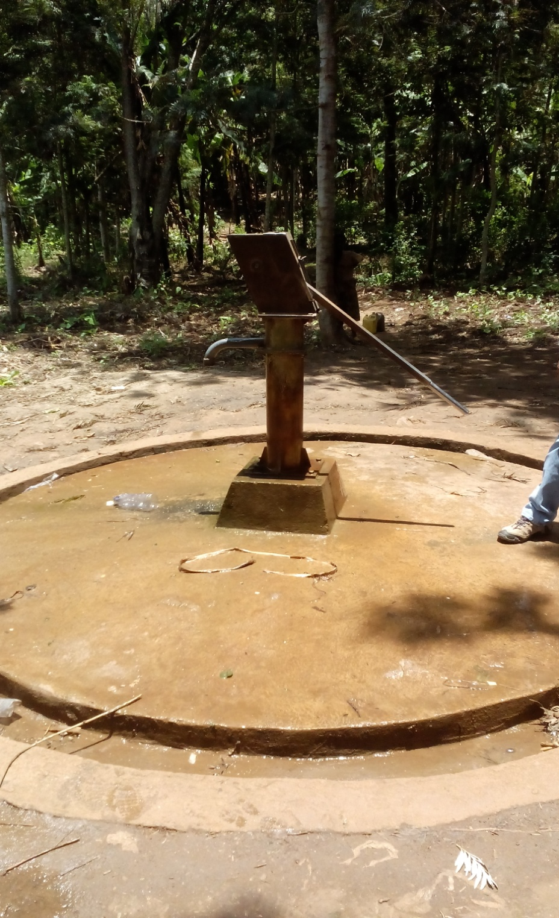
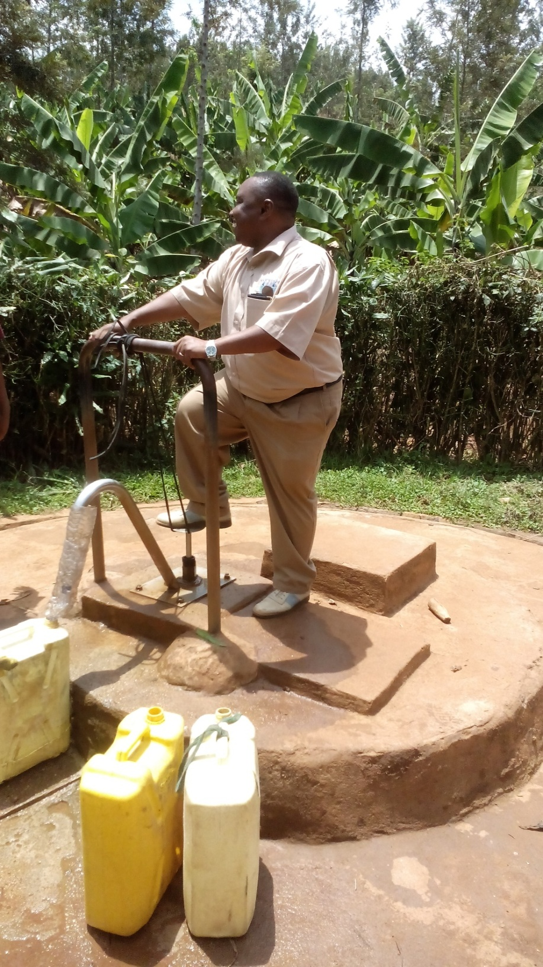
III. IMPACTS OF CLIMATE CHANGE: WATER RESOURCES, Hydrological risks AND HEALTH
Population in Kirundo relies on groundwater for potable water supply

Slide 24
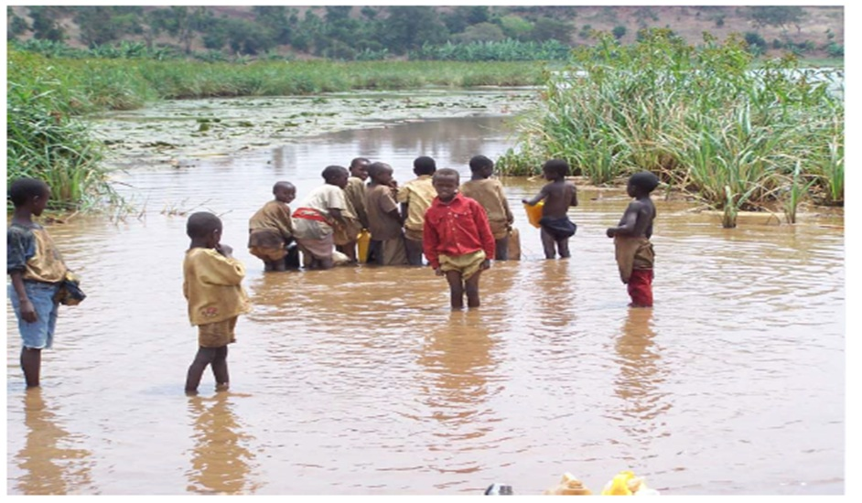
III MPACTS OF CLIMATE CHANGE: WATER RESOURCES, Hydrological risks AND HEALTH
During drought periods water level drammatically drops within the aquifer and people resort to surface water

Slide 25
III. IMPACTS OF CLIMATE CHANGE: WATER RESOURCES, Hydrological risks AND HEALTH
In periods of droughts and high temperatures:
river discharge Q_{riv} will strongly descreases
lack of water for irrigation with the consequent crop failure : food insecurity
lack of water for energy production: hydropower
conflict between water users: farmers, industries,..
loss of water-depend ecosystems with negative consequences on biodiversity
security issues: many conflicts around the world are due to water ressources like in Middle East
conflict between Syria, Israel, Palestinia and Jordania about Jourdan River
conflit between Irak, Syrie and Turkey about Euphrate and Tigre Rivers

Slide 26
IV. CONCLUSIONS AND RECOMMENDATIONS
IV. 1. CONCLUSIONS
Climate change may be charaterised by:
Extreme precipition resulting in:
availability of both surface and groundwater for human consumption and agricultural activities
Flooding and mass movements causing health problems, material and human losses, displacement of populations
water quality issues leading to health problems especially water-borne deseases
Floods also create a suitable envornment for proliferation of vectors of some diseases like mosquitoes
Disruption of road network,electricity, water supply and sewage systems

Slide 27
IV. CONCLUSIONS AND RECOMMENDATIONS
IV. 1. CONCLUSIONS
Climate change may be charaterised by:
b. Erratic rainfal, droughts and high temperatures causing:
scarcity of potable water and cosequents health problems steming from the consumption of poor quality water
water deficit in main growing seasons for crops and consequent crop failure
scarcity of water resources for differents uses: energy production, industial and domestic uses
deterioration of water quality:e.g. Salinization and salt water intrusion

Slide 28
IV. CONCLUSIONS AND RECOMMENDATIONS
IV. 2. Recommendations
Impacts of climate change and variability on health and water resources should be anticipated and adaptation measures adopted in time
Excess rain water resulting from extreme rainfall events should be harnessed through rain harvesting systems in order offset erratic rainfall or drought
A common early warning system should be established in EAC in order to avoid human and some material losses due to climate change and variability
collaborative research through a multidisciplinary team should be strenghthened in EAC in order to tackle and constantly monitor this important issue of climate change and variabilty
Les zones prédisposées aux mouvements gravitaires peuvent être facilement identifiées et cartographiées par des techniques actuellement à notre portée
Les surplus d’eau peuvent être collectées et stockées en prévision du phénomène contraire à EL NINO: LA NINA Systèmes de collecte des eaux pluviales

Slide 29
Thank you
Merci
Asante

