Slide 1
JUMUIYA YA AFRIKA MASHARIKI
The 6th EAHSC
HBV/HCV + HIV co-infection
Prof Rénovat NTAGIRABIRI
University of Burundi
Faculty of Medecine

Slide 2
I. DEFINITIONS
- HVB chronique (Ag HBs+ > 6 mois)
● virus sauvage (Ag HBe+ & Ac anti-HBe-)
ADN > 20 000 UI/ml, Transa > 2N
● virus mutant pré-C (Ag HBe- & Ac anti-HBe+)
ADN > 20 000 UI/ml, Transa > 2N
(2000 UI/ml si VIH+)
- HVC (Ac anti-VHC+) : ARN VHC ⊕, Transa > N
Lok, McMahon. Hepatology 2004 (AASLD Guidelines)
EASL Consensus Statement. J Hepatol 2003; Sup 1
Gastroenterol Clin Biol 2002; 26

Slide 3
II. PREVALENCE
Prevalence | Occident |  | Afrique
 | VIH (-) | VIH (+) | VIH (-) | VIH (+)
Ag HBs (+) | < 1% | 10% | 8-15% | 8-15%
Ac anti-HBc (+) | < 10% | 30% | 60-90% | 60-90%
HVB chroniques | 5-10% | 20-30% | 10% | 30%
Ac anti-VHC* | 1-5% | 20-45% | 1-3% | 1-3%
Pol S. Gastroenterol Clin Biol 2002
Combe P. Trans R Soc Trop Med Hyg. 2001
Rouet F. J Med Virol. 2004;74(1):34-40 ; Mphahlele. J Clin Virol. 2006 Jan;35(1):14-20
* : Égypte & Cameroun ≥ 10%

Slide 4
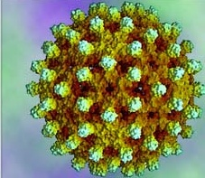
Prevalence of co-infection VIH-VHB
Sang
Sécrétions
Lait maternel
n (VIH+) = 40.3 millions
n (VHB+) = 400 millions
n(VIH-VHB) = 2 – 4 millions (VIH-VHB) / 40 millions (VIH)
UNAIDS 2006 Report on the Global AIDS Epidemic – WHO Report on hepatitis B, 2004

Slide 5
Frequency of co-infection VIH-VHB in Africa
* Kenya : 53 % (patients VIH + with jaundice)
(Otedo et al., East Afr Med J
* Tanzanie : 8,8 % of blood donors
(Matee et al., BMC Public Health 2006)
* Malawi: 20.4% VIH/VHB
(Nyiremba M, J Infect 2008)
* Mali : 21,5% chez tout PVVIH
(DAO S et al., Médecine d’Afrique Noire 2007 - 54 (10):485-88)
* Nigéria : 9,7% chez des PVVIH sous ARV
(Ejele et al., Niger. J Med. 2004 ; 13 (2):175-9)
* Bénin : 11,2% chez des PVVIH sous ARV
(cohorte du CTA/ CHU, Cotonou à juin 2007)

Slide 6
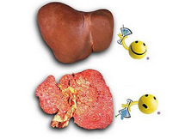
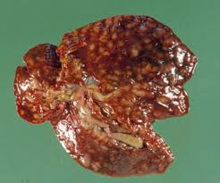
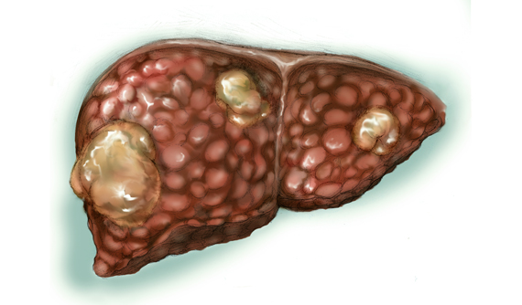
Evolution of liver disease: Cirrhosis, Hepatocellular carcinoma

Slide 7
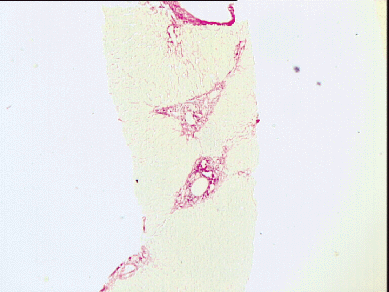
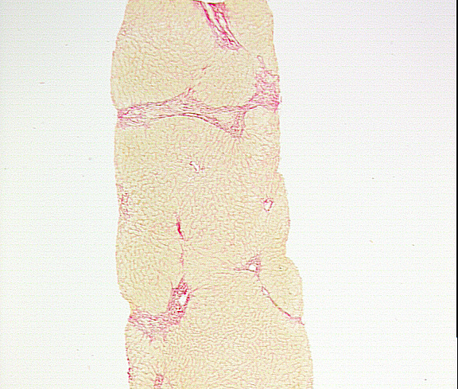
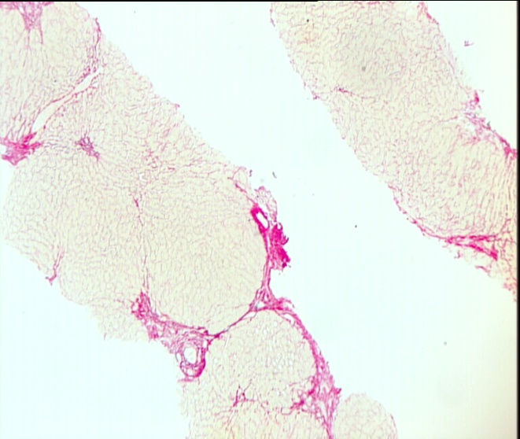
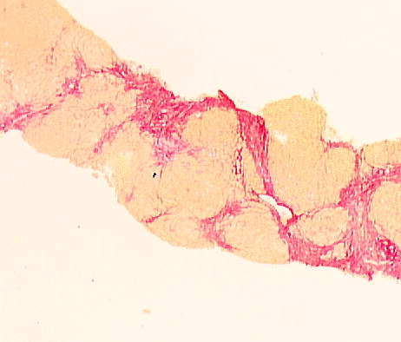
Liver biopsy: METAVIR score
F1
F 2
Fibrose portale sans septa
Fibrose portale + septas
F3
F4
Fibrose septale
Cirrhose

Slide 8
Liver
Serum : FibroTest
lésions hépatiques
Alpha2Macroglobulin
Bilirubine totale
Gamma GT
Apolipoproteine A1
Matrice extracellulaire
Cellules étoilées
Haptoglobine
Imbert-Bismut, Lancet 2001

Slide 9
Liver fibrosis: Fibrotest®
FibroTest | METAVIR Stade de fibrose estimé | Knodell Stade de fibrose estimé | Ishak Stade de fibrose estimé
0.75-1.00 | F4 | F4 | F6
0.73-0.74 | F3-F4 | F3-F4 | F5
0.59-0.72 | F3 | F3 | F4
0.49-0.58 | F2 | F1-F3 | F3
0.32-0.48 | F1-F2 | F1-F3 | F2-F3
0.28-0.31 | F1 | F1 | F2
0.22-0.27 | F0-F1 | F0-F1 | F1
0.00-0.21 | F0 | F0 | F0

Slide 10
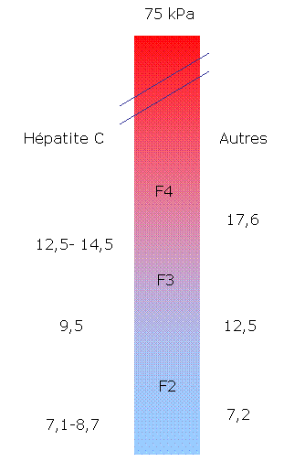
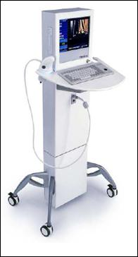
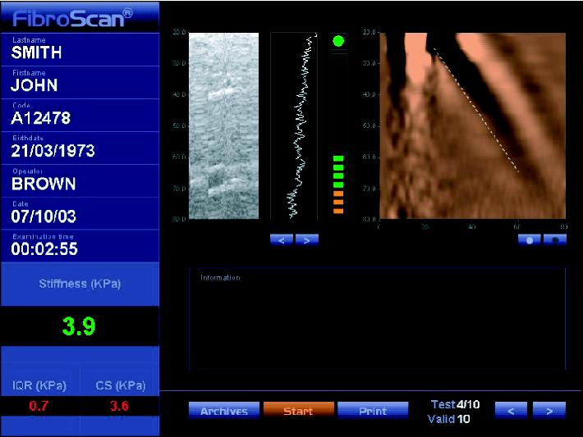
Liver fibrosis: Fibroscan®

Slide 11
Impact of co-infection HIV-B-C
HBV
HCV
VIH
HBV /VHC  réplication du VIH in vitro
HBV/HCV  hépatotoxicité des ARV & MDCTS IOs

Slide 12
Co-infection HBV + VIH

Slide 13
HBV+ HIV Coinfection (1)
Before initiation of antiretroviral therapy (ART), all patients who test positive for hepatitis B surface antigen (HBsAg) should be tested for hepatitis B virus (HBV) DNA using a quantitative assay to determine the level of HBV replication (AIII).

Slide 14
HBV+ HIV Coinfection (2)
Because emtricitabine (FTC), lamivudine (3TC), tenofovir disoproxil fumarate (TDF) and tenofovir alafenamide (TAF) have activity against both HIV and HBV
For patients coinfected with HIV and HBV, ART should be initiated with the fixed-dose combination of TDF/ TAF+FTC or TAF/TAF+3TC as the nucleoside reverse transcriptase inhibitor (NRTI) backbone of a fully suppressive antiretroviral (ARV) regimen

Slide 15
HBV+ HIV Coinfection (3)
If TDF or TAF cannot safely be used, the alternative recommended HBV therapy is entecavir in addition to a fully suppressive ARV regimen.
Entecavir has activity against HIV; its use for HBV treatment without ART in patients with dual infection may result in the selection of the M184V mutation that confers HIV resistance to 3TC and FTC.
Therefore, entecavir must be used in addition to a fully suppressive ARV regimen when used in HBV/HIV coinfected patients
Peginterferon alfa monotherapy may also be considered in certain patients.

Slide 16
HBV+ HIV Coinfection (4)
Other HBV treatment regimens including adefovir alone or in combination with 3TC or FTC and telbivudine are not recommended for HBV/HIV coinfected patients.
Discontinuation of agents with anti-HBV activity may cause serious hepatocellular damage resulting from reactivation of HBV; patients should be advised against stopping these medications and carefully monitored during interruptions in HBV treatment.
If ART needs to be modified due to HIV virologic failure and the patient has adequate HBV suppression, the ARV drugs active against HBV should be continued for HBV treatment in combination with other suitable ARV agents to achieve HIV suppression.

Slide 17
A Phase 3 Study of Tenofovir Alafenamide Compared With Tenofovir Disoproxil Fumarate in Patients With HBeAg-Negative, Chronic Hepatitis B: Week 48 Efficacy and Safety Results
Tenofovir alafenamide (TAF)
New tenofovir (TFV) prodrug; greater plasma stability than TDF^{1–3}
Enhances delivery of active drug (TFV-DP) to hepatocytes^{1–3}
Reduces circulating levels of TFV relative to TDF^{4,5}
Improved bone and renal safety demonstrated in HIV patients^{5,6}
94
93
HBV DNA <29 IU/mL, %
268/285
130/140
TAF
TDF
Treatment difference (95% CI): +1.8% (-3.6%, +7.2%); p=0.47
Reasons for failure: HBV DNA ≥29 IU/mL (2% TAF; 3% TDF); missing data (<1% TAF; 1% TDF); D/C for AE (1% TAF; 1% TDF); D/C for other reasons (2% TAF; 3% TDF).
Buti M et al. EASL 2016

Slide 18
Co-infection HCV + VIH

Slide 19
Impact of HIV infection on HCV disease progression
Several studies have demonstrated that patients coinfected with HCV and HIV have:
More rapid fibrosis progression than monoinfected patients, even after taking into account age, sex and alcohol consumption
People with HCV/HIV coinfection may have quantitative and/or qualitative deficiency in their immune responses to HCV.
HIV accelerates the course of HCV-associated liver disease, particularly in patients who are more severely immune deficient, by increasing: the HCV viraemia level from two- to eightfold, resulting in a significant decrease in spontaneous rec overy from acute hepatitis
Ragni MV et al. 2009 ; Opravil M, et al (2008)
Notes:
Several studies have demonstrated that patients coinfected with HCV and HIV have:
More rapid fibrosis progression than monoinfected patients, even after taking into account age, sex and alcohol consumption
People with HCV/HIV coinfection may have quantitative and/or qualitative deficiency in their immune responses to HCV.
HIV accelerates the course of HCV-associated liver disease, particularly in patients who are more severely immune deficient, by increasing: the HCV viraemia level from two- to eightfold, resulting in a significant decrease in spontaneous
Rec overy from acute hepatitis

Slide 20
Impact of HIV infection on HCV disease progression (2)
The risk of mother-to-child and sexual transmission: 6% to 20% and from 0% to 3%, respectively
Rates of liver fibrosis (two- to fivefold), cirrhosis, decompensation, hepatocellular carcinoma (HCC) and liver-related mortality.
SO, the liver disease is the leading cause of morbidity and mortality in HCV/HIV-coinfected patients in some parts of Europe.
Notes:
° the risk of mother-to-child and sexual transmission (from averages of 6% to 20% and from
0% to 3%, respectively); and
° rates of liver fibrosis (two- to fivefold), cirrhosis, decompensation, hepatocellular carcinoma
(HCC) and liver-related mortality (25).
• Liver disease is the leading cause of morbidity and mortality in HCV/HIV-coinfected patients in
some parts of Europe, despite the suggestion that HAART, especially protease inhibitors, may
decrease the severity of liver disease and the related mortality (1).

Slide 21
Impact of HIV infection on HCV disease progression
Comorbidities with hepatic consequences (drug hepatotoxicity, HBV, steatosis, alcohol or drug abuse) are frequent
Patients with CD4 <200 cells/mm3 are those most likely to progress to severe liver
In profoundly immunosuppressed patients, HCV serology has occasionally been found to be falsely negative despite HCV chronic infection.
Spontaneous clearance of HCV is significantly lower in HIV-infected patients than in immunocompetent

Slide 22
TREATMENT HCV
Inhibiteurs de protéase
SimePREVIR
AsunaPREVIR
DanoPREVIR
SovaPREVIR
VedroPREVIR
VaniPREVIR
ParitaPREVIR
GrazoPREVIR
Inhibiteurs de NS5A
DaclatASVIR
LedipASVIR
OmbitASVIR
SamatASVIR
ElbASVIR
VelpatASVIR
Inhibiteurs de NS5B
SofosBUVIR
DeleoBUVIR
DasaBUVIR
SetroBUVIR
BeclaBUVIR

Slide 23
HCV treament
Paritaprevir
Ombitasvir
Viekirax®
Sofosbuvir
Ledipasvir
Harvoni®
Grazoprevir
Elbasvir
Zepatier®
Sofosbuvir
Sovaldi®
Simeprevir
Olysio®
Daclatasvir
Daklinza®
Dasabuvir
Exviera®
2014
2015
2016
Janvier
Mai
Septembre
Novembre
Janvier

Slide 24
Concurrent Treatment of HIV and Hepatitis C Virus Infection
Concurrent treatment of HIV and HCV is feasible
but treatment may be complicated by pill burden, drug-drug interactions, and toxicities.
In this context, the stage of HCV disease should be assessed to determine the medical need for HCV treatment and to inform the decision on when to start treatment.
ART regimen may need to be modified before HCV treatment is initiated to reduce the potential for drug-drug interactions and/or toxicities
Notes:
Concurrent treatment of HIV and HCV is feasible, but treatment may be complicated by pill burden, drugdrug
interactions, and toxicities. In this context, the stage of HCV disease should be assessed to determine
the medical need for HCV treatment and to inform the decision on when to start treatment. Additional
guidance on the treatment and management of HCV in HIV-infected and uninfected adults can be found at
http://www.hcvguidelines.org/. If the decision is to treat HCV, the ART regimen may need to be modified
before HCV treatment is initiated to reduce the potential for drug-drug interactions and/or toxicities that may
develop during the period of concurrent HIV and HCV treatment.

Slide 25
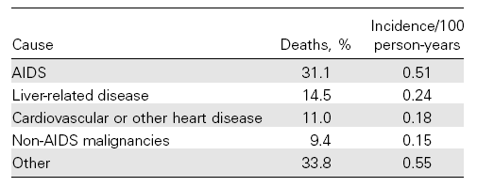
Co-infection HIV-B-C
Weber R, Arch Intern Med 2006

Slide 26
CONCLUSION (1)
Patients HIV–HBV (AgHBs+) should:
Treated with tenofovir based regimen: (TDF+3TC based in Burundi /EAC)
Should have an active trt again HBV when TENOFOVIR (or TAF cannot safely be used)
Should have a followup according to the liver stage: should have an assessment of liver fibrosis or Ultrasound and Upper endoscpy
5. Screen and Treat HBV monoinfected patients:
Program HIV-hepatitis
6. Vaccination / Immunization !!

Slide 27
CONCLUSION (2)
Patients HIV –VHC (ARN+):
Should have assessment of liver fibrosis or Ultrasound and Upper endoscpy
Should have a follow up
Should have treatment (before or concomitant treatment: SVR : 95%)
Take into account drug interaction!!!

Slide 28
Thank you for your attention

