Slide 1
Integrating SRHR/HIV/TB and SGBV
Delivering a world where every pregnancy is wanted, every childbirth is safe and every young person's potential fulfilled.
Richard Delate
HIV/SRHR Programme Specialist
01 February 2016

Slide 2
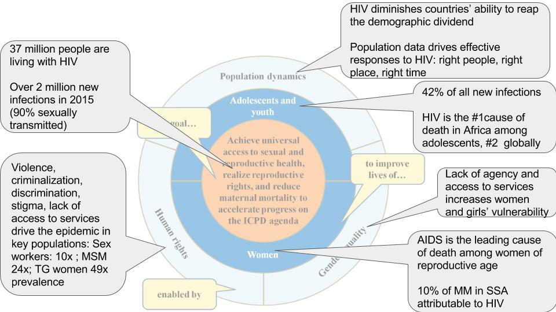
SRHR/HIV - Adolescents - Women
At centre of UNFPA’s work

Slide 3
UNFPA & Adolescent Sexual RH in
East & Southern Africa
UNFPA supports countries to scale up comprehensive sexuality education in line with the ESA commitment.
pre-service and in-service teacher training module
Developing scripted lesson plans.
Assesses the quality of services for young people and advocates for the scale-up & institutionalization of Adolescent and Youth Friendly Health Services in pre-and in-service training programmes.
Our flagship programme - Safeguard Young People (SYP) identifies and scales up promising practices engaging young people on SRHR/HIV in 8 Southern African countries

Slide 4
Key Concepts: Linkage and Integration
Integration
Linkages: The bi-directional synergies between laws, policies, programmes, services and advocacy around SRHR/HIV, recognising that SRH and HIV share root causes in poverty, gender inequality, gender based violence and social marginalisation.
Integration: The process of bringing together in a holistic manner diferrent kinds of related SRH/HIV interventions at the levels of legislation, policy, programming and service delivery to ensure access to comprehensive integrated SRHR/HIV/TB and SGBV services in an efficient and effective manner.

Slide 5
The UNFPA/UNAIDS
SRHR/HIV Linkages Project 2011 – 2015

Slide 6
Integrating SRHR/HIV/TB and SGBV
Using every opportunity to prevent, screen/test and ensure access to treatment
SRHR
HIV
TB
SGBV
HIV
TB
HIV
SRHR
SGBV
TB
HIV
SRHR
SGBV
SGBV
SRHR
HIV
TB

Slide 7
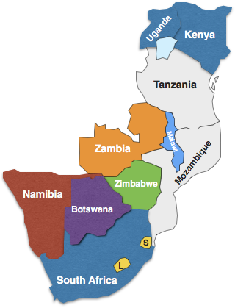
Countries and Models of Implementation
7 Countries participated in the Linkages project from 2011 – 2015 funded by the EU Commission & SIDA.
2015 – 3 additional countries added – Kenya, South Africa & Uganda
  Countries implement a mix of models including
  one stop shop (Kiosk) – all services provided on service provider in one room
  supermarket model – clients are referred (linked) to points in sites.
  mall model referral clients receive specialised services – e.g. hospitals.

Slide 8
Output 1: Creating an Enabling Environment
All 7 Countries incorporated a commitment to provide integrated SRHR/HIV services into different national health, broader development strategies and plans.
  Lesotho, Malawi, Zambia and Zimbabwe incorporated a commitment to deliver integrated SRHR/HIV services for adolescents within their adolescent reproductive health strategies.
  SADC developed minimum standards on SRHR/HIV Integration.
  7 countries integrated SRHR and HIV into relevant SRHR and HIV national guidelines.
  Two countries, incorporated the provision of SRHR/HIV services into their national guidelines on adolescent youth friendly health services.
  Evaluation Finding: Project was successful in “advocating for the development, and adaptation of existing policies, guidelines to integrate HIV/SRHR”. UNFPA and UNAIDS should continue efforts to integrate SRHR/HIV into policies, programmes and services. Ministries of Health (MOHs) should lead the process.

Slide 9
Output 2: Integrated Service delivery
52 sites successfully piloted the delivery of integrated SRHR/HIV in all 7 countries.
  Training curricula developed for health care workers & community health care workers,
  The most common additional service provided was HIV counselling and testing.
Clients regard integrated SRHR/HIV services relevant to their needs and circumstances. Family planning and primary health care services are common entry points for people accessing services integration enables opportunities to test, identify and initiated patients on treatment, and is a good strategy to contribute towards the attainment of the 90-90-90 goals.
Ministry’s of Health should expand the provision of integrated services with complementary programmes, such as community mobilisation, as it contributes towards improved health outcomes.

Slide 10
CHALLENGES TO INTEGRATION
Staff rotation and shortages and perceived increased workloads (because of integration) can undermine the integration.
Labelling of services (HCT/FP etc) is a deterrent for people to access services, owing to perceived stigma and discrimination.
Men and boys largely underserved owing to health care worker attitudes, men’s attitudes towards services and masculinity. Lack of male involvement barrier for partners to access services.
Wider social and cultural beliefs relating to the SRH of young people, adolescents, PLHIV and key populations undermine service delivery by health care workers in spite of training and sensitisation.
Reporting burden lack of harmonisation of linkage indicators into national M&E systems and a lack of analysis of collected data.

Slide 11
Key Recommendations
Institutional strengthening to ensure adolescent health and youth friendly SRHR friendly are part of the process of scaling up the provision of integrated SRHR/HIV services.
Remove legal and policy barriers for young people to access SRHR/HIV and SGBV services, for example, age of consent.
Integrate SRHR/HIV into pre-service curricula and capacity building plans for continuous professional development for HCWs.
Improve health profiling (risk assessment) of clients to ensure that they receive a comprehensive set of SRHR/HIV and SGBV services.
Ensure that all youth receive comprehensive sexuality education that includes referral to SRHR/HIV services.
Strengthening demand creation to support programme implementation, communities and integrated health care services.
Strengthen the provision/referral from and to social and non-facility based health-related services within communities through working with traditional leaders, community leaders

Slide 12


BENEFITS OF INTEGRATING HIV AND SRH SERVICES
Case Study: NAMIBIA
A PEOPLE-CENTRE INTEGRATED APPROACH
Ms .D. Diergaardt (MOHSS) / L. Amkongo (UNFPA)
HIV prevention and Sexual and Reproductive Health and Rights for Adolescent Girls and Young Women Regional Meeting
Windhoek Namibia
01 February 2017

Slide 13
Background
Namibia has a generalized HIV epidemic with a HIV prevalence of 17.2% and high antiretroviral (ARV) coverage over (90%).
There is high coverage of Antenatal Care (97%), skilled deliveries (88%) and prevalence of modern contraceptive use (50%).
Maternal mortality (385/100,000), teenage pregnancy ( 19%) and unmet need of Family Planning (FP) (12%)
HIV and SRH services were provided in silos (HIV clinic, FP services, Malaria, TB clinic)
Seven (7) health facilities implementing the model & 2 new across the country
The country has adapted the “ one stop shop” approach (“ one provider”, “one client”, “ one room”)
Namibia has a conducive policy environment & guidance in place
Notes:
In some regions teenage pregnancy rate is above 30%

Slide 14
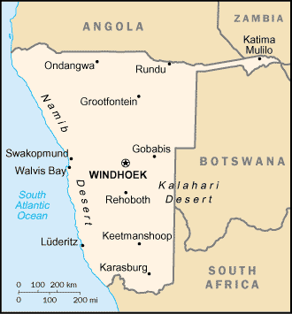
PILOT HEALTH FACILITIES
The Model: Clients assigned to a health care worker in a health facility that speaks their language. From that point on the client is always seen by the same health care provider in the facility who provides a comprehensive package of SRHR/HIV services.
1-Hakahana (Windhoek)
2-Khomasdal (Windhoek)
3-NAPPA (Windhoek)
4-Epako (Gobabis)
5-Nau Aib (Okahandja)
6-Okankolo (Oshikoto)
7-Kanono (Caprivi)

Slide 15
Methodology
. Pre and Post Integration assessment
Data collected in the 7 pilot facilities for 1 week in 2012 & 2013 for Pre-baseline assessment and post assessment done in 2015)
Structured observations of client -provider interactions
Client flow analysis ( tracked using a tool)
Pre-baseline assessment - 105 first antenatal care (ANC) clients tracked, and for post-implementation assessment -5,452 clients and 98 first ANC’s
Client exit interviews.
Data collected was compared against routine programme data (District Health information system , Electronic patient monitoring data , Electronic TB Register).
Notes:
Pre baseline assessment was conducted between 2012- 2013.
7 facilities selected – included two public health centres, four clinics and one none –governmental clinic. Providing a range services for example three of these facilities provided ARVs, one clinic provided only first ANC,, FP, and HIV counselling.
All 7 facilities are located in five regions across the country , two in rural areas and urban environment.
All facilities open from 8-17, one health centre opened 24 hours
Structured observations done without interference from observers.
Clients tracked by using a tool ( numbers given to health care workers indicated time spend by clients with them and services provided.
Client interviews - asked how they rated the services using scale “good , very good, poor , satisfactory”
Routine data - DHIS district health information system, Electronic Patient Monitoring Data System, ETR- Electronic TB Registers
Data was collected at each facility for one week, from Monday – Friday

Slide 16
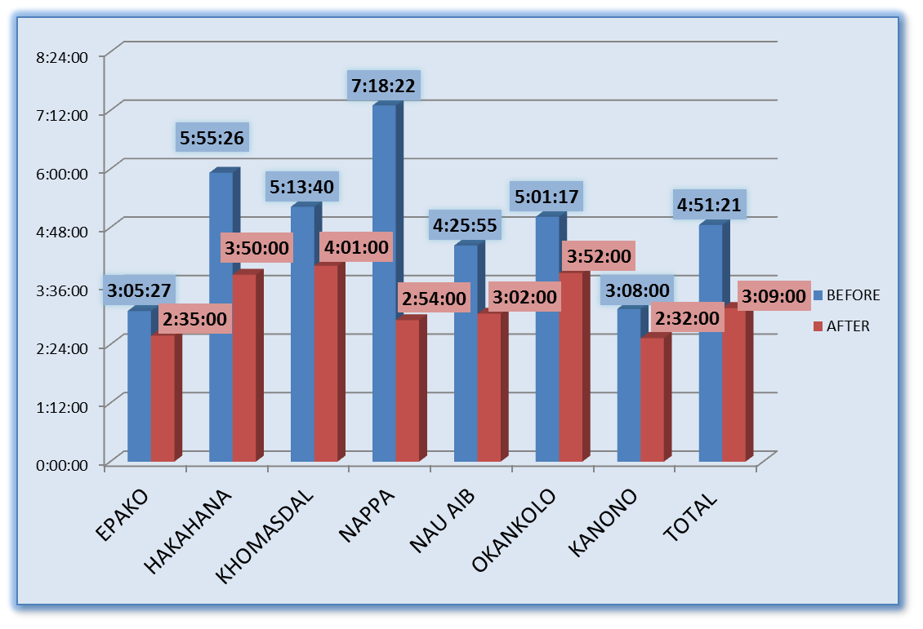
Results Waiting Times for First ANCs in facility
Waiting times at health facility (waiting to be seen) reduced by 1 hour 40 minutes.
A reduction of 35.1% on waiting times
Figure 1: Total time in the clinic to get a first ANC service
Notes:
Waiting times at health facility (waiting to be seen) reduced from 4.51:21 minutes to 3:09.00 minutes.
There is an overall reduction of 35.1%

Slide 17
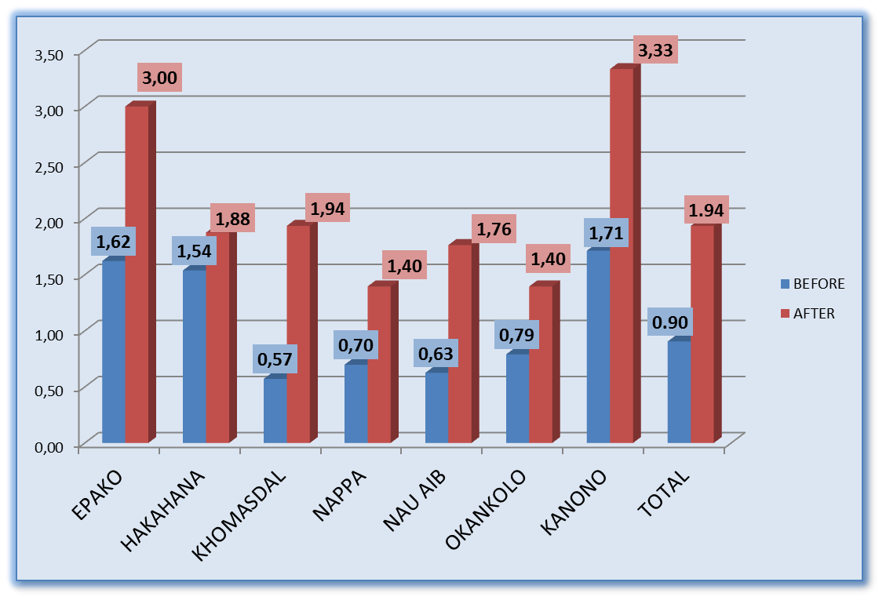
Results: Nurse Productivity for first ANC
Health Care worker productivity increased by53.6%.
Productivity was measured by the number of antenatal clients, per nurse, per hour .
Notes:
Productivity was measured by the number of antenatal clients, per nurse, per hour .
Productivity improved from 0.9 -1.94 patients per nurse, per hour
This implies increase productivity by 53.6% with new model

Slide 18
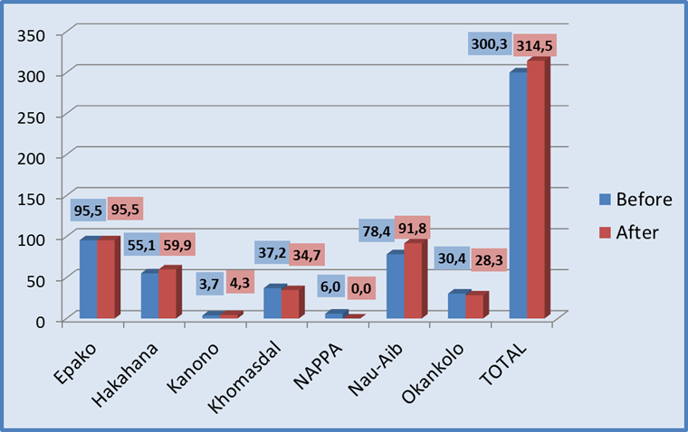
Results Services Utilization : Uptake of First ANCs
The number of first antenatal care clients per month increased by 4. 5 %. through making services available daily
Kanono and Nau-Aib had the highest increase with 60.4 % and 14.6% respectively.
Notes:
The number of first antenatal care clients per month increased with 4. 5 %. ( why because services are offered From Monday to Friday unlike pre –integration)
Kanono and Nau-Aib had the highest increase with 60.4 % and 14.6% respectively.

Slide 19
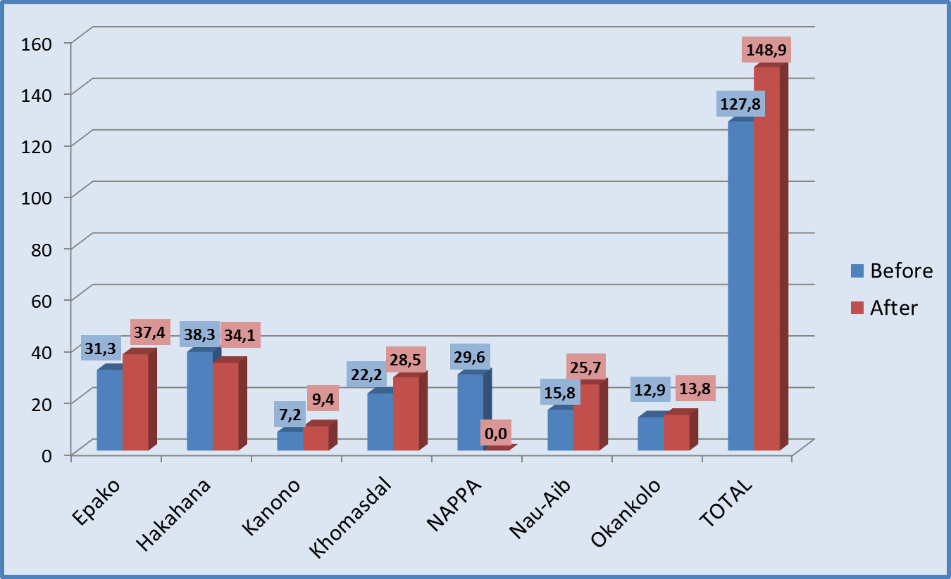
Results: Service Utilization: First Family Planning Before and After
The number of first family planning visits increased by 14.7% - mostly adolescents and young girls.
The highest increase were Nau-Aib (62.2%), Kanono (30.1%) and Khomasdal (28.4%). Only Hakahana reduced the number of first visits (-11.1%).
Notes:
The number of family planning first visits increased by 14.7% - which in most cases first FP is accessed by adolescents and young girls. This can imply that young people are accessing services.
The highest increase were Nau-Aib (62.2%), Kanono (30.1%) and Khomasdal (28.4%). Only Hakahana reduced the number of first visits (-11.1%).

Slide 20
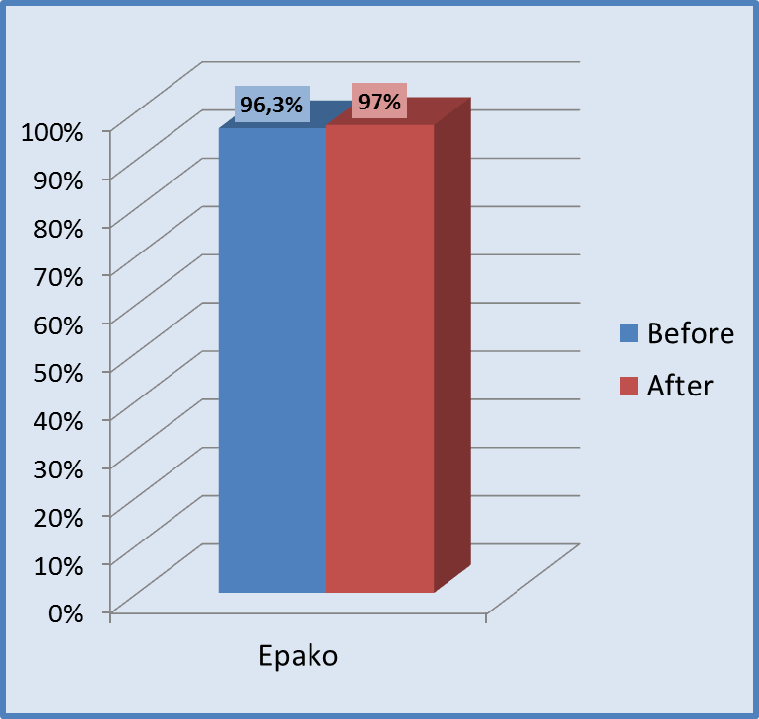
Results: Service Utilization: Services Utilization : TB cure rate
There was no real change in the TB cure rate which remained the same before and after integration.
Notes:
There is general concern (from some health workers) not to integrate TB and HIV programmes with all other services is that the quality of these services could be compromised.
Cure rate is the number of patients who initially had positive sputum and were cured , TB success rate is number of patients with positive sputum, who were cured and completed treatment
However, data from this study shows that TB treatment cure rate and treatment success rate has slightly improved (from 92.3% to 99%) with the person-centred integrated model.

Slide 21
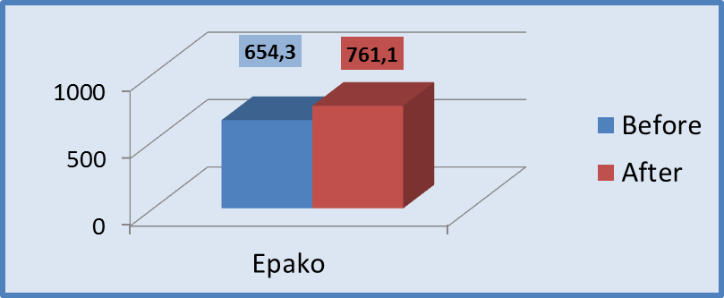
Results
Service Utilization: Number of Routine refills or ARVs per month
Number of patients collecting time routine refills per month increased (18%) attributed to the removal of disease labels from doors, and integrating HIV services into SRH services.

Slide 22
Key Findings
Improved acess to services ( all services provided from Monday to Friday)
The new model focus on the “persons” not diseases
Improved nurse productivity and workload distribution.
Reduced patient waiting times
Improved provider – client communication and minimized stigma
Improved uptake of services such as first ANCs, HIV, TB and first Family Planning
The patient centered approach improved many health outcomes for clients in Namibia and this approach can be replicated in other countries.
Notes:
In pre –baseline language was not factor – but in the new model the client is able to receive services in own language

Slide 23
Conclusions
This Model be replicated
  Reorganization of facility (space, staff distribution, numbering rooms)
  Client allocation system ( to nurses, using language);
  Staff capacity building onsite trainings)
  Equipment, drugs, IEC and registers,
  Staff Meetings
Community Mobilisation, establishing links with community leaders
The organization of services using the ‘one nurse, one patient, one room’ model has the potential to improve nurse productivity, reduce patient waiting times by half, and reduce stigma and discrimination.
A time-motion study -suggests that improvements in infrastructure, patient flow, and capacity building have the potential to improve efficiencies and the overall quality of care provided to clients.
Country committed to Scale up
Political commitment

Slide 24
Put People First!!!
Arrange your services around the needs of people – not around diseases ,programs and funding priorities .
Thank You

