Slide 1
Integration of services for Reproductive, Neonatal, Maternal, Child, Adolescent Health (RMNCAH), HIV, Sexually Transmitted Infections (STI)
Available Resources
EAC Symposium on Integration of Reproductive Maternal Newborn, Child and Adolescent Health and HIV/AIDS.
Integration of Policy, Strategy, Services and Programmes for Improved Economy, Effectiveness and Efficiency
Morkor Newman Owiredu
WHO IST ESA

Slide 2
Summary
Integration:
“The organization and management of health services so that people get the care they need, when they need it, in ways that are user-friendly, achieve the desired results and provide value for money.”
Different services or operational programmes that can be joined to ensure and maximize collective outcomes.
Based on the need to offer comprehensive services that are client focused
Linkages: Bi-directional Synergies in Advocacy, Policy, programmes and services

Slide 3
Points to note
Supporting integrated services does not mean that everything has to be integrated into one package.
Essential to have clarity and investment
Aim – to provide client centred services which are not disjointed for the user and which the user can easily navigate
*For specialist care, the issue is how their activities are linked to other services

Slide 4
Why integrate RMNCAH, STI, HIV and TB services?
Common goals to reduce maternal newborn and child morbidity and mortality`
Women of reproductive age and their children require both services
Facilities are invariably the same and service providers the same health worker
Supports continuity of services minimizes dropout and reduces missed opportunities
Majority of HIV infections in Sub Saharan Africa are sexually transmitted
One stop shop-cuts costs to the patient

Slide 5
Entry points; Think integration at all levels
  Along six health systems strengthening building blocks
  Leadership / Governance
  Health care financing
  Health workforce
  Medical products, technologies (PSM)
  Service delivery
  Health Information
Notes:
Leadership and Governance (Policy, planning and strategy development; Advocacy)
Health care financing (Resource mobilization for integrated services)
Health workforce (Capacity building, mentoring, supervision)
Medical products, technologies
Service delivery (Infrastructure )
Strategic Information; HMIS and research (reporting, monitoring and evaluation)

Slide 6
Goals and outcomes of integration
Improved Access, Coverage, Quality, Safety
Improved health (level and equity)
Responsiveness
Financial risk protection
Improved efficiency

Slide 7
Resources available to guide integration / linkages

Slide 8
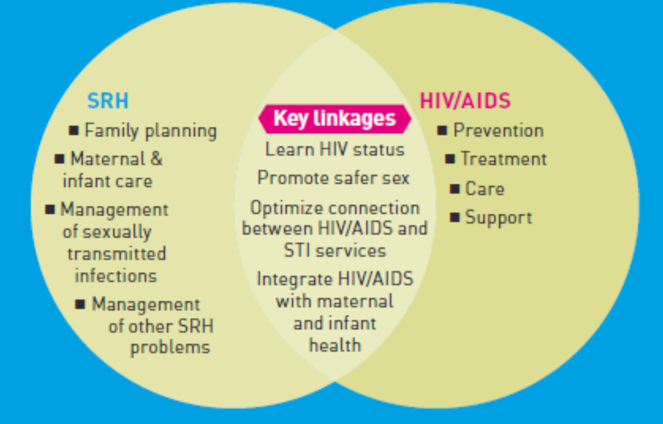
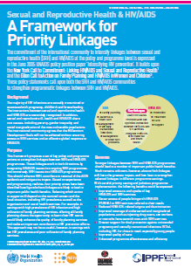
1a. Leadership; policy and programme development
A framework proposing a set of key policy and programme actions to strengthen linkages between sexual and reproductive health and HIV programmes.

Slide 9
1b. Leadership: Evidence for country specific action plans
Assess HIV and SRH bi-directional linkages at the policy, systems and service-delivery levels. It is intended also to identify gaps, and ultimately contribute to the development of country-specific action plans to forge and strengthen these linkages.

Slide 10

1c. Leadership: Strategic Planning
Strategic approach to integrate HIV and SRH
( Utilize the key entry points)

Slide 11
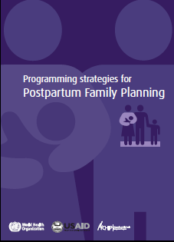

1d. Leadership: programme development
Guidance for the development of National
Advocacy strategies and plans
Designed for use by programme planners and managers when designing interventions to integrate postpartum family planning into national and subnational strategies.

Slide 12
2. Health care financing
National Health Accounts with appropriate components - sitan
Joint Accountability frameworks
One-Health Costing tool
Guidance for incorporation of RMNCAH strengthening into Global Fund Concept Notes and Funding requests

Slide 13
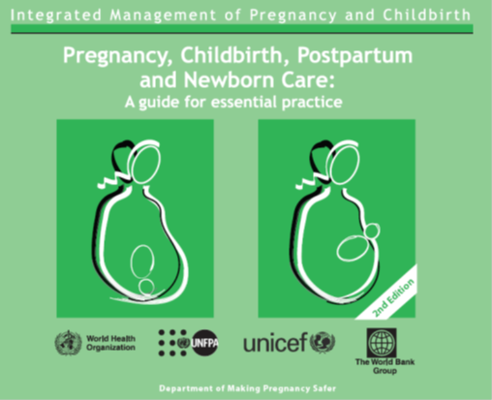
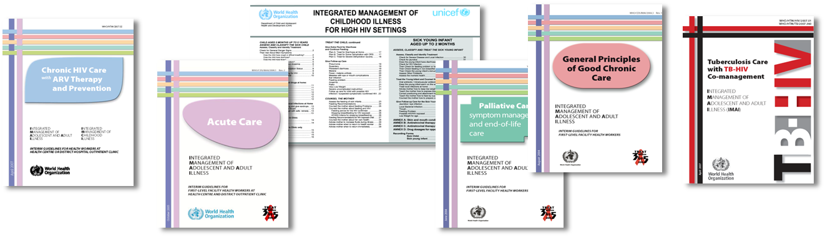
3a. Human Resources for Health; Capacity building
WHO Normative IMAI-IMPAC
Guidelines for integrated service delivery
at primary health care

Slide 14
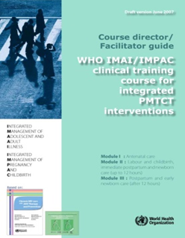
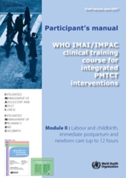

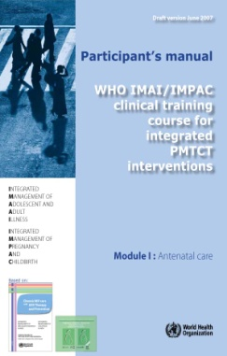
3b. Human Resources for health; Skills development
IMAI/IMPAC clinical course on PMTCT
To equip the health workers to provide integrated PMTCT as part of routine maternal health services
Other relevant training tools
Essential Newborn Care Course (ENCC) contains sessions on HIV
Focused Antenatal care (FANC) training manuals

Slide 15



5a. Service Delivery tools
Counseling for FP in HIV clinics
Counseling on HIV testing services in FP clinics

Slide 16

5b. Community Health Systems: Male involvement in the PMTCT
The paper builds on global and regional efforts to integrate meaningfully men’s participation into health services and programmes.

Slide 17
6. Strategic Information
Joint / integrated reporting and M&E tools
Joint / integrated RMNCAH, HIV and TB programme review tools
Tools for measuring integration – “what gets measured, gets done”

Slide 18
Key Messages
Integration is not a cure for inadequate resources. It may provide savings, but integrating new activities into an existing system cannot be continued indefinitely without the system as a whole being better resourced.
Proper planning critical for effective integration beginning with agreement on
  What to integrate
  How to integrate

Slide 19
Key Messages
Define and prioritize integrated service package based on goals, infrastructure and resources
Integration needs to go hand in hand with quality assurance (QA)
Tools are useful but do not solve the systemic problems
Need for continuous supervision and capacity building (mentoring and coaching etc)

Slide 20
Thank You
Acknowledgements
  WHO FRH cluster
  WHO HSS cluster

