Slide 1

6th EAST AFRICA COMMUNITY HEALTH SUMMIT
SYMPOSIUM
Academic Health Centres
Monitoring, Evaluation, Research and Learning (MERL) University-Health System Partners
Dr. Michaela Mantel
Senior Advisor Health Programmes
Aga Khan University East Africa
Symposiun: Bujumbura, 31 March 2017
Notes:
ES: New GAC logo added.

Slide 2
Key Points
The AKDN Integrated Health System in East Africa
Population health partnership programmes to strengthen health systems
AKU – Academic Units: Centre of Excellence in Women and Child Health and MERL Unit
Role of Monitoring, Evaluation, Research and Learning (MERL) in health system strengthening

Slide 3
Aga Khan Development Network
HIS HIGHNESS THE AGA KHAN
AGA KHAN DEVELOPMENT NETWORK
ECONOMIC DEVELOPMENT
SOCIAL DEVELOPMENT
CULTURE
Aga Khan Fund for Economic Development
Aga Khan
Foundation
Aga Khan
University
Aga Khan Trust for Culture
Tourism Promotion
Services
Industrial Promotion
Services
Aga Khan
Health Services
University of
Central Asia
Aga Khan Award
for Architecture
Historic Cities
Support Programme
Financial Services
Media Services
Aga Khan Planning
& Building Services
Aga Khan
Education Services
Education and Culture
Programme
Aviation Services
Aga Khan Agency
for Microfinance
Notes:
What is the AKDN?
A development network
An implementing group
Non-denominational
Scale and scope
1000+ projects/programmes
74 non-profit and 76 commercial entities
$600m: annual non-profit expenditure
$2.2bn: annual revenues from for-profit entities
(all surpluses reinvested)
30: countries in which AKDN is present
80,000+ employees

Slide 4
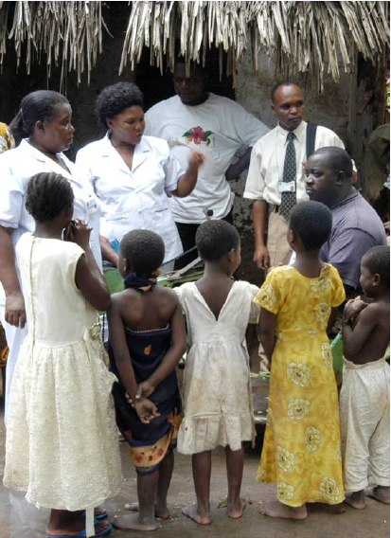
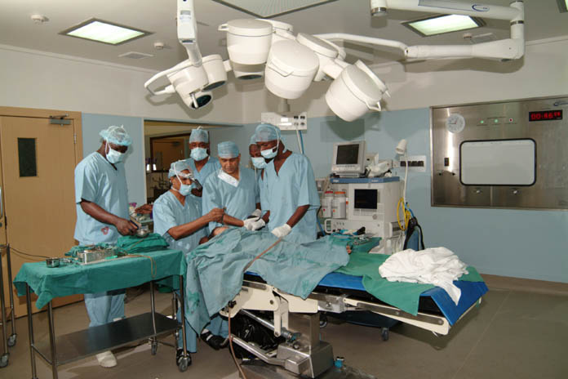
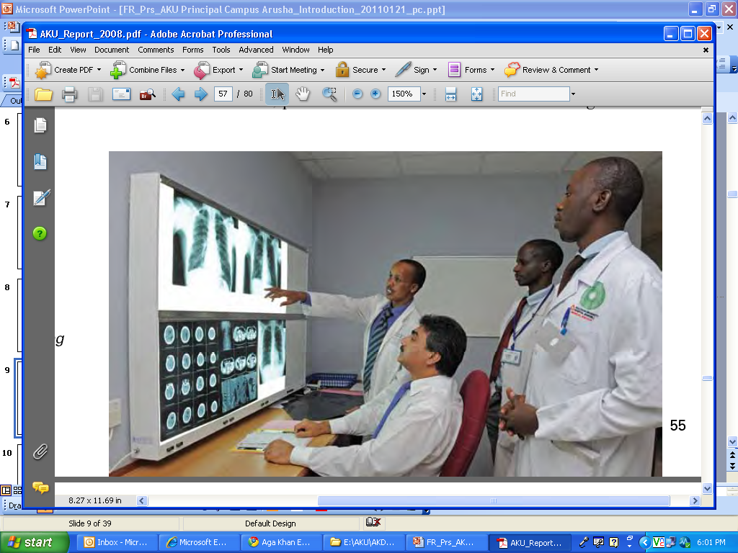
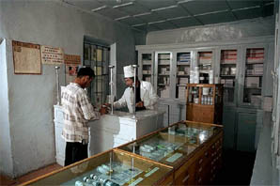
AKDN Integrated Health System (IHS) East Africa
Community Health
Service Delivery
Education/Research
Cross-Cutting
Community-level capacity building and mobilisation
Health promotion and education
Immunisation, systematic antenatal, delivery and postnatal care, IMCI
Increasingly attention for prevention, early diagnosis and treatment of NCDs
Basic and comprehensive health centres in rural areas
Diagnostic centres
Hospitals (13- 12 ISO certified, JCI accreditation)
Increasingly through PPPs
Medical education
Nursing education –
pre- and in-service
Allied health professionals
Community health workers
Public health training
Research – knowledge transfer
Health sector reform programmes, e.g. health financing, e-Health:
Provision of technical assistance to government systems
Infectious diseases programmes, e.g. tb, polio
Management and leadership
Notes:
Quality Health Services:
Currently (2016): 5 hospitals (AKU, AKHS); 42 outreach clinics and 6 diagnostic centres (AKU); 5 primary health centres in Kenya (AKHS), and 5 primary medical centres and clinics in Tanzania (AKHS)
Quality education:
3 campuses across East Africa
Post-graduate Nursing / Midwifery and Medical Education
In-service nursing and midwifery programme & short course programme in medicine
New undergraduate programmes in Nursing/ Midwifery and Medicine (2019)

Slide 5
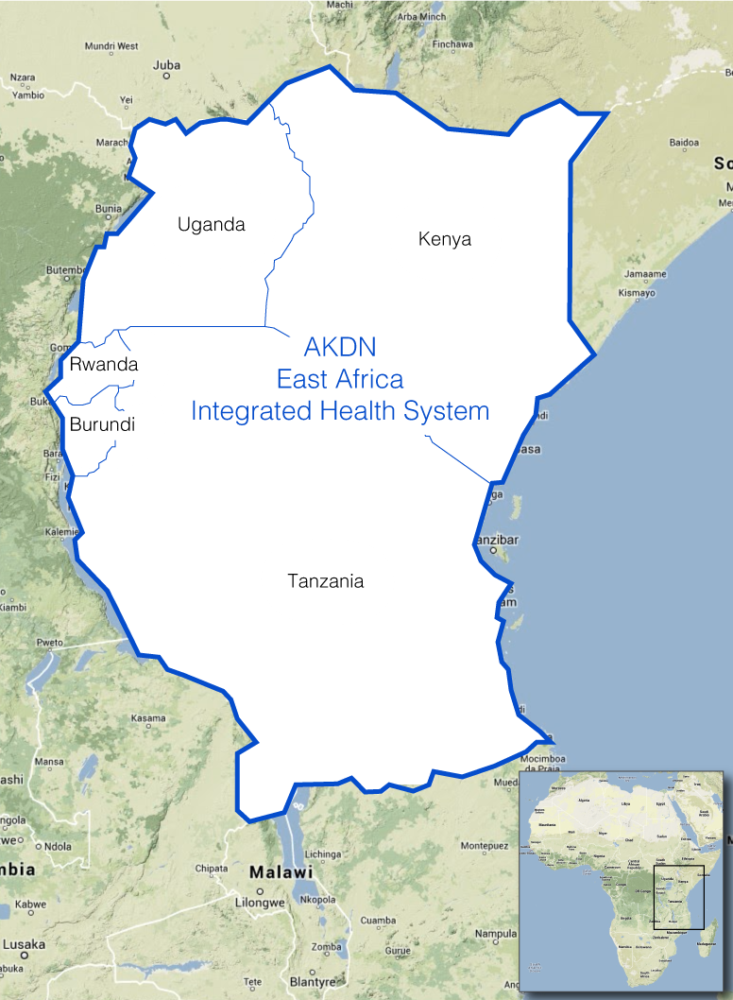
AKDN East Africa Integrated Health System (EAIHS)
catalyzing change
  Response: expanding quality healthcare and education
  Expanding access to high-quality healthcare in all 5 EAC countries and covering an economically diverse population
  Educating and creating clinically relevant leaders and health managers who are catalysts for change in the region
Conducting research into local disease burden and health system design so relevant knowledge is created
Collaborating with the public sector in health
Will impact more patients through partnerships than what the AKDN system can care for directly through its own health services
Will accelerate human resources development in terms of numbers, qualification and motivation of personnel
Will be replicable and sustainable (human resources and financially)
Will be complimentary and not competing with public sector
Coverage of AKDN’s East Africa Integrated Health System

Slide 6
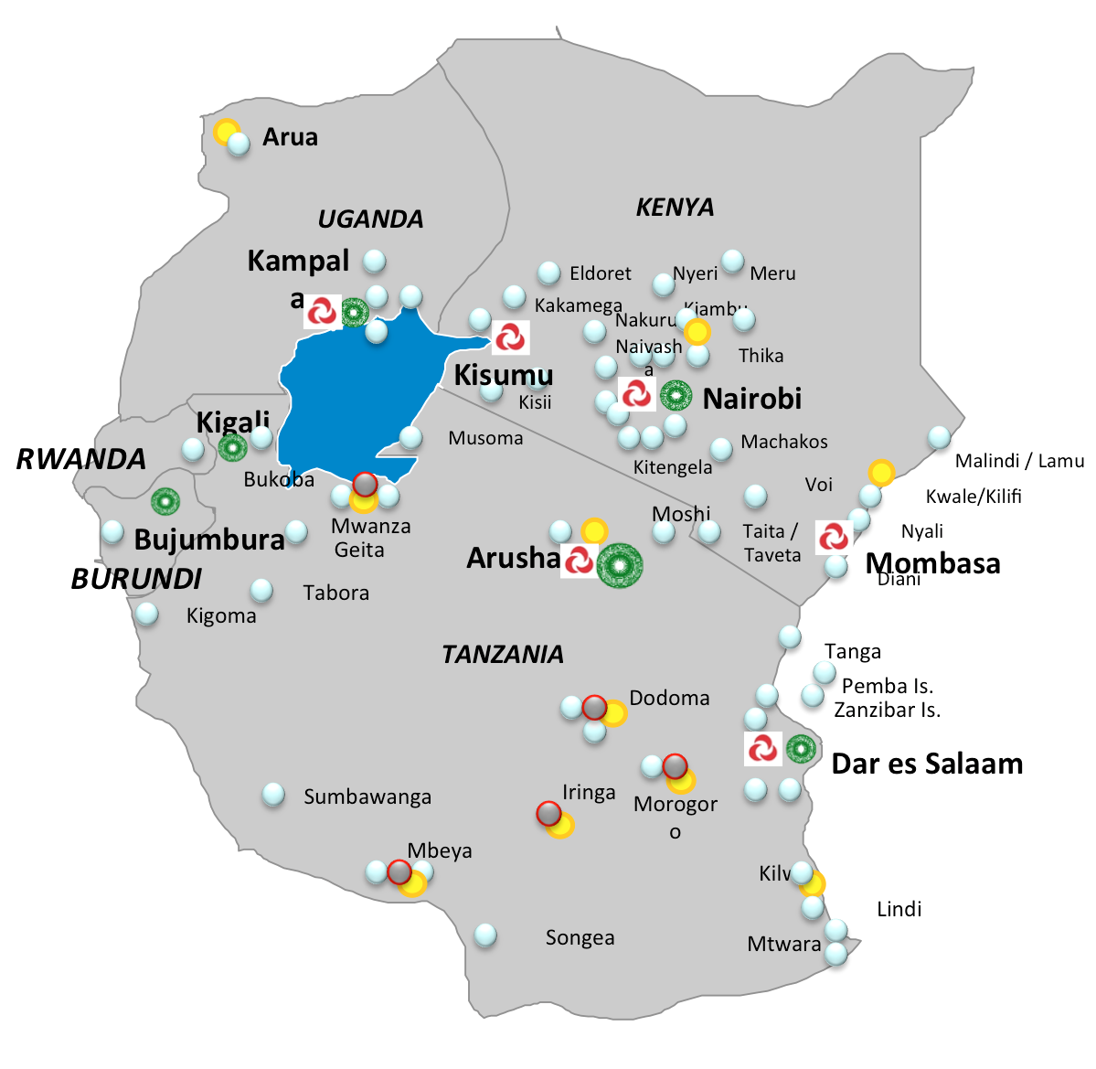


Future footprint of AKDN Integrated Health System, East Africa by 2027
By 2026 | Hospital | Outreach Centres
BR | - | 2
KE | 3 | 106
RW | - | 2
TZ | 2 | 45
UG | 1 | 15
EA IHS | 6 | 172
Does not include planned hospitals through PPP
Legend
Hospital
University Campus
Public Private Partnership site
Cluster Hubs
Nairobi (KE): Central Hub
Dar (TZ): Second Hub
Kampala (UG): Future Hub
Satellite clinic
Primary Medical Center

Slide 7
AKDN Population Health Partnership Programmes to Strengthen Health Systems in East Africa
Capacity building in local health systems
Field exposure of students and residents to enhance context relevant quality education and research
Driving research and collaboration in innovations to advance health systems and inform policy
Strengthening health management information systems
Community based health programmes
Networking – linking with ‘knowledge hubs’

Slide 8



PPP: Referral, Capacity Building, Service Quality, HMIS, Research, Innovations, and Technology
AKDN Health System Strengthening Partnership Model East Africa
AKDN
MOH
Aga Khan University
Faculty of Health Science
‘Knowledge Hub’
Aga Khan University Hospital Nairobi
National Hospital/University&
Research Centres
Tertiary (6)
Secondary Hospital (5)
*
Aga Khan Hospitals
Dar es Salaam, Mombasa, Kisii
Primary Hospital (4)
Health Centre/ Maternity/ Nursing Home (3)
AKU Outreach Clinics &
AKHS Medical Centres
Dispensary/Clinic (2)
Community Health System (1)
Aga Khan Foundation
Multi- sector input to community health & development

Slide 9


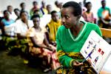
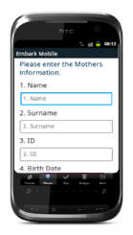
The AKDN IHS works with government partners
to improve quality of care, build capacity and expand access
  Strengthen existing systems and structures
Strengthen Interface
District hospital
  Offer care protocols and pathways to ensure care quality
  Embed trained health practitioners within facility
  Work hand in hand with hospital management to address hospital challenges – connect with knowledge hub
Government PHC
  Influence quality of care and patient pathways
  Align care protocols and pathways to ensure quality care
  Provide targeted training and mentorship programmes
  Leverage patient information to inform population research
  Improve information systems (HMIS)
  Link with community-based system (CHWs)
Government dispensaries
Community health care
  Train and mentor CHWs to strengthen community health
  Develop capacity building programmes for CHWs
  Provide high quality training to develop awareness of district pathways and assets + information system for CHWs
  Increase access to dispersed
  populations
  Strengthen referral system
  Work with partners who provide healthcare to remote populations
  Communication: Use new technologies – build communities of practice
  Influence care by placing nurse students/residents in public health facilities
  Carry out context relevant research jointly with local partners

Slide 10

AKU’s Academic Units Today
Faculty of Health Sciences
School of Nursing & Midwifery
Medical Colleges
Population Health Science
CoE in
Women Child Health
MERL Unit
Aga Khan University
Hospitals
Faculty of Arts &
Sciences
Institute for Human Development
Institute for the Study of
Muslim Civilisations
Institutes for
Educational Development
Aga Khan University
Examination Board
Graduate Professional
Schools
Notes:
AKU offers programmes in medicine, nursing, educational development, allied health sciences and studies in Muslim civilizations

Slide 11
AKU CoE in Women and Child Health East Africa
Established in 2012 - university-wide strategy to focus on the health of women and children with Prof. Dr. Zulfiqar A Bhutta appointed as Founding Director
AKU EA appointed Prof dr Temmerman as Director of AKU CoE WCH in East Africa
Focus on establishing high quality education, research and training programmes in women, child and adolescent health
Targeting population health, clinical, educational and research programmes
Strategies: Partnership with governments to strengthen health systems and increase access to/quality services for marginalized populations; mentorship, student/resident placements and Community of Practice; quality monitoring, evaluation, research, learning (MERL)
Prof. Dr. Marleen Temmerman (MD, MPH, PhD, OB/GYN) East Africa Director, CoE WCH and the Chair, Department of OB/GYN, Aga Khan University Hospital Nairobi; Director AKU MERL Unit; Professor Obstetrics and Gynaecology at Ghent University in Belgium and a Senior WHO Advisor Women, Child and Adolescent Health

Slide 12
AKU MERL UNIT
Unit for MERL of the AKU/CoE WCH, based at AKU Nairobi.
Established in 2016 with the support of the SickKids Centre for Global Child Health at the University of Toronto.
Currently supporting the AQCESS projects in Kenya (Kisii and Kilifi Counties), Mozambique (Cabo Delgado Province), Mali (Mopti and Djenne Districts) and Pakistan (Gilgit and Chitral) and the IMPACT project in Tanzania that started in January 2017.

Slide 13
AKU MERL Unit: Actual Projects
AKDN IHS PARTNERSHIP MODEL
MERL AKU
AQCESS Kenya
IMPACT Tanzania
AQCESS Mali
AQCESS Mozambique
AQCESS Pakistan

Slide 14
MERL for AQCESS and IMPACT: Scope
AKDN IHS PARTNERSHIP MODEL
Establishing M&E system and monitoring and evaluation plans
Developing methodologies and tools for surveys (baseline, endline) and assessments
Continuous routine monitoring and reporting
Data management and data quality assurance
Identifying research priorities and developing research agenda
Developing research methodologies, tools, and implementing research
Documentation of data, research results, case studies, good practice models
Building research capacities through maximizing stakeholder engagement
and active participation
Fostering project learning and knowledge translation, documentation and dissemination.

Slide 15
The Role of AKU MERL in Health Systems
To enhance outcome monitoring and impact evaluation
To ensure quality M&E standards across projects and in alignment with national policy, guidelines and information systems
To increase research capacities and quality research
To provide evidence and generate knowledge to influence policy, strategic development and planning
To build MERL networks within AKDN and beyond – national, regional global

Slide 16
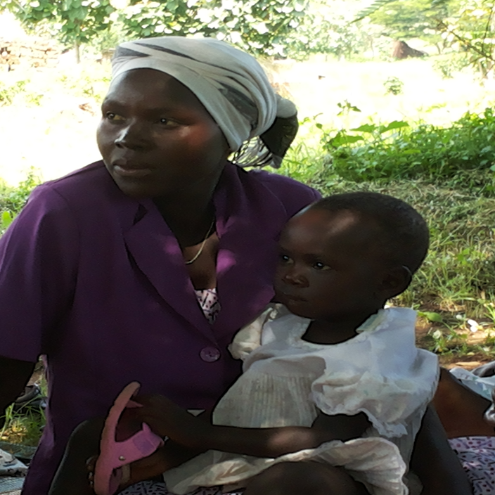

COMMENTS
QUESTIONS
ASANTENI SANA
THANK YOU
COMMENTS?
QUESTION?

