Slide 1
PREVALENCE OF COMMON CIRCULATING ENTERIC BACTERIAL PATHOGENS AND THEIR ANTIMICROBIAL SUSCEPTIBILITY PATTERNS IN SATELLITE AND NON- SATELLITE SITES IN KENYA

Slide 2
Study Design
Hospital based cross-sectional study of all children under five years of age,
Presenting with diarrheal illness seeking treatment,
Parents / guardians consenting for children to participate in the study.

Slide 3
Main objective
To determine the prevalence of common circulating enteric bacterial pathogens and their antimicrobial susceptibility patterns in Kenya.

Slide 4
Specific objectives
Prevalence of common circulating enteric bacterial pathogens
Virulence factors of E.coli strains associated with diarrhoea
Antimicrobial susceptibility of common circulating enteric bacterial pathogens to commonly prescribed antibiotics.

Slide 5
METHODS
Stool samples were collected between 1st February 2013 to 30th June 2016 from a total of 2012 outpatients with diarrhea.
Conventional, biochemicals, and multiplex PCR were conducted to identify bacterial causes and virulence factors in E.coli isolates.
Antimicrobial susceptibility testing was done for all isolated pathogens (E.coli, salmonella and shigella).

Slide 6
Statistical methods
Descriptive statistics for categorical variables i.e. frequency distributions and cross-tabulations were done.
Results are presented in tables and graphs

Slide 7
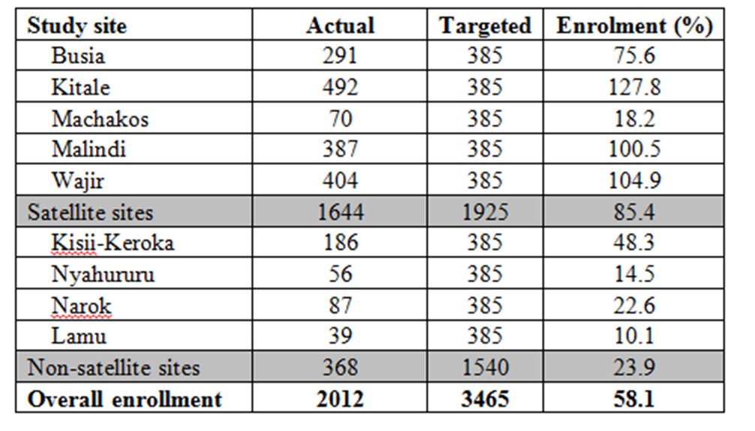
Table 1: Enrollment rate per study sites

Slide 8
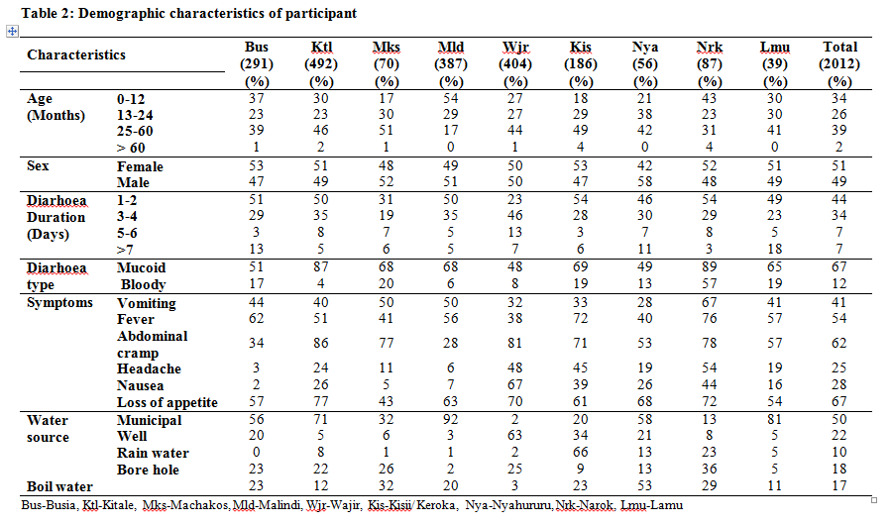
Socio-Demographic and clinical characteristics

Slide 9
Table 3: Percent and confidence interval distribution of common circulating enteric bacterial pathogens in Kenyan study sites

Slide 10
Table 4: Percent distribution of E. Coli pathotypes in Kenya study sites

Slide 11
Summary of Enterics data
participants=2012
No. Positive for bacterial pathogens=522
No. Negative for bacterial pathogens=2012-522
Only E coli = 315
E coli + Shig= 31
E coli + Sal = 9
Only Shig = 117
Only Sal = 46
Shig + Sal = 4
E coli isolates = 355
Eagg =50
Eagg /EIEC/ETEC=1
Eagg/STEC=1
EIEC =28
EPEC =60
EPEC/Eagg=2
EPEC/EIEC=2
EPEC/ETEC=2
EPEC /Eagg/ETEC=1
ETEC =49
ETEC/Eagg = 4
STEC = 145
STEC/Eagg=3
STEC/EIEC=1
STEC/ETEC=1
STEC/EAEC/Eagg=1
STEC/EAEC/ETEC=1
STEC /EPEC hybrid =3
No. of participants with only one of the three bacterial pathogens = 478
No. of participants with either one of the three pathogens = 522
No. of participants with multiple infections (Ecoli + Sal, or E coli and Shig or Sal and shig) = 44
Total no. of isolates ( 315 e coli + 31 E coli +31 Shig + 9 E coli + 9 Sal + 117 shig +46 Sal + 4 Shig + 4 Sal) = 566

Slide 12
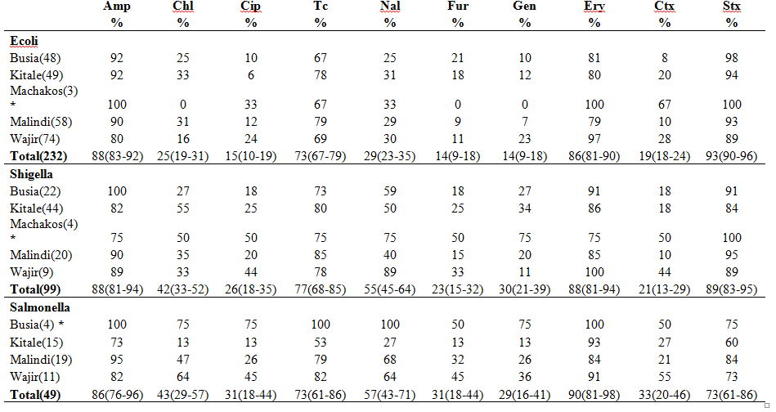
Table 4a: Resistance profiles of enteric bacterial pathogens to commonly prescribed antibiotics in the satellite sites

Slide 13
Table 4b: Resistance profiles of enteric bacterial pathogens to commonly prescribed antibiotics in the non-satellite sites
 | Amp % |  | Chl % |  | Cip % |  | Tc % |  | Nal % |  | Fur % |  | Gen % |  | Ery % |  | Ctx % |  | Stx %
Ecoli
Kisii(35) | 77 |  | 20 |  | 17 |  | 54 |  | 26 |  | 14 |  | 14 |  | 83 |  | 14 |  | 86
Nyahururu(9)* | 100 |  | 22 |  | 22 |  | 89 |  | 33 |  | 11 |  | 11 |  | 100 |  | 0 |  | 78
Narok(10)* | 90 |  | 0 |  | 0 |  | 80 |  | 30 |  | 10 |  | 30 |  | 40 |  | 30 |  | 80
Lamu(5)* | 100 |  | 40 |  | 0 |  | 80 |  | 20 |  | 40 |  | 40 |  | 80 |  | 0 |  | 100
Total (59) | 85(76-94) |  | 19(9-29) |  | 14(5-23) |  | 66(54-78) |  | 27(16-38) |  | 15(6-24) |  | 19(9-29) |  | 78(67-89) |  | 14(5-23) |  | 85(76-94)
Shigella
Kisii(31) | 81 |  | 42 |  | 23 |  | 77 |  | 65 |  | 19 |  | 19 |  | 84 |  | 16 |  | 90
Nyahururu(8)* | 100 |  | 13 |  | 25 |  | 88 |  | 38 |  | 25 |  | 0 |  | 88 |  | 0 |  | 100
Narok(11)* | 73 |  | 27 |  | 18 |  | 45 |  | 27 |  | 18 |  | 9 |  | 73 |  | 0 |  | 64
Lamu(4)* | 100 |  | 25 |  | 18 |  | 50 |  | 50 |  | 50 |  | 50 |  | 75 |  | 25 |  | 75
Total (54) | 83(73-93) |  | 35(22-48) |  | 22(11-33) |  | 74(62-86) |  | 54(41-67) |  | 24(13-35) |  | 19(9-29) |  | 89(81-97) |  | 11(3-19) |  | 93(86-100)
Salmonella
Kisii(1)* | 100 |  | 0 |  | 100 |  | 100 |  | 100 |  | 0 |  | 100 |  | 100 |  | 100 |  | 100
Nyahururu (3)* | 100 |  | 67 |  | 0 |  | 67 |  | 0 |  | 0 |  | 0 |  | 100 |  | 0 |  | 100
Total (4) | 100(N/A) |  | 50(1-99) |  | 25(0-67) |  | 75(33-100) |  | 25(0-67) |  | 0(N/A) |  | 25(0-67) |  | 100(N/A) |  | 25(0-67) |  | 100(N/A)

Slide 14
Conclusion
Pathogenic E.coli was the most prevalent organism isolated from all the study sites.
STEC was the most prevalent pathotype in most the sites
The pattern of antimicrobial resistance was in the following order starting with the highest:
Ampicillin (beta-lactamase)
Trimethoprime / sulphamethoxazole
Tetracycline.
Emerging resistance of enteric pathogens to flouro-quinolones (ciprofloxacin, Nalidixic acid, and 3rd generation Cephalosporin’s (Cefriaxone and Cefotaxime) is a subject of concern

Slide 15
Thank You!!

