Slide 1
Relevance of One Health approaches in East Africa to Risk Managing Epidemics
Mark Rweyemamu
Executive Director, SACIDS,
College of Veterinary and Medical Sciences
Sokoine University, Tanzania

Slide 2
Pre-2012 Ebola Outbreaks
Jean_Jacques Muyembe 2011

Slide 3
WHO Ebola 2014-2015 map http://www.who.int/csr/disease/ebola/maps/en/

Slide 4
EVD epidemic in Sierra Leone
Source: Prof Janusz Paweska, NICD, RSA & Deputy Director-SACIDS

Slide 5
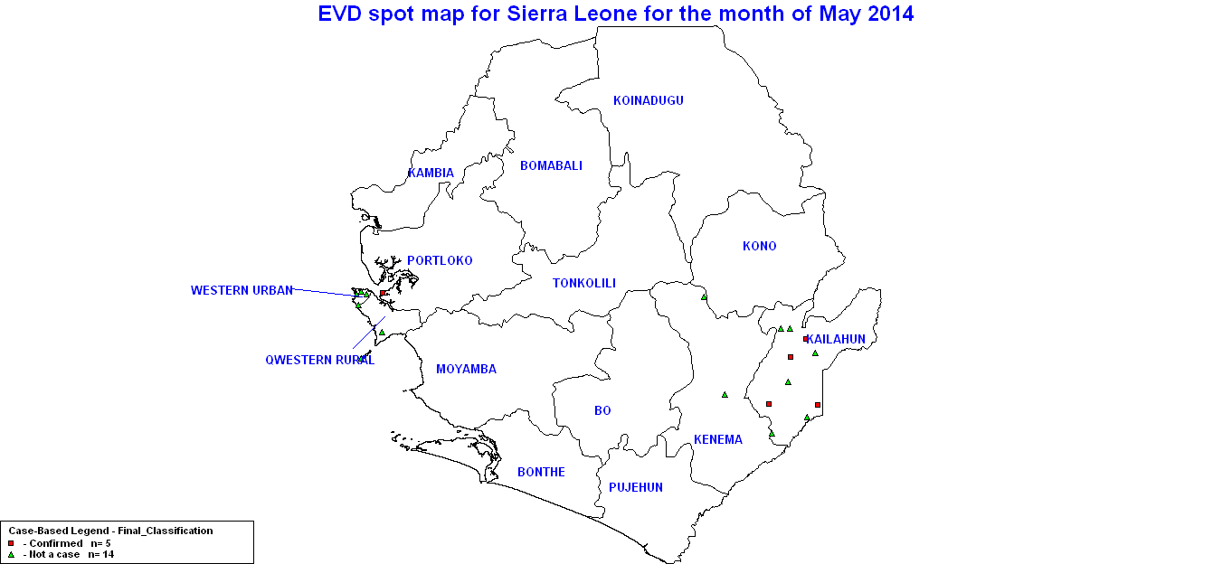
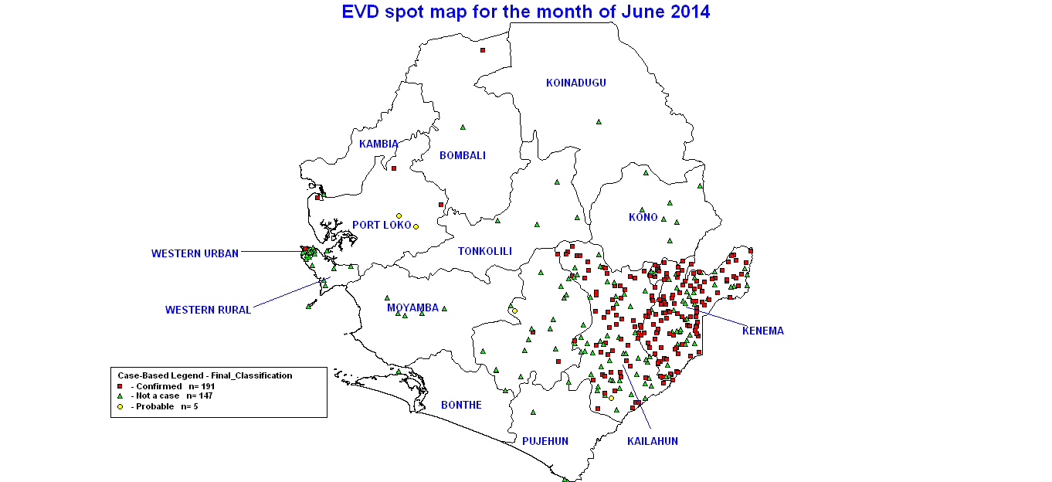
Ebola is spreading across Sierra Leone
May, 2014

Slide 6
Ebola is spreading across Sierra Leone
June, 2014
June, 2014

Slide 7
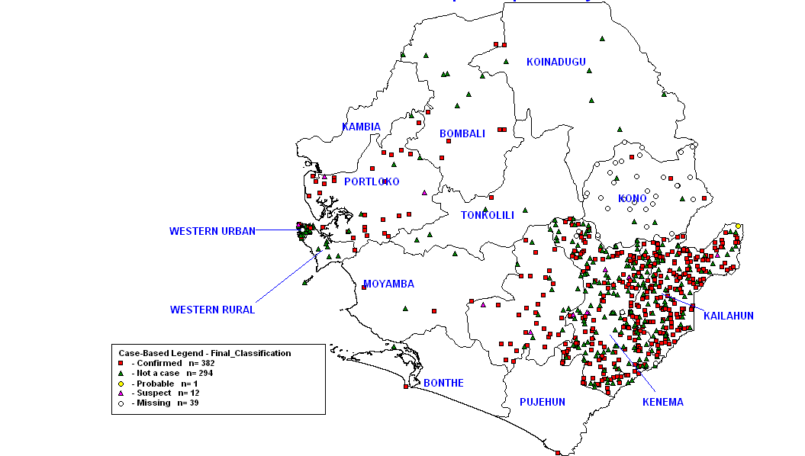
Expanding spread & emerging hot spots
July, 2014

Slide 8
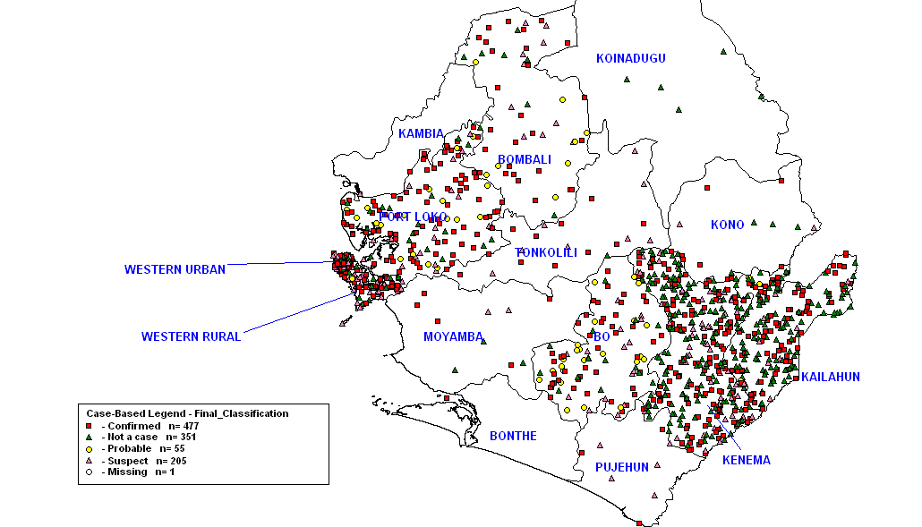
Expanding spread & emerging hot spots
August, 2014

Slide 9
Expanding spread & emerging hot spots
August, 2014
17 Aug 2014 Arrival of 1st NICD EMLU Team

Slide 10
Expanding spread & emerging hot spots
September, 2014

Slide 11
Expanding spread & emerging hot spots
November

Slide 12
Avian influenza
Source: Dr Akiko Kamata, EMPRES-I,

Slide 13
H5N1 : 1997 in Hong Kong, China

Slide 14
H5N1 : Until end-2003 few reported

Slide 15
H5N1 : Dec. 2003–Jan. 2004 (only 2 months)

Slide 16
H5N1 : by July 2004 spread to Russia

Slide 17
H5N1 : By October 2004 reached Europe

Slide 18
H5N1 : By 2005 reached Africa

Slide 19
H5N1 : confined in endemic area e.g. 2011/2012

Slide 20
H5N1: May 2016 – Mar. 2017 spread again

Slide 21
H5N6: in Far-East and South East Asia now

Slide 22
H5N8: from Far East, now in Sub Sharan Africa

Slide 23
Some shared characteristics
Relatively low impact or quiescent period
Potential change in either pathogen characteristics or enabler circumstances
Relatively slow start
Late detection & identification
Explosion into major epidemic/pandemic
Unprepared national/regional health systems
Extensive spread

Slide 24
Key Question
What FIT FOR PURPOSE
Technologies and risk management options for IDs in Africa?

Slide 25
Fighting emerging pathogens
Expect the unexpected
Effective surveillance for new disease events
Surveillance in potential reservoirs
Surveillance does not begin at home – but at source in endemic settings (geography and zoology)
Need effective international co-operation
Linked to capacity for rapid, effective action
One medicine
Need effective inter-sectoral co-operation between public health and animal health agencies
Notes:
25

Slide 26
Fighting emerging pathogens
Disease is more than single pathogen –host interaction
Syndemics approach to disease burden
Understand the biocomplexity of disease in ecoystems
Disease risk management/control is more than single technical intervention, e.g. Vaccination
Transdisciplinary approaches - ecohealth
Socio-anthropology
Understanding of interaction between people, animals and environment
One Health
Notes:
26

Slide 27
One Medicine – One Health
Rudolf Virchow 19th Century
Between animal and human medicine there is no dividing line – nor should there be. The object is different but the experience obtained constitutes the basis of all medicine.
Calvin Schwabe (1960s)
There is no difference between human and veterinary medicine. Both sciences share a common body of knowledge in anatomy, physiology, pathology, on the origines of diseases in all species

Slide 28
One Medicine – One Health
The European Union Commission:
‘the improvement of health and well-being through (i) the prevention of risks and the mitigation of effects of crises that originate at the interface between humans, animals and their various environments, and (ii) promoting a cross-sectoral, collaborative, ‘‘whole of society’’ approach to health hazards, as a systemic change of perspective in the management of risks’
Lonnie King 2007
A holistic systems approach to understanding health across all species. It's a recognition that human and animal health are inextricably linked, and one health is about how to promote, improve, and defend the health and well-being of all species, with the cooperation of physicians and veterinarians.
The One Health Initiative Taskforce Report from AVMA:
The ‘collaborative effort of multiple disciplines working locally, nationally, and globally to attain optimal health for people, animals and our environment’ (AVMA 2008).

Slide 29
Stone Mountain 2011
A. Improving health and well-being through the prevention of risks and the mitigation of effects of crises (e.g. emerging diseases) that originate at the interface between humans, animals and their various environments.
B. Promoting multi (cross) sectoral collaborations and a “whole of society” treatment of health hazards, as a systemic change of perspective in the management of risk.

Slide 30
WHO OH unique approach
The OneHealth Tool is a model to be used for supporting the costing, budgeting, financing and national strategies development of the health sector in developing countries with a focus on integrated planning and strengthening health systems.

Slide 31
The OIE and FAO One Health Unique approaches
The “One Health” concept is founded on an awareness of the major opportunities that exist to protect public health through policies aimed at preventing and controlling pathogens at the level of animal populations, at the interface between humans, animals and the environment - OIE
The One Health vision is a unifying force to safeguard human and animal health, to reduce disease threats and to ensure a safe food supply through effective and responsible management of natural resources – FAO

Slide 32
International One Health Platform
One Health recognizes that the health of humans, animals and ecosystems are interconnected.
Health science professionals, key opinion leaders and public health officials need to work together to attain optimal health for people, domestic animals, wildlife, and our environment.

Slide 33
SACIDS Is
A One Health VIRTUAL CENTRE for studying infectious diseases of humans, animals and ecosystems in endemic settings of Africa
The Mission is: to improve Africa’s capacity to DETECT, IDENTIFY and MONITOR (DIM) infectious diseases in order to better manage the RISK posed by them.
The modus operandi is the Community of Practice approach underpinned by inter-sectoral collaboration

Slide 34
Emerging Technologies for DIM of IDs
UC1. Data mining and data fusion (Informatics, Modelling)
UC2. Genomics and post-genomics to characterise new diseases
UC3. Hand-held diagnostic devices
UC4. Fast throughput screening at ports, airports and livestock markets

Slide 35
Ucs: Technologies and ID risk mangnt
Major disease threats | Potential contribution to managing future risk
 | UC1 | UC2 | UC3 | UC4
Evolution of new diseases | *** | *** | ** | **
Acquiring resistance in pathogens | *** | ** | *** | *
Zoonoses | ** | ** | *** | ***
HIV/TB/Malaria | ** | * | *** | *
Plant disease threats | *** | * | *** | ***
Acute respiratory infections | *** | ** | *** | ***
STIs | ** | * | *** | *
Transboundary animal diseases | *** | ** | *** | ***

Slide 36
UC2: Genomics and post-genomics to characterise new diseases – Kasanga et al @ SUA,
RT-PCR and capillary-based sequencing
Next generation sequencing
Used for identification and genetic characterisation of pathogens
Identification of fine genetic changes; Multi-agent detection

Slide 37
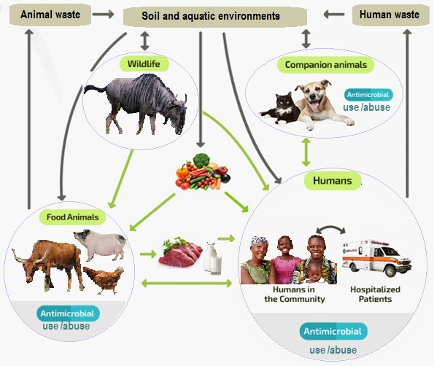
Genomics surveillance of AM-Resistome spread: Using the ONE Health approach

Slide 38
Key discovery from Tanzanian studies
ESBL: The dissemination and persistence of blaCTX-M-15 in different compartments in Mwanza City appeared to be due to the horizontal transfer of multiple IncF and IncY plasmids.
Novel strains of Achromobacter spp. and Enterobacter spp. (Enterobacter bugandensis) carrying blaCTX-M-15
A draft genome (050AP) of multi-resistant bovine isolate of Staphylococcus lentus.
The 050AP appears to encode a novel mph(C) variant.
Methicillin resistant Staphylococcus aureus (MRSA) Methicillin-Resistant coagulase-negative Staphylococci in raw milk

Slide 39
Ucs: Technologies and ID risk mangnt
Major disease threats | Potential contribution to managing future risk
 | UC1 | UC2 | UC3 | UC4
Evolution of new diseases | *** | *** | ** | **
Acquiring resistance in pathogens | *** | ** | *** | *
Zoonoses | ** | ** | *** | ***
HIV/TB/Malaria | ** | * | *** | *
Plant disease threats | *** | * | *** | ***
Acute respiratory infections | *** | ** | *** | ***
STIs | ** | * | *** | *
Transboundary animal diseases | *** | ** | *** | ***

Slide 40
UC3: Developing PoC Genetic Detection Diagnostics – Kasanga et al @ SUA
RT-LAMP (Reverse Transcription Loop-mediated isothermal amplification)
Mobile RT-PCR for diagnosis of FMD under the field condition

Slide 41
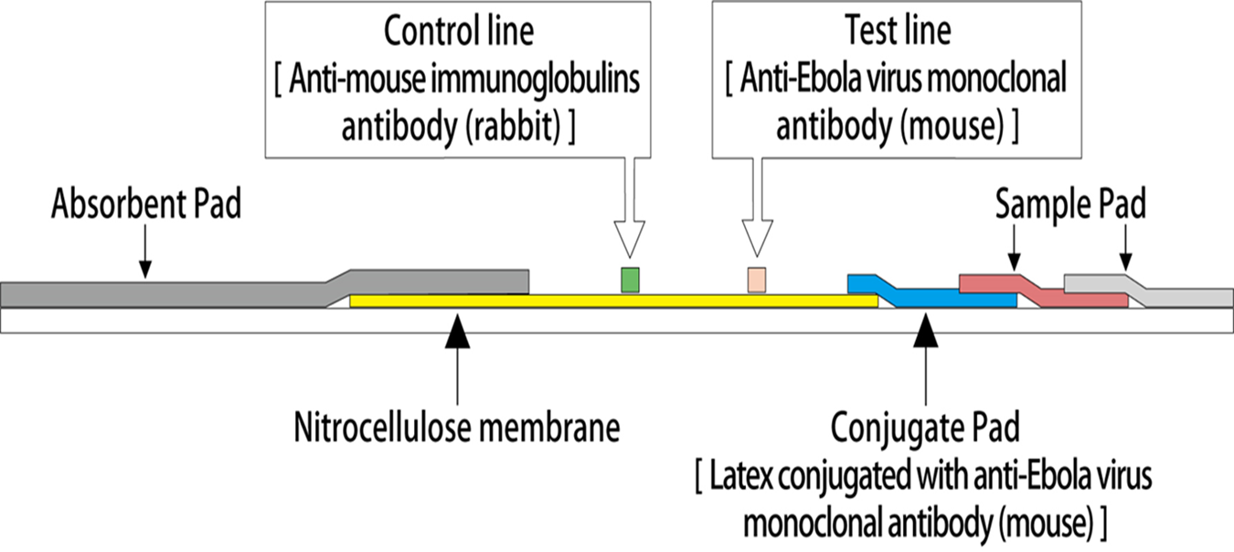
UC3:Developing PoC Antigen Detection Diagnostics – Katendi et al @ UNZA
Monoclonal antibody based lateral flow Ebola virus antigenic detection developed
A candidate for PoC field test for Ebola and Bundibugyo viruses
– to be scaled up -

Slide 42
Ucs: Technologies and ID risk mangnt
Major disease threats | Potential contribution to managing future risk
 | UC1 | UC2 | UC3 | UC4
Evolution of new diseases | *** | *** | ** | **
Acquiring resistance in pathogens | *** | ** | *** | *
Zoonoses | ** | ** | *** | ***
HIV/TB/Malaria | ** | * | *** | *
Plant disease threats | *** | * | *** | ***
Acute respiratory infections | *** | ** | *** | ***
STIs | ** | * | *** | *
Transboundary animal diseases | *** | ** | *** | ***

Slide 43
UC1: Towards Community based OH Disease Surveillance - Designing the Disease Surveillance Framework together
Ngorongoro pastoral community leadership
Community Health Worker
Medical Epidemiologist
Veterinary Epidemiologist
Wildlife Health specialist
IT Software Analysts and Programmers
EpiHack Approach – December 2014, Ngorongoro, Tanzania

Slide 44
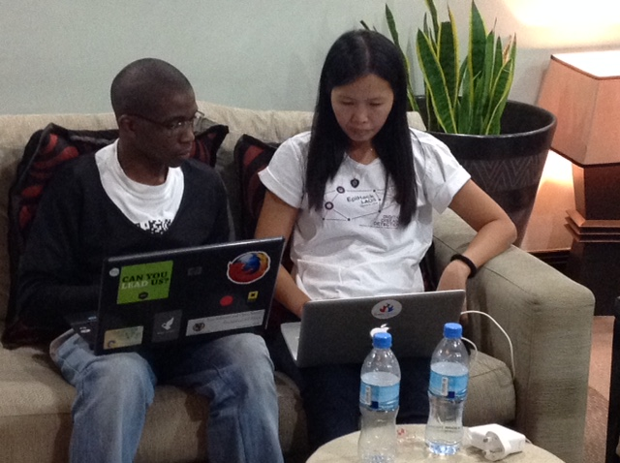
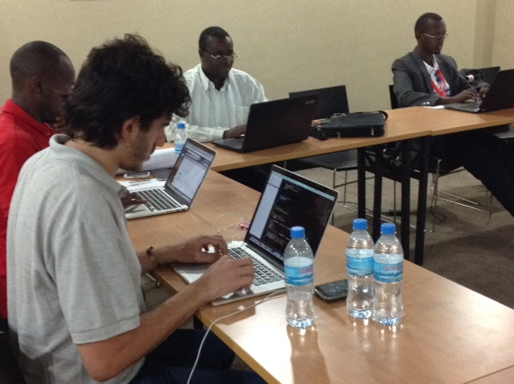
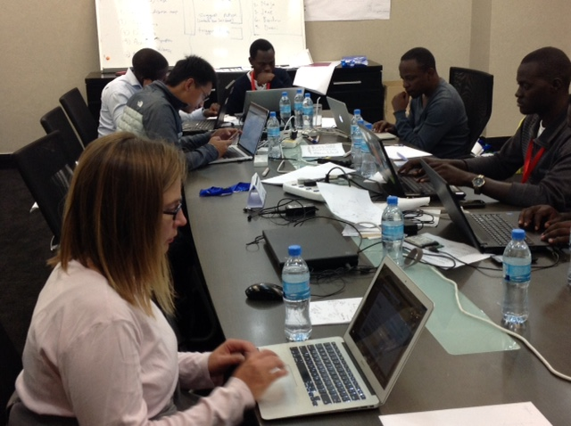
UC1: Towards Community based One Health Disease Surveillance - Two days, Two nights Hacking together -
Integrated Disease Surveillance & Response Framework for:
Community level disease information and data collection
Official Medical and Veterinary Disease Reporting and Surveillance
Forward and Backward Tracing
Feed-back system to community level
EpiHackers from Tanzania, Kenya, Uganda, Rwanda, Burundi, Zambia, Malawi, South Africa, Argentina, USA, FAO, CDC, AU

Slide 45
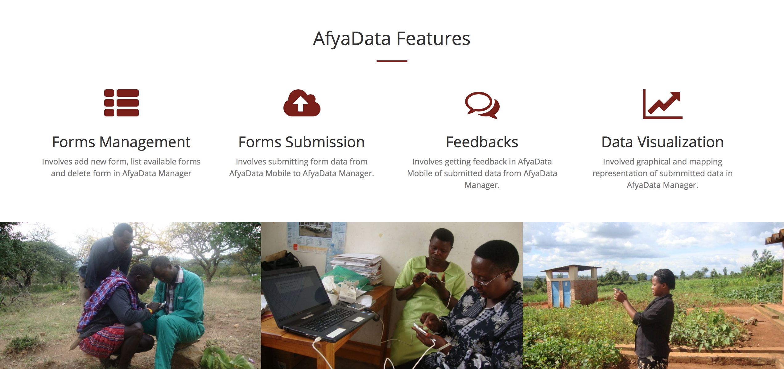
Afya data - eIDSR
A tool to assist: collect, analyze and respond to health related events Uses smart phone to collect, Web interface to analyze and sends feedback

Slide 46
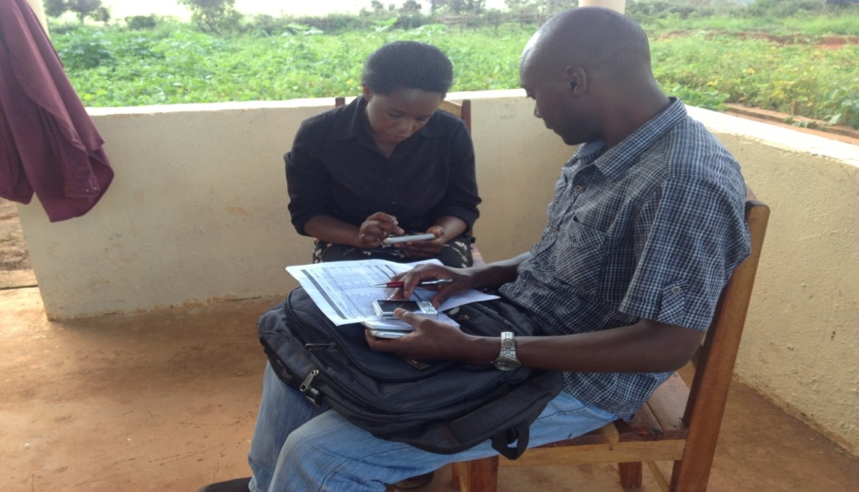
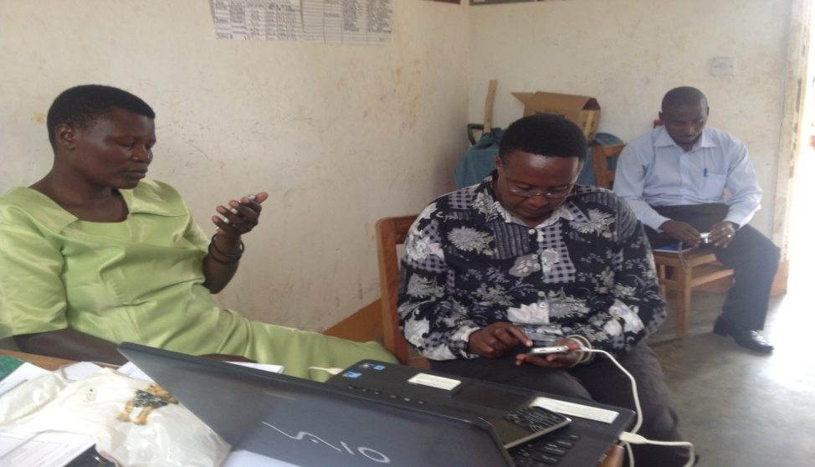
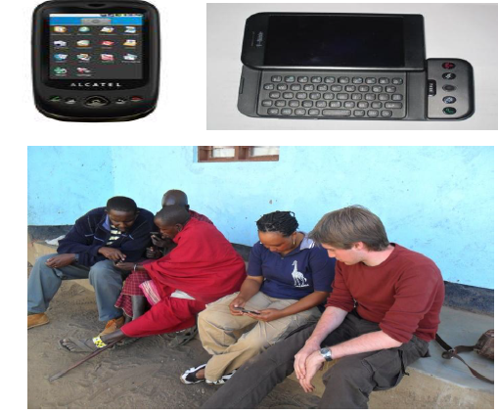
Technical support: visiting data collectors

Slide 47
SACIDS-ACE Innovation Lab for Disease Detection, Identification and Monitoring
OUR THEORY OF CHANGE: Community Level One Health Security in Africa
Innovative Communication Strategy
Digital Technology based Syndromic surveillance tools
Genomics based Diagnostic tools
Epidemiological risk modelling and socio-anthropology

Slide 48
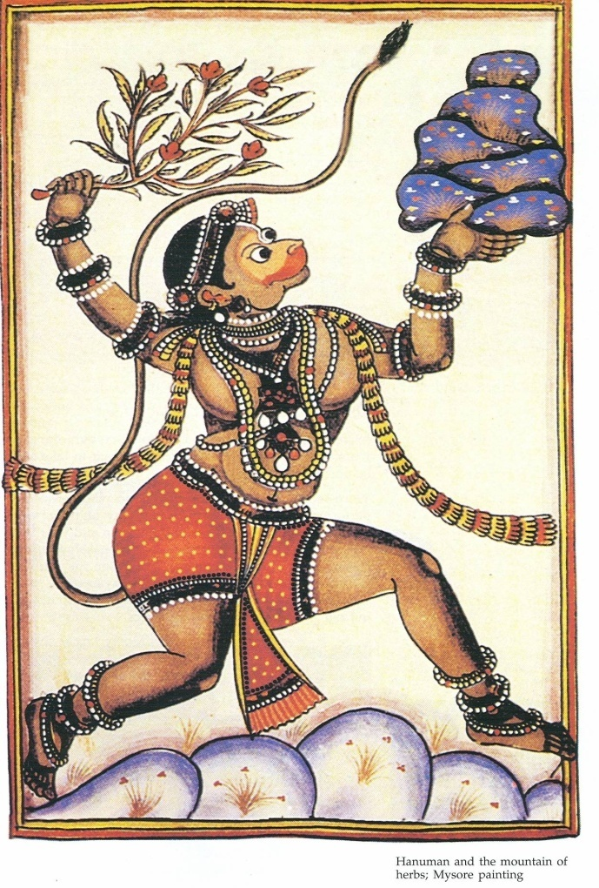
WAKE UP CALL
International public good concerns of today are: Transboundary /Epidemic and Emerging Infectious Diseases
But the chronic and endemic tropical diseases have serious impact on household food security and livelihoods in Africa.
Public Health and Veterinary medicine in Africa need to embrace and champion One Health as the cost effective approach to sustainable risk management of infectious diseases IRRESPECTIVE of species
Need to cultivate new multi-disciplinary partnerships for addressing infectious disease in the endemic settings (geographically and zoologically)
One Health is the holistic science

Slide 49
Thank you!!
www.sacids.org

