Slide 1
REPRODUCIBILITY OF LABORATORY RESULTS AND PERFORMANCE OF TB DIAGNOSTIC TOOLS IN DIFFERENT GEOGRAPHICAL SETTINGS IN KENYA EAPHLN PROJECT - OPERATIONAL RESEARCH
Authors: *Githui WA¹, Mwangi M¹, Wanzala P¹, Sang WK¹, Kariuki JN¹, Kiptoo M²
Institutional Affiliations:
¹Kenya Medical Research Institute
²South Eastern Kenya University

Slide 2
Background
Reproducibility of laboratory results and performance of diagnostic tools form a major part of quality assurance in diagnosis, which is key to care of patients with tuberculosis (TB).
Reproducibility is the ability of diagnostic test to be duplicated, either by the same researcher or by someone else working independently.
Performance of a diagnostic tool results in diagnostic values (sensitivity, specificity, ppv and npv ) generated using a gold standard.
In Kenya, performance of new diagnostic tools including LED-FM and GeneXpert, has recently been documented.
No study to our knowledge has documented comparison of reproducibility and performance of these tools in different geographical settings.

Slide 3
Objective
To compare reproducibility of laboratory results and performance of ZN and new TB diagnostic tools in different geographical settings in Kenya.

Slide 4
Methods (1)
Study Design: A cross sectional design involving determination of the diagnostic test values of new TB diagnostics.
Study area: Busia, Kitale, Machakos, Malindi, Wajir, Kisii-Keroka, Nyahururu, Olololunga-Narok, Lamu.
Study population: People presumed to have TB.
Inclusion criteria: Consenting, aged 18 years and above enrolled in public health facilities.

Slide 5
Methods (2)
Specimen collection: Two sputum specimens (spot and morning) collected from each patient over two consecutive days.
  At the study sites, a proportion of each specimen aseptically processed for ZN, LED-FM and GeneXpert.
  The remainder of the specimen triple packaged and shipped to the TB research laboratory at KEMRI, Nairobi and processed using the three tests and LJ culture in accordance with standard procedures.

Slide 6
Methods (3)
Data processing and Statistical methods: Data processing was done using MySQL and IBM SPSS.
Reproducibility of laboratory results determined by Kappa values on homogenous specimens.
Diagnostic values (sensitivity, specificity, ppv and npv with 95% CI).
Results from the same specimens processed at the study sites were compared with those from KEMRI research laboratory.
LJ culture was used as a gold standard.

Slide 7
Results

Slide 8
Study proﬁle for the enrolled people with presumptive TB
Total number of patients with presumptive TB enrolled
N=2967
6 patients without sputum samples
Number of patients with sputum samples
N=2961
2761 patients with accepted sputum samples sputum
5420 sputum samples
- 2659 with both (spot (S) & morning (M))
- 102 with one (14 S, 88 M)
Sputum samples from 200 patients rejected
Processed at Study sites Laboratories
ZN: 2698 patients (97.7%)
- 5269 Sputum Processed
- 2571 with both (S & M)
- 127 with one (100 S, 27 M)
FM: 2316 patients (83.8%)
- 4494 Sputum Processed
- 2178 with both (S & M)
- 138 with one (108 S, 30 M)
GXpt: 948 patients (34.3%)
- 1691 Sputum Processed
- 743 with both (S & M)
- 205 with one (186 S, 19 M)
Processed at KEMRI Research Laboratory
ZN: 2469 patients (89.4%)
- 4453 Sputum Processed
- 1984 with both (S & M)
- 485 with one (227 S, 258 M)
FM: 2467 patients (89.4%)
- 4458 Sputum Processed
- 1991 with both (S & M)
- 476 with one (221 S, 255 M)
GXpt: 1556 patients (56.4%)
- 2429 Sputum Processed
- 873 with both (S & M)
- 683 with one (311 S, 372 M)
Cult: 2358 patients (85.4%)
- 4086 Sputum Processed
- 1728 with both (S & M)
- 630 with one (319 S, 311 M)

Slide 9
Table 1: Selected demographic characteristics of the enrolled people presumed to have TB
Characteristics |  | n=2761 | %
Study sites | Busia | 565 | 20.5
 | Kitale | 572 | 20.7
 | Machakos | 150 | 5.4
 | Malindi | 971 | 35.2
 | Kisii-Keroka | 94 | 3.4
 | Nyahururu | 125 | 4.5
 | Narok | 62 | 2.2
 | Lamu | 27 | 1.0
 | Wajir | 195 | 7.1
Gender | Male | 1464 | 53.0
 | Female | 1297 | 47.0
Age in years | <20 years | 206 | 7.5
 | 20 - 29 years | 626 | 22.7
 | 30 - 39 years | 690 | 25.0
 | 40 - 49 years | 453 | 16.4
 | 50 - 59 years | 291 | 10.5
 | 60 - 69 years | 211 | 7.6
 | 70 - 79 years | 136 | 4.9
 | 80 and above | 50 | 1.8
 | Not documented | 98 | 3.5

Slide 10
Table 2: Prevalence of tuberculosis among the study participants according to different diagnostic tools (with both spot and morning samples)
Notes:
Table 2 shows the prevalence of tuberculosis among the study participants (with both spot and morning samples)
according to different diagnostic tools and the testing site. At the study sites laboratories, GeneXpert detected
more participants as TB positive (25.8%) followed by FM (19.5%) and ZN (18.5%). Similarly, analysis at the
KEMRI research laboratory revealed that, GeneXpert detected more study participants as TB positive (25.8%)
followed by FM (20.6%) and ZN (20.3%). The prevalence of TB was comparable according to the microscopy
diagnostic tools (ZN and FM) but significantly high according to GeneXpert at both study sites and
KEMRI research laboratories. The prevalence of TB by culture was significantly lower than microscopy
and Genexpert at both study sites and at the KEMRI laboratory.

Slide 11
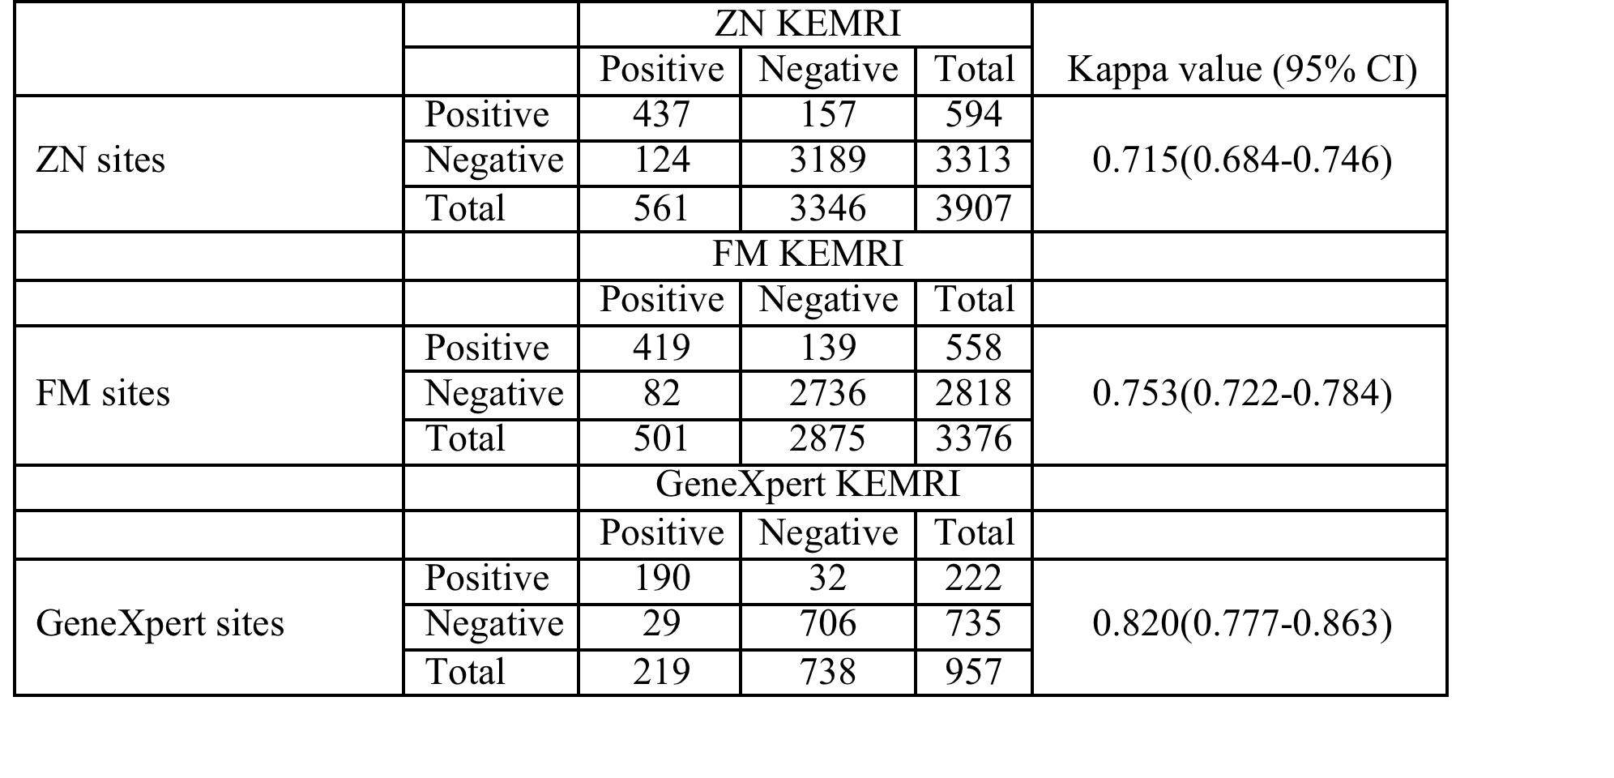
Table 3: Reproducibility of results for different TB diagnostic tools between study sites and KEMRI research laboratory
Notes:
Table 3 shows the reproducibility of results for different TB diagnostic tools between study sites and KEMRI research laboratory. Generally, excellent Kappa value for GeneXpert (0.820(95%CI:0.777-0.863), n=957) was significantly higher than ZN microscopy (0.715(0.684-0.746), n=3376).
FM Kappa value (0.753(0.722-0.784), n=3907) indicated substantial agreement.

Slide 12
Table 4: Reproducibility of ZN results between satellite sites and KEMRI research laboratory
Study site | Diagnostic tool |  | ZN KEMRI |  |  | Kappa value | 95% CI
 |  |  | Positive | Negative | Total |  | L | U
Busia | ZN sites | Positive | 93 | 29 | 122 | 0.700 | 0.629 | 0.771
 |  | Negative | 33 | 595 | 628
 |  | Total | 126 | 624 | 750
Kitale | ZN sites | Positive | 109 | 51 | 160 | 0.709 | 0.646 | 0.772
 |  | Negative | 19 | 685 | 704
 |  | Total | 128 | 736 | 864
Machakos | ZN sites | Positive | 41 | 9 | 50 | 0.788 | 0.692 | 0.884
 |  | Negative | 8 | 205 | 213
 |  | Total | 49 | 214 | 263
Malindi | ZN sites | Positive | 123 | 41 | 164 | 0.721 | 0.662 | 0.780
 |  | Negative | 39 | 1141 | 1180
 |  | Total | 162 | 1182 | 1344
Wajir | ZN sites | Positive | 29 | 16 | 45 | 0.643 | 0.516 | 0.770
 |  | Negative | 9 | 211 | 220
 |  | Total | 38 | 227 | 265

Slide 13
Table 5: Reproducibility of ZN results between non-satellite sites and KEMRI research laboratory
Study site | Diagnostic tool |  | ZN KEMRI |  |  | Kappa value | 95% CI
 |  |  | Positive | Negative | Total |  | L | U
Kisii-Keroka | ZN sites | Positive | 15 | 3 | 18 | 0.761 | 0.602 | 0.920
 |  | Negative | 5 | 138 | 143
 |  | Total | 20 | 141 | 161
Nyahururu | ZN sites | Positive | 23 | 2 | 25 | 0.835 | 0.717 | 0.953
 |  | Negative | 5 | 102 | 107
 |  | Total | 28 | 104 | 132
Narok | ZN sites | Positive | 3 | 5 | 8 | 0.352 | 0.023 | 0.681
 |  | Negative | 4 | 89 | 93
 |  | Total | 7 | 94 | 101
Lamu | ZN sites | Positive | 1 | 1 | 2 | 0.341 | 0.000 | 0.913
 |  | Negative | 2 | 23 | 25
 |  | Total | 3 | 24 | 27

Slide 14
Table 6: Reproducibility of FM results between satellite sites and KEMRI research laboratory
Study site | Diagnostic tool |  | FM KEMRI |  |  | Kappa value | 95% CI
 |  |  | Positive | Negative | Total |  | L | U
Busia | FM sites | Positive | 102 | 34 | 136 | 0.767 | 0.704 | 0.830
 |  | Negative | 15 | 595 | 610
 |  | Total | 117 | 629 | 746
Kitale | FM sites | Positive | 95 | 41 | 136 | 0.729 | 0.660 | 0.798
 |  | Negative | 13 | 510 | 523
 |  | Total | 108 | 551 | 659
Machakos | FM sites | Positive | 47 | 9 | 56 | 0.796 | 0.706 | 0.886
 |  | Negative | 9 | 198 | 207
 |  | Total | 56 | 207 | 263
Malindi | FM sites | Positive | 132 | 45 | 177 | 0.744 | 0.689 | 0.799
 |  | Negative | 31 | 1130 | 1161
 |  | Total | 163 | 1175 | 1338
Wajir | FM sites | Positive | 0 | 2 | 2 | -0.182 | -0.356 | -0.008
 |  | Negative | 2 | 9 | 11
 |  | Total | 2 | 11 | 13

Slide 15
Table 7: Reproducibility of FM results between non-satellite sites and KEMRI research laboratory
Study site | Diagnostic tool |  | FM KEMRI |  |  | Kappa value | 95% CI
 |  |  | Positive | Negative | Total |  | L | U
Kisii-Keroka | FM sites | Positive | 14 | 6 | 20 | 0.679 | 0.503 | 0.855
 |  | Negative | 5 | 134 | 139
 |  | Total | 19 | 140 | 159
Nyahururu | FM sites | Positive | 27 | 2 | 29 | 0.843 | 0.737 | 0.949
 |  | Negative | 6 | 138 | 144
 |  | Total | 33 | 140 | 173
Narok | FM sites | Positive | 0 | 0 | 0 | N/A | N/A | N/A
 |  | Negative | 0 | 1 | 1
 |  | Total | 0 | 1 | 1
Lamu | FM sites | Positive | 2 | 0 | 2 | 0.778 | 0.362 | 1.000
 |  | Negative | 1 | 21 | 22
 |  | Total | 3 | 21 | 24

Slide 16
Table 8: Reproducibility of GeneXpert results between satellite sites and KEMRI research laboratory
Study site | Diagnostic tool |  | GeneXpert KEMRI |  |  | Kappa value | 95% CI
 |  |  | Positive | Negative | Total |  | L | U
Busia | GeneXpert sites | Positive | 49 | 7 | 56 | 0.809 | 0.721 | 0.897
 |  | Negative | 10 | 186 | 196
 |  | Total | 59 | 193 | 252
Kitale | GeneXpert sites | Positive | 114 | 18 | 132 | 0.850 | 0.797 | 0.903
 |  | Negative | 11 | 376 | 387
 |  | Total | 125 | 394 | 519
Machakos | GeneXpert sites | Positive | 13 | 0 | 13 | 0.861 | 0.710 | 1.000
 |  | Negative | 3 | 40 | 43
 |  | Total | 16 | 40 | 56
Malindi | GeneXpert sites | Positive | 6 | 4 | 10 | 0.611 | 0.329 | 0.893
 |  | Negative | 2 | 50 | 52
 |  | Total | 8 | 54 | 62
Wajir | GeneXpert sites | Positive | 8 | 3 | 11 | 0.675 | 0.434 | 0.916
 |  | Negative | 3 | 54 | 57
 |  | Total | 11 | 57 | 68

Slide 17
Table 9: Performance of different TB diagnostic tools at study sites and KEMRI research laboratory
Notes:
Table 9 shows the performance of different TB diagnostic tools at study sites and KEMRI research laboratory. Cumulatively, there was marginal significant incremental sensitivity of microscopy at study sites ZN (70.8% (95%CI:66.8-74.8)%; n=500) and FM (78.4% (74.5-82.3)%; n=431) than at KEMRI ZN (66.4% (62.3-70.5)%; n=500) and FM (71.0% (95%CI:66.7-75.3)%; n=431). However, the sensitivity of GeneXpert at the study sites (86.5%(95%CI:80.7-92.3)%; n=133) was comparable to that of GeneXpert at KEMRI (85.7%(95%CI:79.8-91.7)%; n=133). Specificity of Genexpert at the site was comparable to KEMRI but significantly lower than microscopy both at site and KEMRI.

Slide 18
Table 10: Performance of ZN microscopy at study sites and KEMRI research laboratory
.
Notes:
Table 10 shows performance of ZN at satellite study sites and KEMRI laboratory by and non-satellite sites. Sensitivity of ZN microscopy at the satellite sites ranged from 50.0%(95% CI:28.1-71.9)% in Wajir to 81.4%(95% CI:75.0-87.9)% in Kitale. Specificity was generally comparable with the lowest observed in Wajir (85.7%(95% CI:81.3-90.1)%).Sensitivity of ZN microscopy at non-satellite sites ranged from 36.4%(95% CI:7.9-64.87)% in Narok to 87.0%(95% CI:73.2-100.0)% in Nyahururu. Specificity was generally comparable with the lowest observed in Keroka (94.9%(95% CI:91.2-98.6)%). However, due to the small number of enrolled patients, and especially in Lamu, sensitivity and specificity of ZN microscopy was estimated with wider confidence intervals, therefore with reduced precision. Apart from Kitale site where the sensitivity of ZN is significantly higher than at KEMRI, the reproducibility of ZN was comparable between the study sites and KEMRI

Slide 19
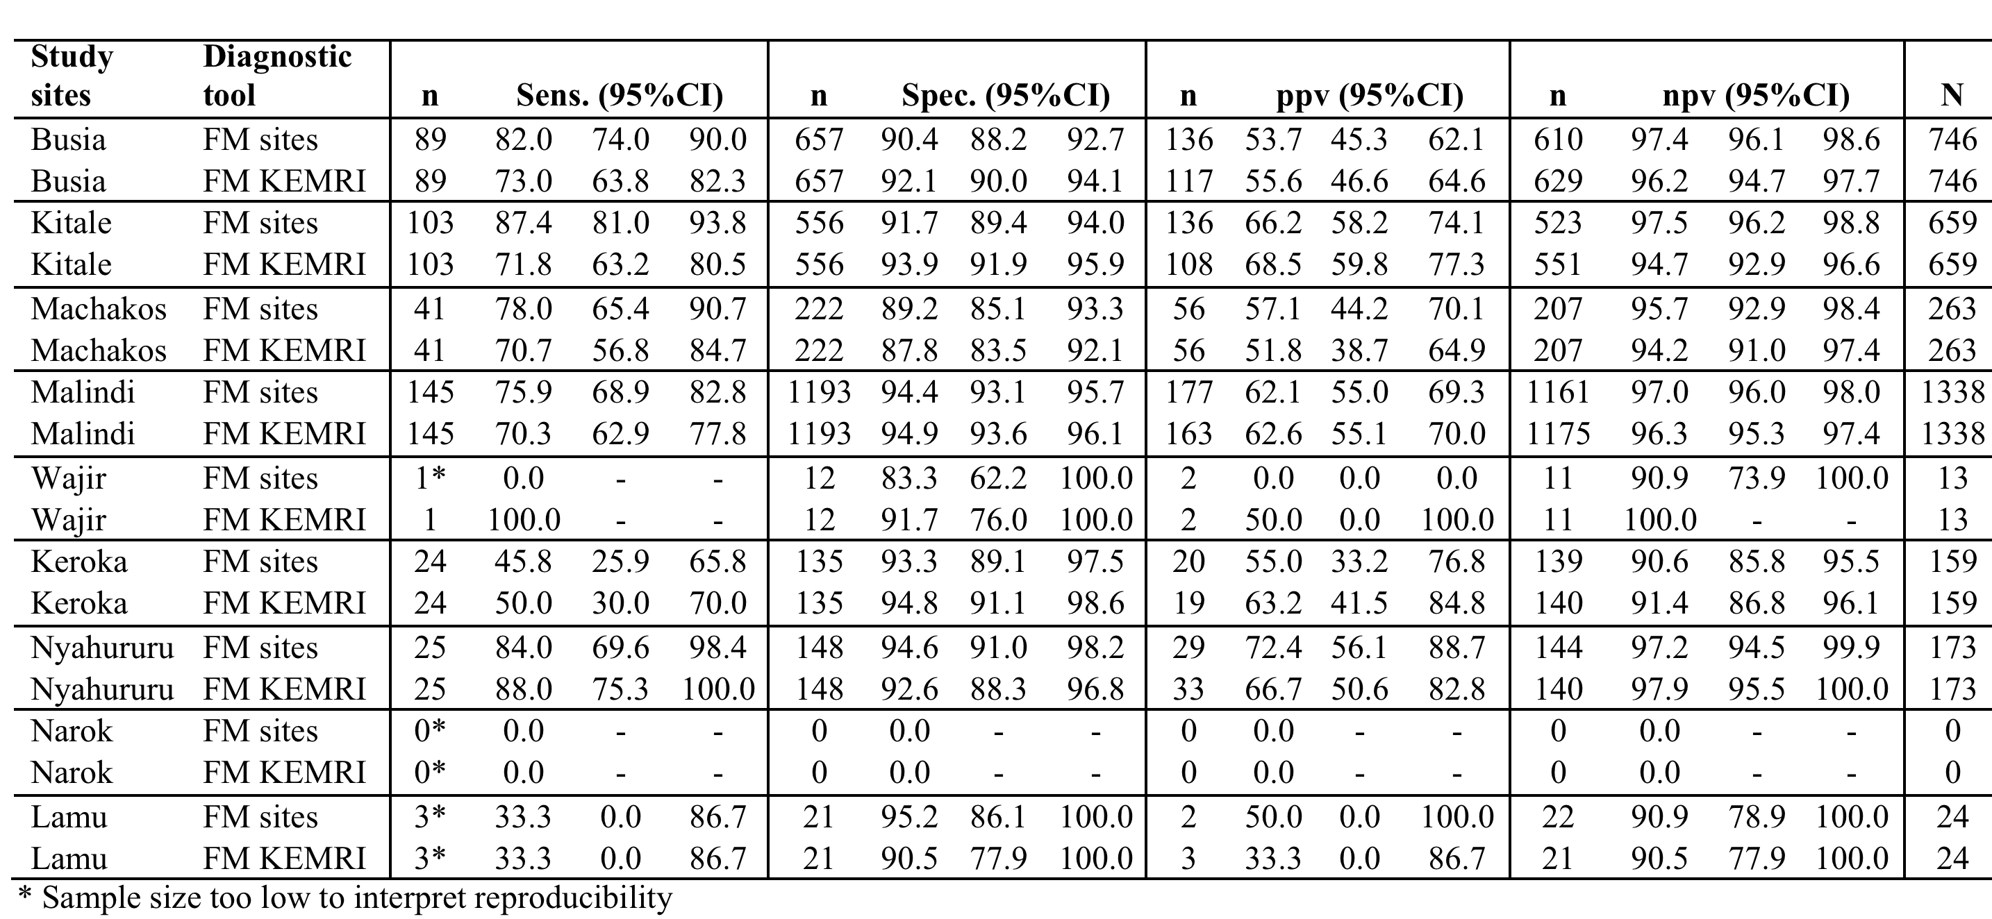
Table 11: Performance of FM at study sites and KEMRI research laboratory
Notes:
Table 11 shows performance of FM at study sites and KEMRI laboratory by satellite and non-satellite sites. Sensitivity of ZN microscopy at study sites within satellite sites ranged from 75.9%(95% CI:68.9-82.8)% in Malindi to 87.4%(95% CI:81.0-93.8)% in Kitale. Specificity was generally comparable with the lowest observed in Machakos (89.2%(95% CI:85.1-93.3)%).Sensitivity of FM microscopy at study sites within non-satellite sites ranged from 33.3%(95% CI:0.0-86.7)% in Lamu to 84.0%(95% CI:69.6-98.4)% in Nyahururu. Specificity was generally comparable with the lowest observed in Keroka (93.3%(95% CI:89.1-97.5)%). However, due to the small number of enrolled patients, and especially in Wajir, Narok and Lamu, sensitivity and specificity of ZN microscopy was estimated with wider confidence intervals, therefore with reduced precision.

Slide 20
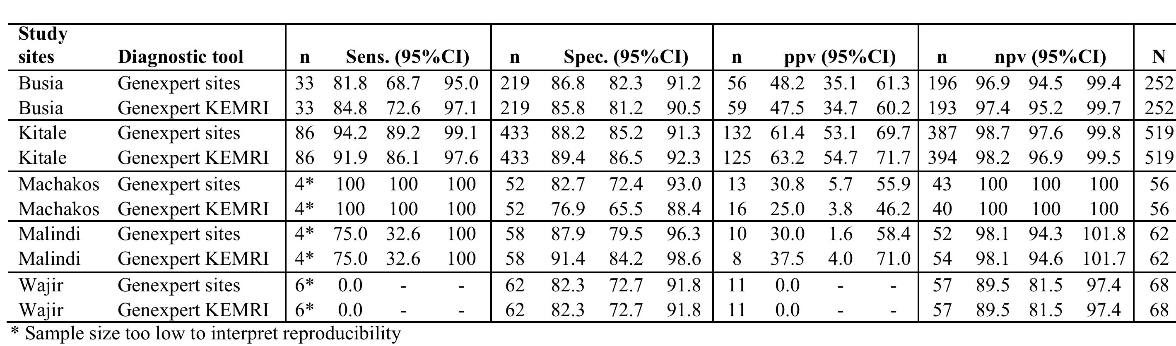
Table 12: Performance of GeneXpert at satellite sites and KEMRI research laboratory
.
Notes:
Table 12 shows performance of GeneXpert at study sites and KEMRI laboratory by satellite and non-satellite sites. Sensitivity of GeneXpert at study sites ranged from 75.0%(95% CI:32.6-100.0)% in Malindi to 94.2%(95% CI:89.2-99.1)% in Kitale. Specificity was generally comparable with the lowest observed in Machakos (82.7%(95% CI:72.4-93.0)%). However, due to the small number of specimens analyzed using GeneXpert at both study sites and KEMRI, and especially in Wajir, the sensitivity and specificity of GeneXpert was estimated with wider confidence intervals, therefore with reduced precision. Four from Machakos were culture positive at KEMRI and were detected as GeneXpert positive at both site and KEMRI. Four from Malindi were culture positive at KEMRI and were detected as GeneXpert positive at both site and KEMRI. None of the 6 culture positive from Wajir were found to be positive by GeneXpert at site and KEMRI

Slide 21
Conclusion
Results generated by GeneXpert MTB/RIF indicate excellent reproducibility and comparable performance, regardless of geographical setting in Kenya.
  This suggests that GeneXpert MTB/RIF is a reliable diagnostic tool irrespective of the facility setting.
In Kitale study site had consistently higher microscopy sensitivity results than other sites, possibly due to working with partners e.g. AMPATH, Moi University.
  There is need for continuous training in microscopy to enhance reproducibility of laboratory results and performance of both ZN and FM microscopy especially in sites where the values were low.

Slide 22
Thank You!!

