Slide 1
'' The Challenges in prevention and management of Cervical Cancer in HIV positive patients in EAC region '‘
Dr Sylvestre BAZIKAMWE
MD/Obs/Gynecologist/MPH
Lecturer, Faculty of Medicine The University of BURUNDI

Slide 2
'' The Challenges in prevention and management of Cervical Cancer in HIV positive patients in EAC region '‘
Outline
General overview on HIV and Cervical Cancer
Who milestone for 2020
The concerns in EAC Region
The Integration of Screening and Treatment services
Conclusion

Slide 3
'' The Challenges in prevention and management of Cervical Cancer in HIV positive patients in EAC region '‘
General overview
There is
An increased risk for human papillomavirus (HPV) infection in women living with HIV/AIDS
The prevalence of HPV increases with immunosuppression
(Denny et al, 2008; Firnhaber et al, 2010)

Slide 4
'' The Challenges in prevention and management of Cervical Cancer in HIV positive patients in EAC region '‘
HIV infected women appear to have a high rate of
Persistent infection by high risk types of Human Papiloma Virus (HPV) strongly associated with High grade–Squamous Intraepithelial Lesions (HSIL) & Invasive cervical carcinoma
Spitzer M et al. 1998 ; Chibwesha CJ et al. 2011

Slide 5
'' The Challenges in prevention and management of Cervical Cancer in HIV positive patients in EAC region '‘
HIV seropositive patients appare to present earlier with SIL (Squamous intra epithelial lesions ) compared to HIV seronegative
Suggesting a role of HIV in altering the natural history of HPV infection and cervical lesions
(Mwakigonja et al., Tanzania 2012)
The burden of hrHPV and CIN2/3 in HIV-positive women in Kenya was high and was related to immunosuppression level (De Vuyst et al, Nairobi 2012)

Slide 6
'' The Challenges in prevention and management of Cervical Cancer in HIV positive in EAC region '‘
In Nairobi :
The most frequent types in CIN2/3 were HPV16 (26.5%), HPV35 (19.5%), and HPV58 (12.4%)
( De Vuyst et al. Nairobi 2012)
In Bujumbura :
The most frequent genotypes in HIV⁺ were HPV52 (49%), HPV54 (19%), HPV 39 (17%), HPV 33(14%)
69% of HPV⁺ women were HIV⁺ versus 31% in HIV⁻ Women living with HIV, were found to be more likely at risque of HPV infection compare to HIV⁻
(Ndizeye Z et al. , Bujumbura 2008)

Slide 7
'' The Challenges in prevention and management of Cervical Cancer in HIV positive in EAC region '‘
Elevated prevalence of HPV (reported 50% or more) and high grade lesions has been consistently reported in HIV positive women in many studies
(Clifford et al, 2006; Singh et al., 2009; Firnhaber et al. , 2010; Djigma et al, 2011; Tobian et al, 2011), (Clifford et al, 2006; Paramsothy et al, 2009)
Cervical Cancer is among elements in AIDS definition Since 1993 (CDC Atlanta 1993)

Slide 8
'' The Challenges in prevention and management of Cervical Cancer in HIV positive in EAC region '‘
Concern
in EAC
Cervical cancer continues to be a public health problem in Rwanda; … as well as in other EAC countries
(Makuza JD et al. , Rwanda 2015)
However the use of HPV testing in HIV positive women in very high prevalence populations have created concerns due to the low test specificity in settings (Giorgi-Rossi et al. 2012 ; Int J Cancer 130)

Slide 9
'' The Challenges in prevention and management of Cervical Cancer in HIV positive in EAC region '‘
Concern in EAC region
Although HIV infection and Cervical Cancer are major public health problems, the frequency and HIV/HPV association of cervical cancer and HSIL is not well documented in EAC region
The frequency of genotypes seem not to be the same as in the European and western regions,
( Ndizeye Z et al. , Bujumbura 2008; De Vuyst et al. Nairobi 2012 )

Slide 10
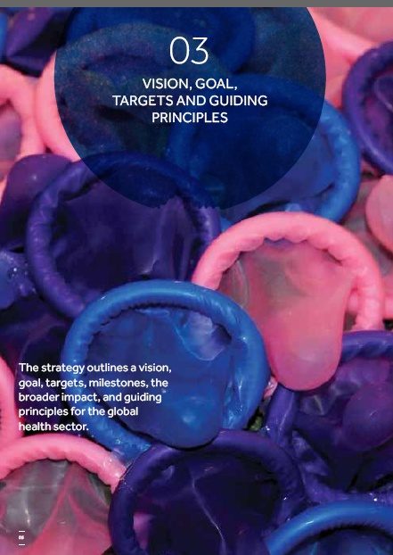
'' The Challenges in prevention and management of Cervical Cancer in HIV positive in EAC region '‘
WHO milestone for 2020

Slide 11
'' The Challenges in prevention and management of Cervical Cancer in HIV positive in EAC region '‘
HO milestone for 2020
70% of key populations for HIV have access to a full range of services relevant to sexually transmitted infection and HIV, including condoms
70% of countries deliver HPV vaccines through the national immunization programme
(who 2016 recommendation)

Slide 12
'' The Challenges in prevention and management of Cervical Cancer in HIV positive in EAC region '‘
WHO strategy on Sexually Transmitted Infections 2016–2021 (Monitoring Evaluation)
Targets 2030 :
Sustain 90% national coverage with the human papillomavirus vaccine in the national immunization program and
At least 80% in every district (or equivalent administrative unit)

Slide 13
'' The Challenges in prevention and management of Cervical Cancer in HIV positive in EAC region '‘
HIV and cervical cancer which have a synergistic relationship that requires an integrated screening prevention and treatment services.
Fortunately
VIA (Visual Inspection with Acetic Acid ) is practical and feasible even in rural settings. (Makuza JD et al. , Rwanda 2015)

Slide 14
'' The Challenges in prevention and management of Cervical Cancer in HIV positive in EAC region '‘
HIV and cervical cancer which have a synergistic relationship that requires an integrated screening prevention and treatment services.
Fortunately
Integrating HIV testing into CaCx screening services is highly acceptable to clients and is an effective means of reaching HIV-positive women who don’t know their status
(Potkin et al. Tanzania 2014 )

Slide 15
'' The Challenges in prevention and management of Cervical Cancer in HIV positive in EAC region '‘
HIV and cervical cancer which have a synergistic relationship that requires an integrated screening prevention and treatment services.
The integration of HIV testing into CaCx screening services should be prioritized in HIV-endemic settings, but more work is needed to eliminate logistical barriers as well as
The integration at that time of the HPV vaccine in the national vaccination program WHO recommendation)

Slide 16
'' The Challenges in prevention and management of Cervical Cancer in HIV positive in EAC region '‘
Screening Methods in Low-Economic Setttings:
Pap Smears (Cytology, Papanicolaou)
Visual Inspection (VIA )
CRYOTHERAPY (or Thermocoagulation )

Slide 17
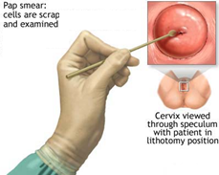
'' The Challenges in prevention and management of Cervical Cancer in HIV positive in EAC region '‘
Screening Methods in Low-Economic Setttings:

Slide 18
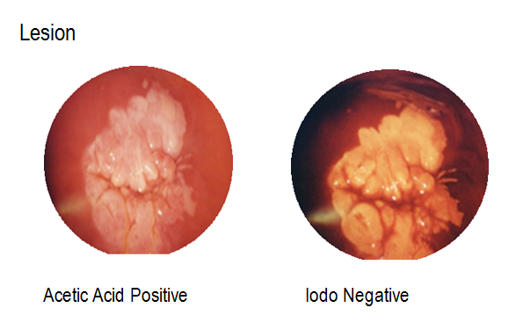
'' The Challenges in prevention and management of Cervical Cancer in HIV positive patients in EAC region '‘
Screening Methods in Low-Economic Setttings

Slide 19
“Integrated screening prevention and treatment services”
The model used in Tanzania (Potkin et al. Tanzania 2014 ) for integrating HIV testing in to cervical cancer prevention services holds great promise.
The approach was accepted by both providers and clients: providers offered HIV tests when tests kits were available; and women almost agreed to HIV testing when offered.
The biggest challenge affecting the effectiveness of integration was insufficient supply of HIV test kits at the health facilities providing the service.

Slide 20
Conclusion
The integration of screeting prevention and treatment services for HIV and Cervical cancer in our health facilities is more than a Necessity

Slide 21
Think you for your attention

