Slide 1
The Human-Animal Interface: Impact on the Use of Antimicrobial Agents and Spread of Antimicrobial Resistance
Benon Asiimwe, DVM, MSc, PhD, MPH
Makerere University college of Health Sciences

Slide 2
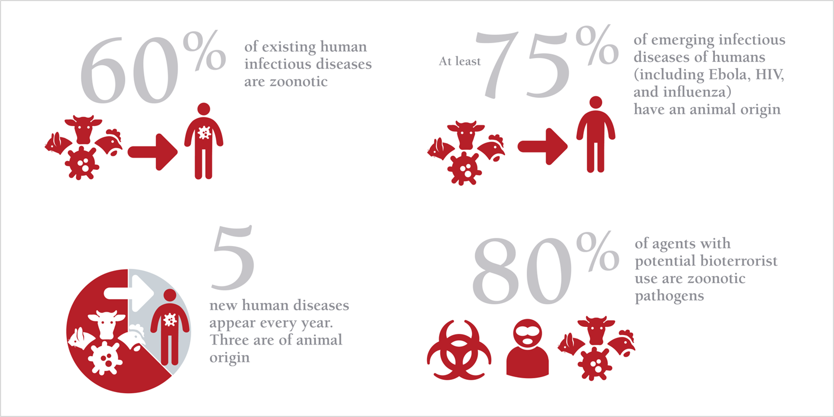
Burden of Disease at the Human-Animal Interface
www.oie.int/onehealth

Slide 3











Global Health Security Agenda (GHSA)
Antimicrobial Resistance
National Laboratory Systems
Emergency Operations Centers
Zoonotic Diseases
Real-time Surveillance
Linking Public Health with Law Enforcement
Biosafety/Biosecurity
GHSA Reporting
Medical Countermeasures and Personnel Deployment
Immunization
Workforce Development

Slide 4
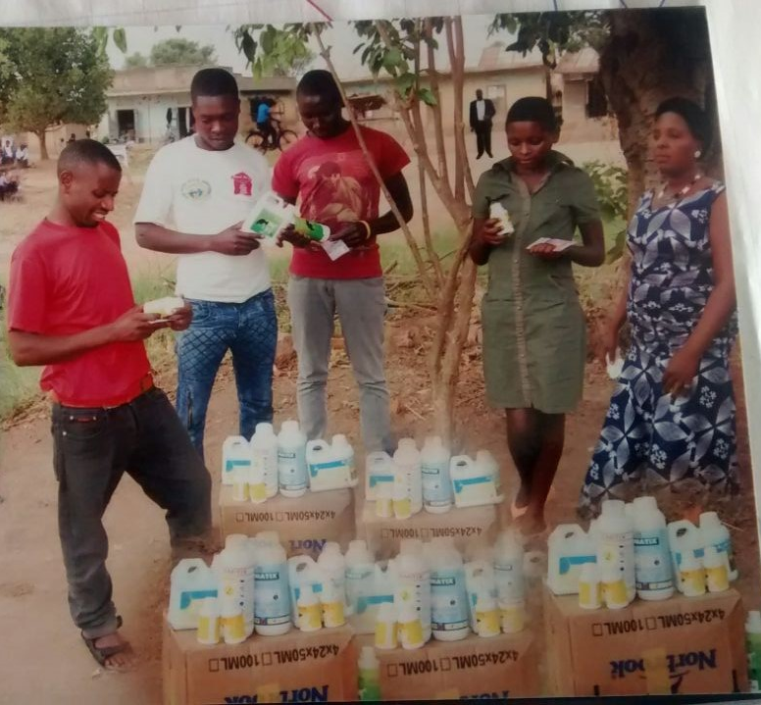
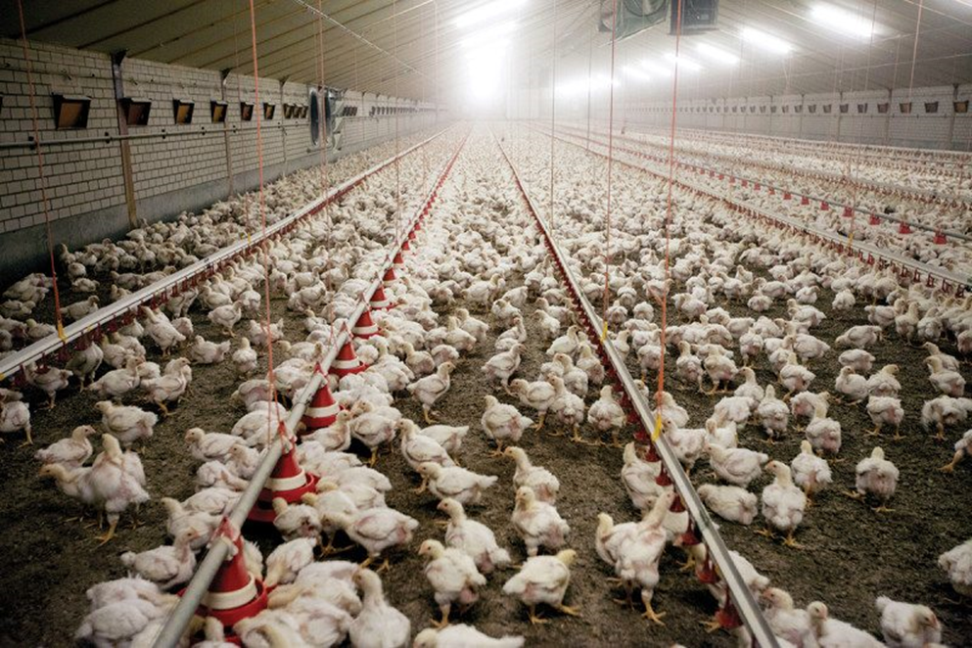
Animals will consume more antibiotics than humans in 2017
Antibiotic resistance hits crisis point. The New Scientist issue 3104, published 28 December 2016
Antimicrobials accessed in cattle markets under trees !!
Antimicrobials mostly used as growth promoters

Slide 5
What Research has been done?...scattered at best!

Slide 6
Are Bad Farmer Practices to Blame?
Country | Ethnic group | %ge self-administered drugs | % Consultation with Vets | Observed withdrawal period (%) | %Use of Animal drugs in humans
Tanzania (415 hh) Mark et al., PLoS One. 2017 | Maasai | 74 | 36 | 7 | ?
 | Arusha | 21 | 45 | 72 | ?
 | Chagga | 1 | 96 | 96 | ?
Uganda (120 hh) Asiimwe et al., manuscript | Bahima | 87 | 13 | 0 | ?
 | Basongora | 100 | 0 | 0 | 98

Slide 7
We know what is happening. But how, why?
Are farmers really to blame?
Are we merely treating symptoms?
What happens at the human-animal interface?

Slide 8
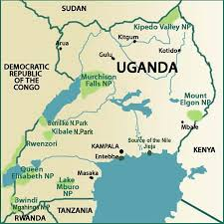
Karimojong
Batuku
Basongora
Bahima

Slide 9
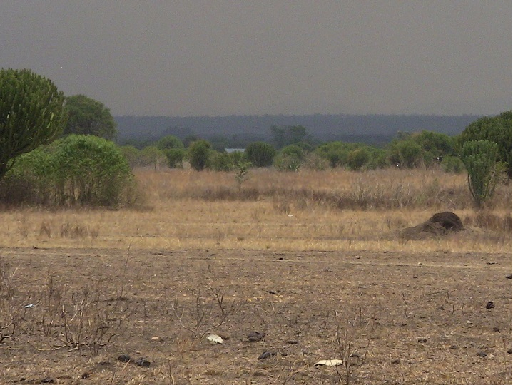
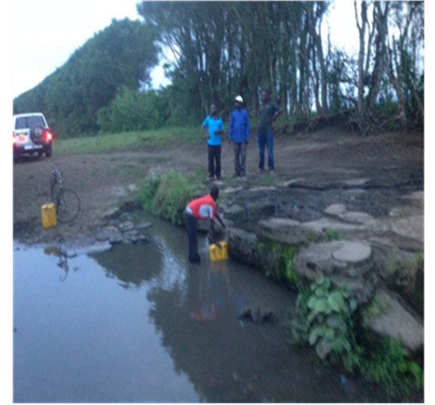
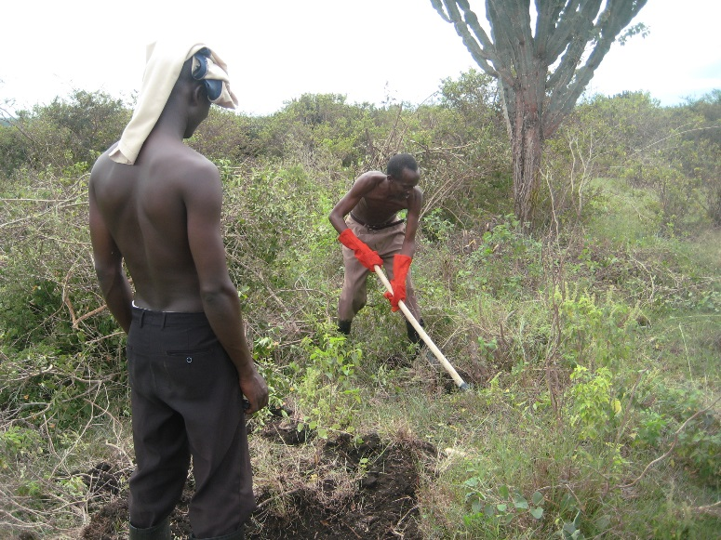
Major Vulnerabilities at the Human-Animal Interface
Water scarcity
Poor pastures & invasive weed species

Slide 10
A geo-eye satellite image (0.5 m resolution) showing permanent settlements

Slide 11
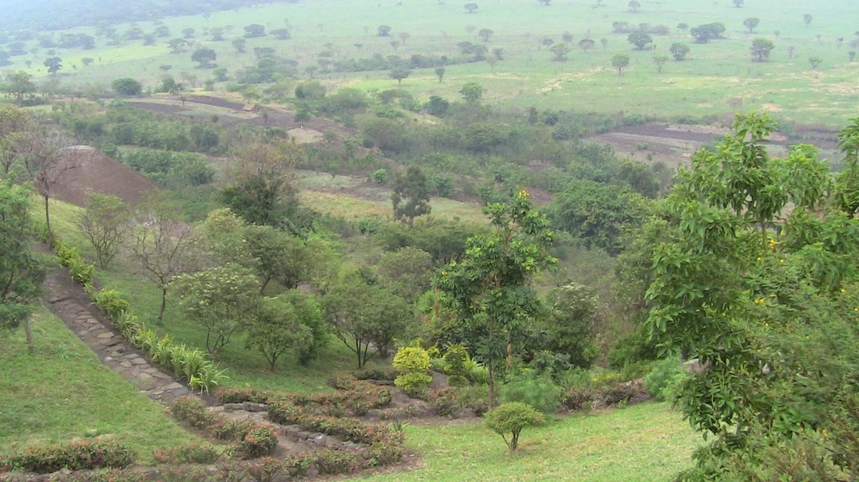
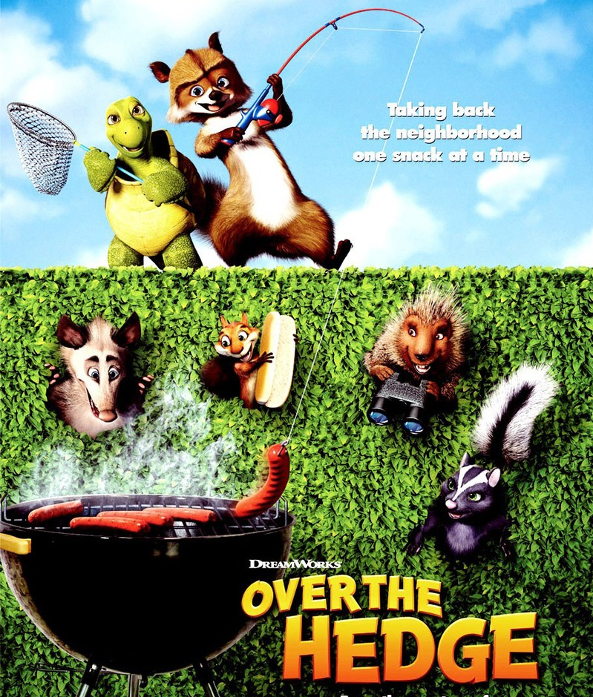
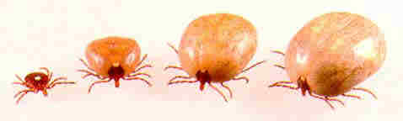
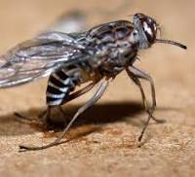
Creates an “over the hedge” situation

Slide 12
Wild animals too invade rangelands !!

Slide 13
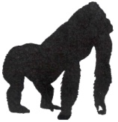
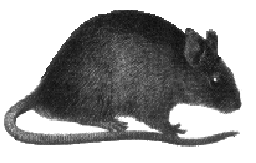
Human Cases
Wild Animal
Domestic Animal
The Human-Animal Interface
Animal Amplification
CASES
Wildlife Surveillance/ Forecasting
Early Detection
Control Opportunity
SPILL OVER
SPILL OVER
SPILL OVER
Human Amplification
TIME

Slide 14
Human Cases
Wild Animal
Domestic Animal
Animal Amplification
CASES
Wildlife Surveillance/ Forecasting
Early Detection
Control Opportunity
SPILL OVER
TIME

Slide 15
The farmers use AMRs because of the high diseases burden in their herds!
The health system has relegated them to the periphery !

Slide 16
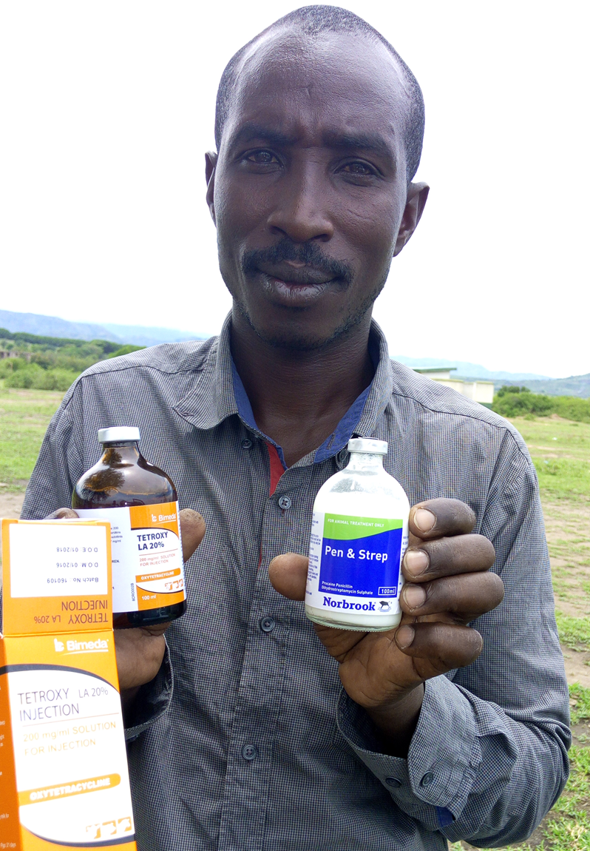
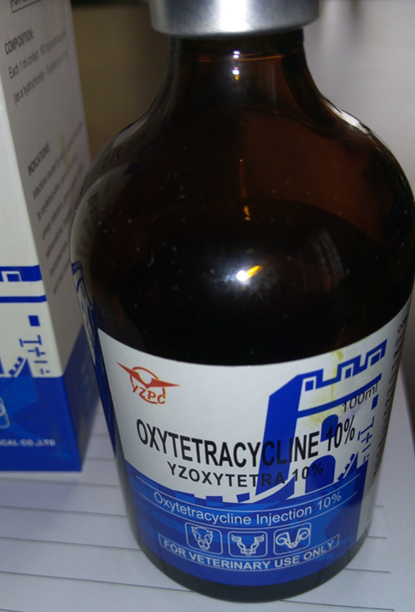
Antimicrobial Resistance
“Ngombe”
“Ngombe does not work anymore, we now have to use twice the amount previously used”…..Musongora pastoralist, Kasese, Uganda

Slide 17
Possible Interventions
WGS studies to inform Biotechnology: vaccines, new drugs
Policies against over-the counter drugs
Ban the use of non-curative (growth promotion) drugs in livestock

Slide 18
Possible Interventions
Increased resilience to the vulnerabilities
  Barriers to wildlife-domestication animal interaction
  Improved rangelands: technologies to increase yield per acreage
  Provision of water sources: valley dams, valley tanks
  Vector control: ticks, tsetse flies
Political commitment and community involvement
  Supervision: curb grand misappropriation of project funds
Multi sectoral collaboration
  Line ministries, Law enforcement, Academia, etc

Slide 19




Acknowledgements
plus

